Slide 1
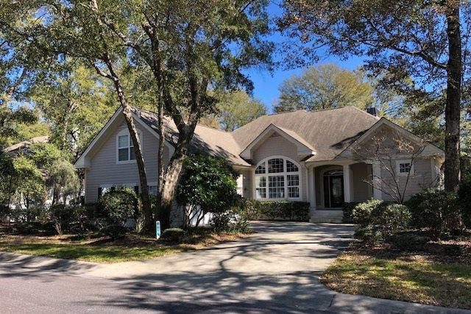
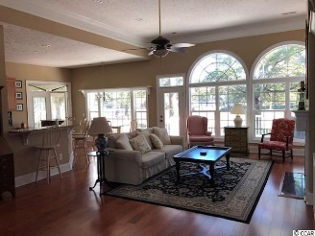
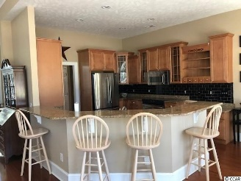
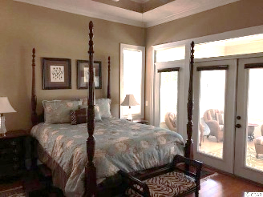
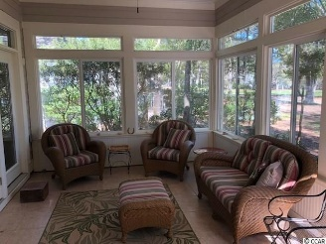
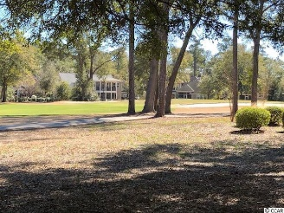
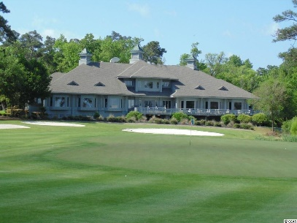
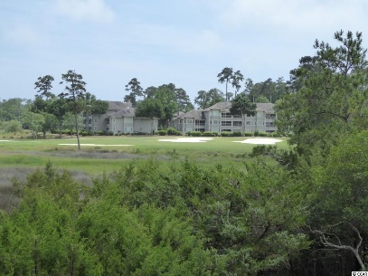
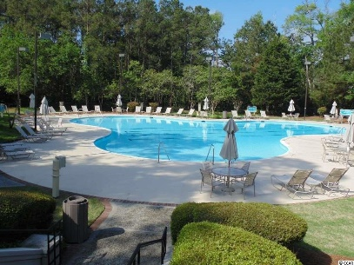
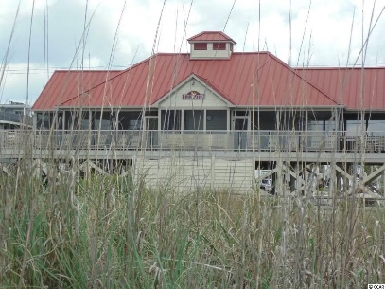

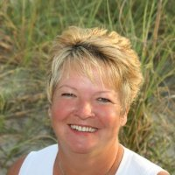
Dream Home in Tidewater
911 Heshbon Dr
North Myrtle Beach, SC 29582
MLS# 1903935 ~ $439,900
World Class Tidewater Golf Course Community. And it's also amazingly affordable in the Bluffs of Tidewater Plantation Resort, where the Atlantic Ocean rolls into the Cherry Grove Marsh, offering a singular golf-beach community lifestyle. Owners even enjoy a private oceanfront beach cabana at low HOAs. This appealing traditional ranch, open floor plan, with 3 large bedrooms and 2 1/2 baths with bonus room, tons of storage, in a preferred split-bedroom floor plan, is an easy walk to the Bluffs private pool and amenities, including cabana and grilling area. Home located on #11 fairway. The Bluffs pool is exclusive to residents of the Bluffs; however, they may use two other pools on the Plantation side. This quality home has it all, plus beach-golf fun and at a compelling value. A fully landscaped yard with lots of color in every season welcomes you to a conveniently designed, easy-living home with oversized double-car garage, front porch, and spacious front entry. The great room, at the heart of the house, opens to lovely formal dining, Carolina-room area with access from master bedroom as well as the family room and kitchen with breakfast bar and dining nook, all overlooking the golf course. To the right is the big master bedroom, fully-equipped en-suite, and two roomy walk-in closet; the master overlooks the golf course as well and provides lots of space for relaxation and comfort. The entire house just lives very well. To the left is the guest wing with jack and jill bath, two guest bedrooms with lots of light, good-sized closets and privacy. The laundry room is between the garage entry and the kitchen, providing ease of entry and a nice traffic pattern. The washer/dryer is included. The kitchen itself has pecan cabinets and luxury appliances, in keeping with the home's traditional decor. Outback is a deck convenient for cooking and dining, in addition to the serenity of ocean breezes and a tee-to-green fairway panorama. Amenity-rich Tidewater is on a tree-lined road Tidewater itself is on an elevated peninsula of live oaks and southern pines between the Intracoatal Waterway and the Cherry Grove Inlet to the Atlantic Ocean. The plantation also preserves the singular look of its own historic origins. It is minutes from the beach, shopping, medical services, entertainment and access to major highways. Rich amenities include that oceanfront beach cabana for owners' use with open/screened porches, bathrooms, showers, and kitchen. Residents enjoy the use of several pools/hot tubs. Other amenities include a driving range, golf shop, clubhouse with bar/dining and event facilities overlooking the 18th hole, clay and hard surface tennis courts, pickle ball court, fitness center overlooking a pool, bocce courts and amenity center for public/private events. Tidewater has a gated storage yard for boats, jet skis, motorcycles, and kayaks. Tidewater Plantation, with its full range of things to do and to enjoy, really reflects a "way of life" in safe, popular North Myrtle Beach.
Donna Fortney 703-624-3517
dofortney@aol.com
Robert Jacoby 843-455-7075
NEW WAY PROPERTIES MYRTLE BEACH

