Slide 1
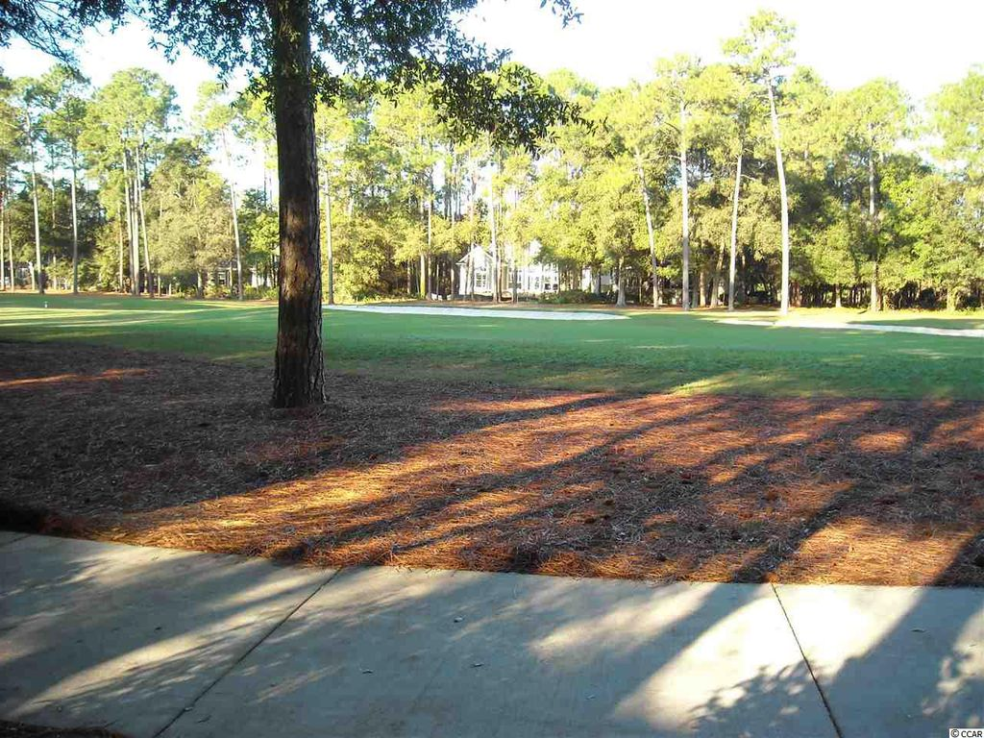
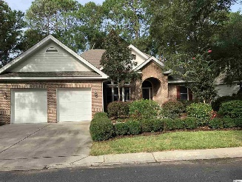
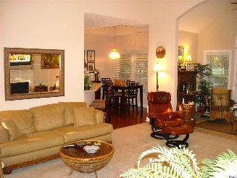
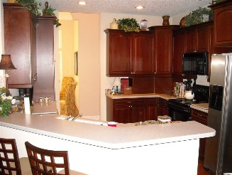
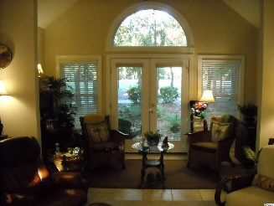
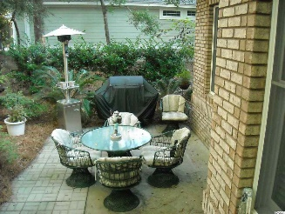
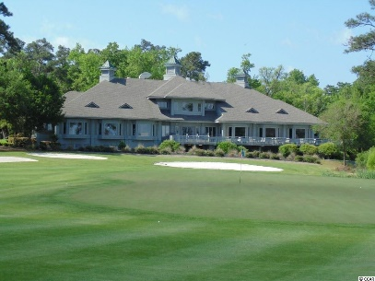
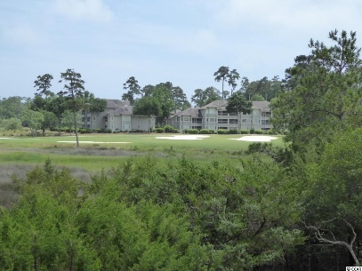
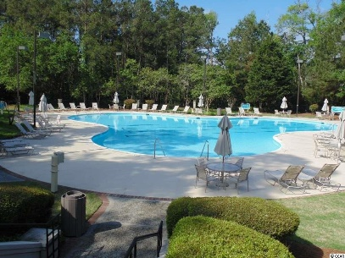
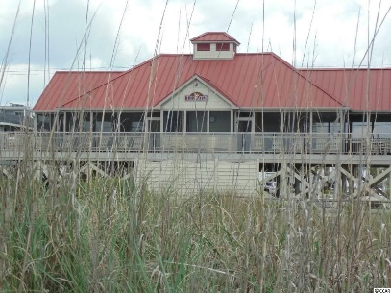


Tidewater Plantation
Bluff's All Brick Home
912 Heshbon Dr
Tidewater Plantation
North Myrtle Beach, SC 29582
MLS# 1720377
$369,900
Tidewater Golf Plantation, This move in ready all brick home located on second hole of Prestigious Tidewater Golf Course. 3 bedroom, 2 full baths and one 1/2 bath with Carolina Room and out side patio. Recently updated appliance, HVAC, and hot water heater. Tidewater, with low HOA fees, offers pools, tennis, golf, pro-shop, restaurant, amenity center, fitness center, and many social events. Short drive to Tidewater Oceanfront Cabana for the exclusive use of owners. Tidewater is must see community to appreciate the nature of this treed gated community with 24/7 security.
Donna Fortney
703-624-3517
dofortney@aol.com
NEW WAY PROPERTIES MYRTLE BEACH

