Slide 1
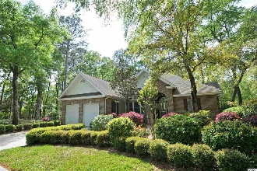
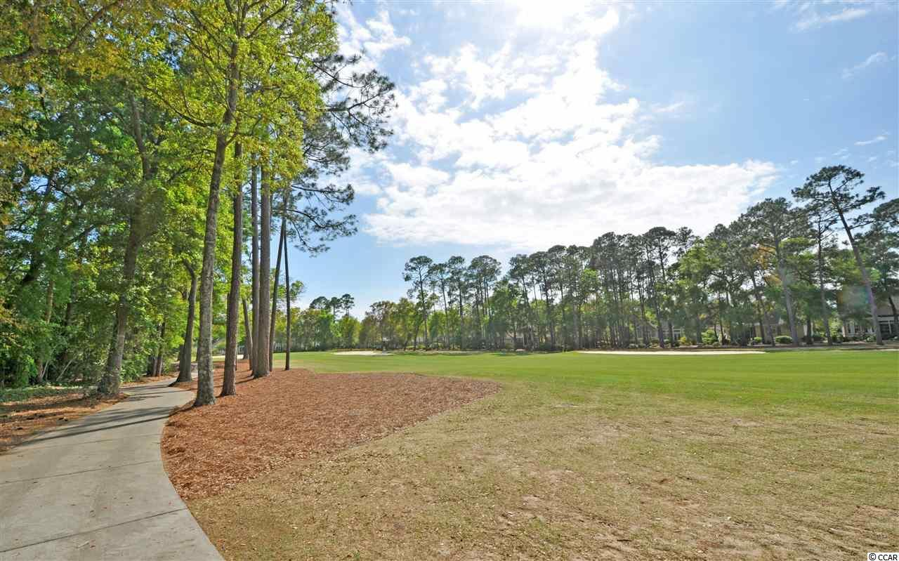
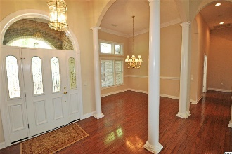
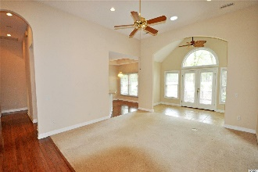
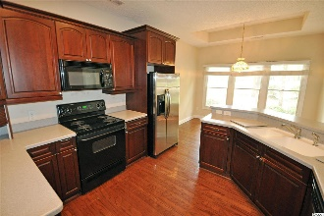
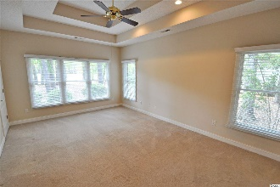
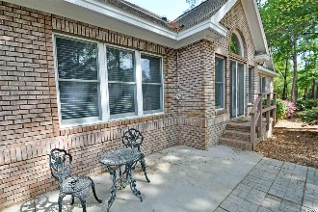
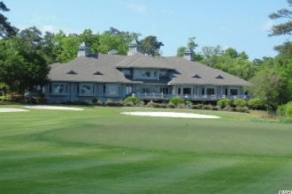
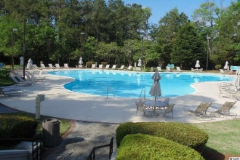
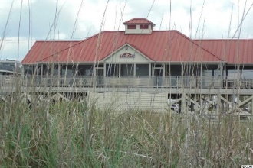


Tidewater Plantation
Bluff's All Brick Home
912 Heshbon Dr
Tidewater Plantation
North Myrtle Beach, SC 29582
MLS# 2007821 ~ $367,900
Settle for nothing less than an upscale, custom-built ALL-BRICK home on the signature second hole of world-class Tidewater Golf Course! And it's also amazingly affordable in the prestigious Bluffs of Tidewater Plantation Resort, where the Atlantic Ocean rolls into the Cherry Grove Marsh, offering a singular luxury golf-beach-community lifestyle. You can hear the ocean from the front porch. Owners even enjoy a private oceanfront beach cabana at low HOAs and city taxes. This appealing traditional ALL-BRICK ranch, with 3 large bedrooms and 2 1/2 baths in a preferred split-bedroom floor plan, is an easy walk to the Bluffs private pool and amenities, including cabana and grilling area. The Bluffs pool is exclusive to residents of the Bluffs; however, they may use two other pools on the Plantation side. This quality home has it all, plus beach-golf fun and at a compelling value. Did we say ALL BRICK? That is worth repeating! The lot is approximately 1/3-acre, about 12,197 square feet, with a 103-ft. frontage and about 91 feet of golf-course frontage, on the signature second hole...A fully matured, landscaped yard with lots of color in every season welcomes you to a conveniently designed, easy-living home with over-sized double-car garage; front porch; and stately, spacious front entry -- AND, YES, THEY, TOO, ARE BRICK. The great /living room, at the heart of the house, opens to lovely formal dining, Carolina-room area and kitchen with breakfast bar and dining nook, all overlooking the golf course. To the right is the big master bedroom, fully-equipped en-suite, and a roomy walk-in closet; the master overlooks the golf course as well and provides lots of space for relaxation and comfort, roomy enough for even a cozy sitting area. The entire house just lives very, very well. The powder room is likewise off of the entry to the right, perfect also for guests & entertaining family or a foursome. To the left is the guest wing with jack and jill bath, two guest bedrooms with lots of light, good-sized closets and privacy. The laundry room is between the garage entry and the kitchen, providing comfortable home entry and a nice traffic pattern. The washer/dryer is included. The kitchen itself has handsome, dark-wood cabinets and luxurious appliances, in keeping with the home's traditional decor. Out back is a brick-paver patio convenient for cooking and dining, in addition to the serenity of ocean breezes and a tee-to-green fairway panorama. Amenity-rich Tidewater is on a tree-lined road to oceanfront Anne Tilghman Boyce Coastal Reserve, a nature conservancy, including Waties Island, with access for managed recreational use. Tidewater itself is on an elevated peninsula of live oaks and southern pines between the Intracoastal Waterway and the Cherry Grove Inlet to the Atlantic Ocean. The plantation also preserves the singular look of its own historic origins. It is minutes from the beach, shopping, medical services, entertainment, dining & access to major highways. Rich amenities include that oceanfront beach cabana on the wide, white-sand of the 11th best beach in the nation, Cherry Grove Beach, for owners' use with open/screened porches, bathrooms, showers, kitchen, private entrance to beach access and plentiful parking. Residents enjoy the use of several pools/hot tubs. Other amenities include a driving range, golf shop, clubhouse with bar/dining and event facilities overlooking the 18th hole, clay and hard surface tennis courts, pickle ball court, fitness center overlooking a pool, bocce/horseshoe courts and amenity center for public/private events. Tidewater has a gated, monitored storage yard for boats, jet skis, motorcycles, kayaks and the like, complimentary to owners. Tidewater Plantation, with its full range of things to do and to enjoy, really reflects a "way of life" in safe, popular North Myrtle Beach, just named a Top-10 Beach Town in the U.S. and the Safest City in the Carolinas. And this wonderful custom home is ALL BRICK!
Deborah Collins
843-424-9013
dctidewater@yahoo.com
Connie Ross-Karl
702-306-2643
conniesross@aol.com
NEW WAY PROPERTIES MYRTLE BEACH

