Slide 1
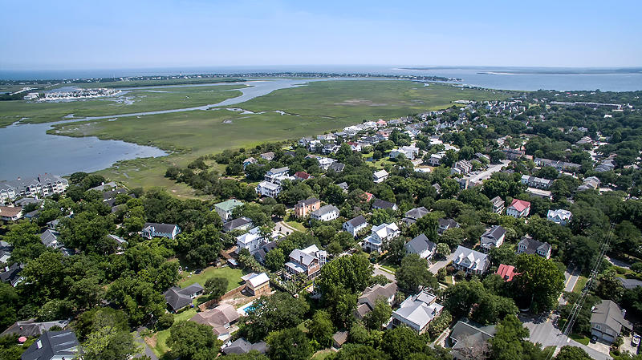
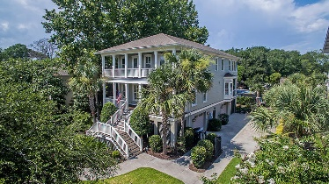
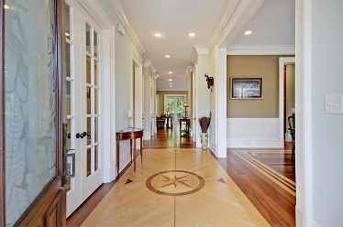
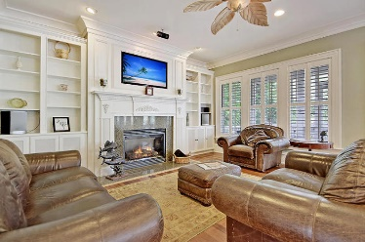
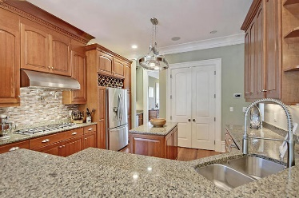
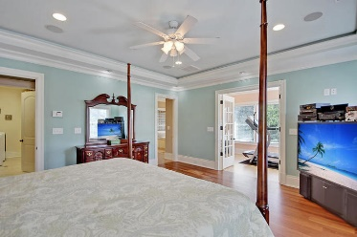
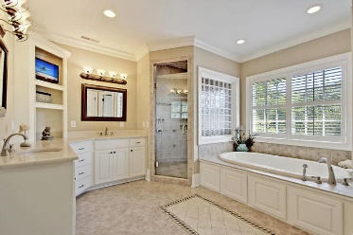
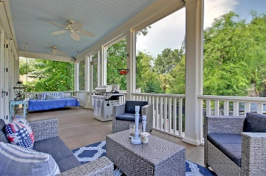
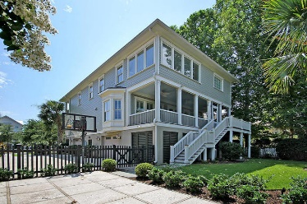

912 Mciver Street
Old Village · Mount Pleasant · MLS# 18018195 · $1,200,000
Gorgeous Listing
New Price!
STUNNING VILLAGE HOME, All Custom built in 2007. This is a Gorgeous elevated home with Chefs Kitchen and EXTRA LARGE Bedrooms. The front entry greets visitors with double 8' wide full front porches and a beautiful milled wood front door. When they enter the foyer it is GRAND with a custom maple inlay compass rose on Cumaru flooring, the entire first floor has 10 ft ceilings, custom milled heavy crown moldings, thick door casings and heave trim like no other home in the neighborhood. All windows have Plantation Shutters on the first floor. The dining room to the right has a custom inlay maple border, and numerous windows providing an abundance of natural light. The flex room to the left can be used as an office, or guest bedroom and has private entrance to full bath with high end water fixtures. The GOURMET kitchen is a CHEF'S DREAM: stainless steel appliances, granite countertops, gas cooktop with pot filler, custom range hood, wall oven, 42" stained cabinets, wet bar with under counter ice maker leading to dining room, sizable pantry, breakfast bar, and generous eat-in area that holds a table that seats six and is surrounded by windows! The spacious family room is open to the kitchen and has a custom mantle with recessed TV area above, and built-in cabinets. The kitchen/family room lead to the immense 10' wide screened porch that has a relaxing hanging swing bed on one side, room for entertaining on the other and attached grilling deck. Wood tread steps lead to the second floor with 9' ceilings and where the elegant master bedroom suite is located. The suite has a wonderful sunroom attached that is perfect for a sitting, craft, or office area, trey ceiling with rope lighting, and an ensuite SPA-LIKE master bath with tranquil soaking jetted tub, separate massive walk-in tiled shower, dual vanities and walk-in closet! The master closet has private entry to the large laundry room. Two additional generously sized bedrooms are upstairs each with walk-in closets, full bathrooms, and access to 2nd floor covered porch. This home has many features: upgraded engineer floor system, engineered truss roof system, 2x6 exterior walls, spray foam insulation exterior cavity batt, insulated interior walls, Cumaru hardwood floors upstairs and downstairs-NO CARPET ANYWHERE, IPE steps, deck, and porch flooring, speakers main floor, master, garage, rear porch and man cave, custom interior heavy trim package including large base, crown, and door casings, elevator shaft from garage to all floors, alarm system, recessed lighting throughout, man cave bar area underneath back porch with cypress/sapele bar, tabby concrete patio with fire pit, lawn irrigation, gigantic two car garage with additional storage area under front porch, exterior painted in 2017, and CHARMING custom wood swing gates to large driveway.
ALL THIS With a Fantastic Location Just off Ben Sawyer Blvd and Center Street. Bike to Tolers Cove Marina and Sullivan's Island easily or Walk the Pitt Street Bridge, Shopping and Dining.
Stan Huff
843-670-2835
stan.huff@agentowned.com
Jill Marcacci
843-297-5590
jill@agentowned.com
www.agentownedrealty.com
AgentOwned Realty Co. Preferred Group, Inc. | 824 Johnnie Dodds Blvd | Mt Pleasant, SC 29464

