Slide 1
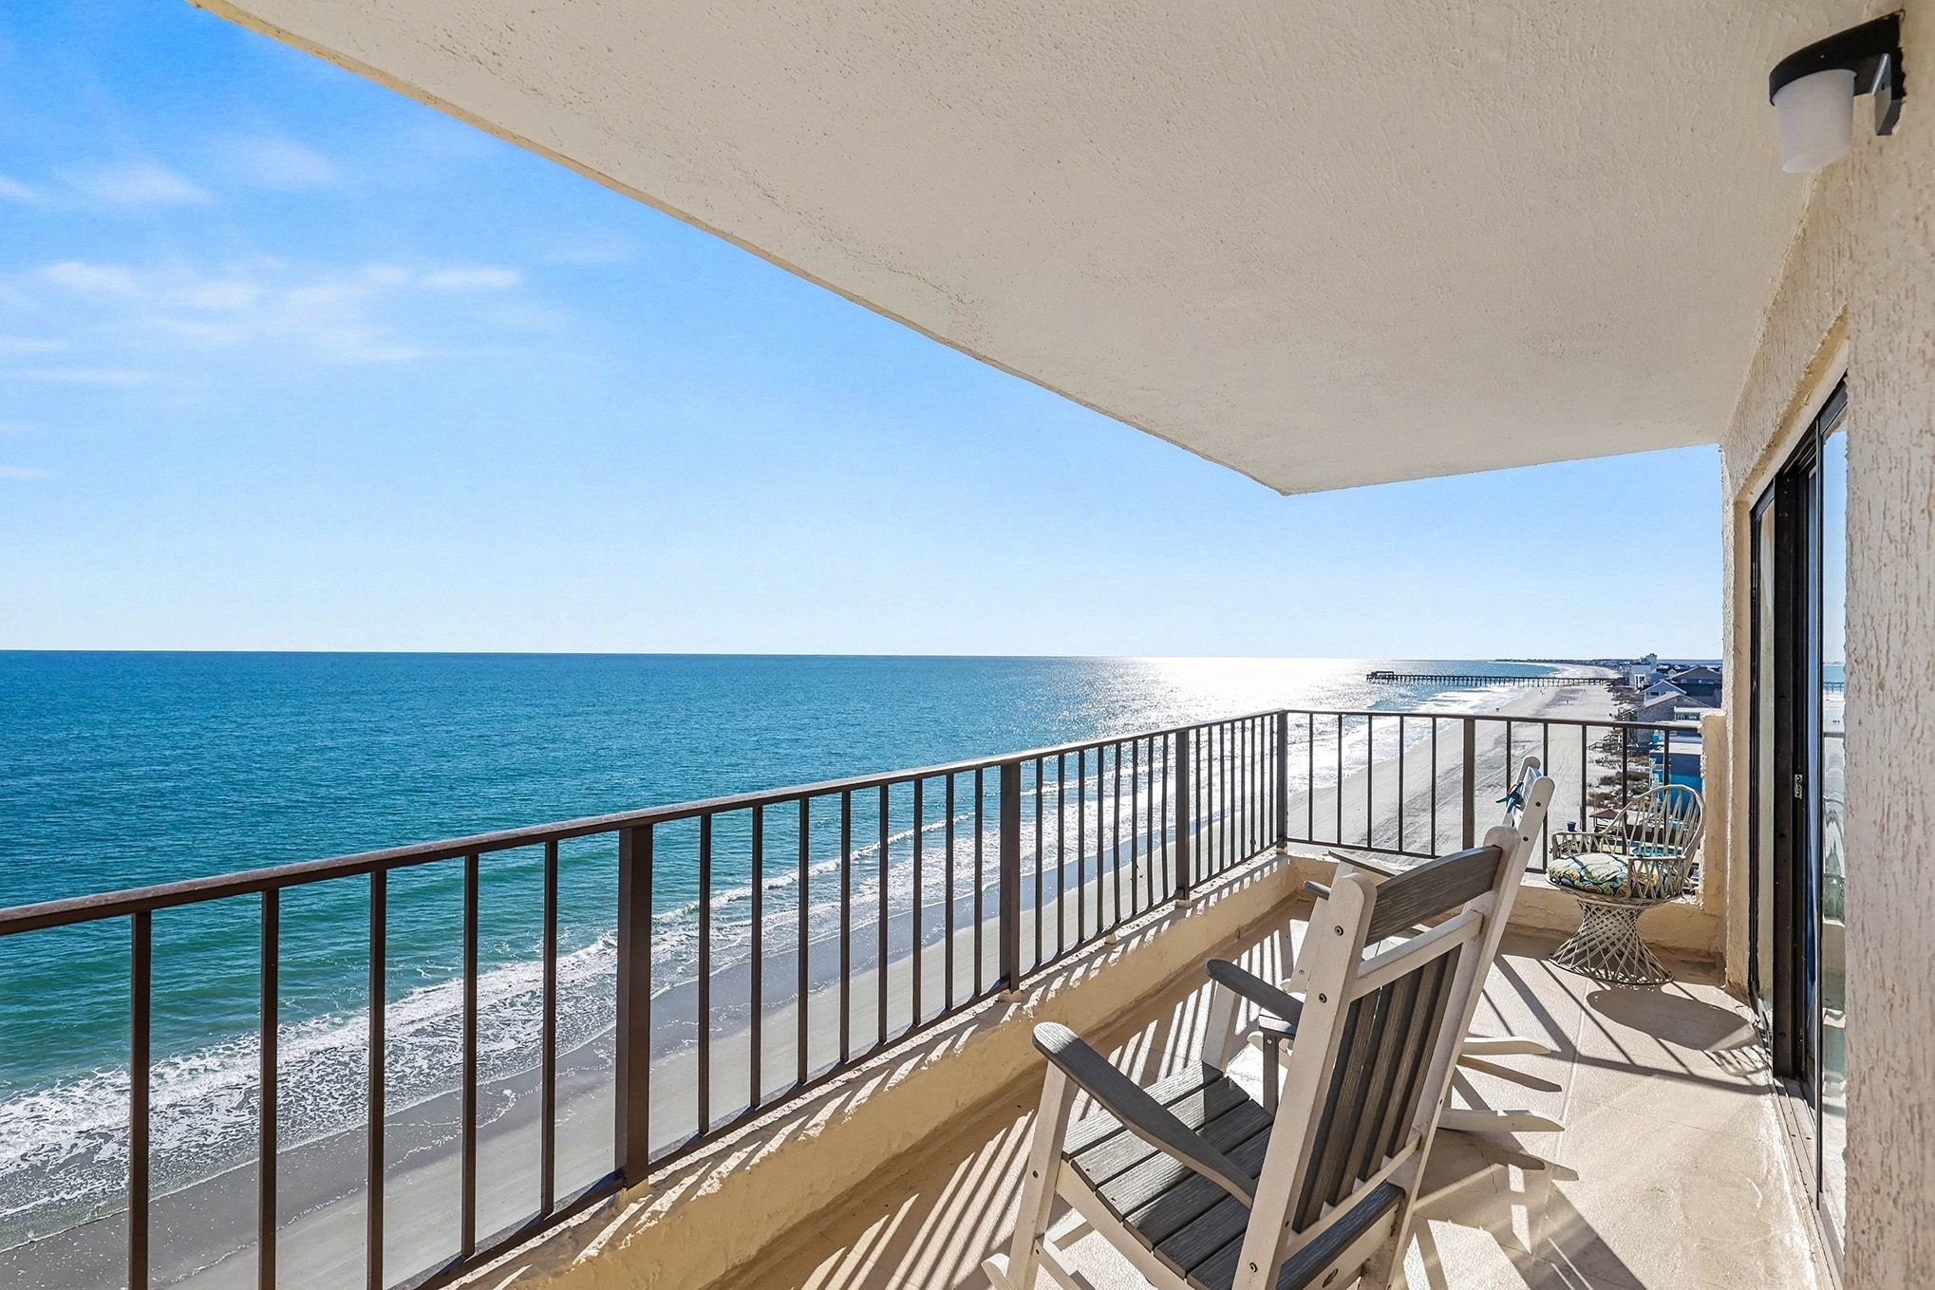
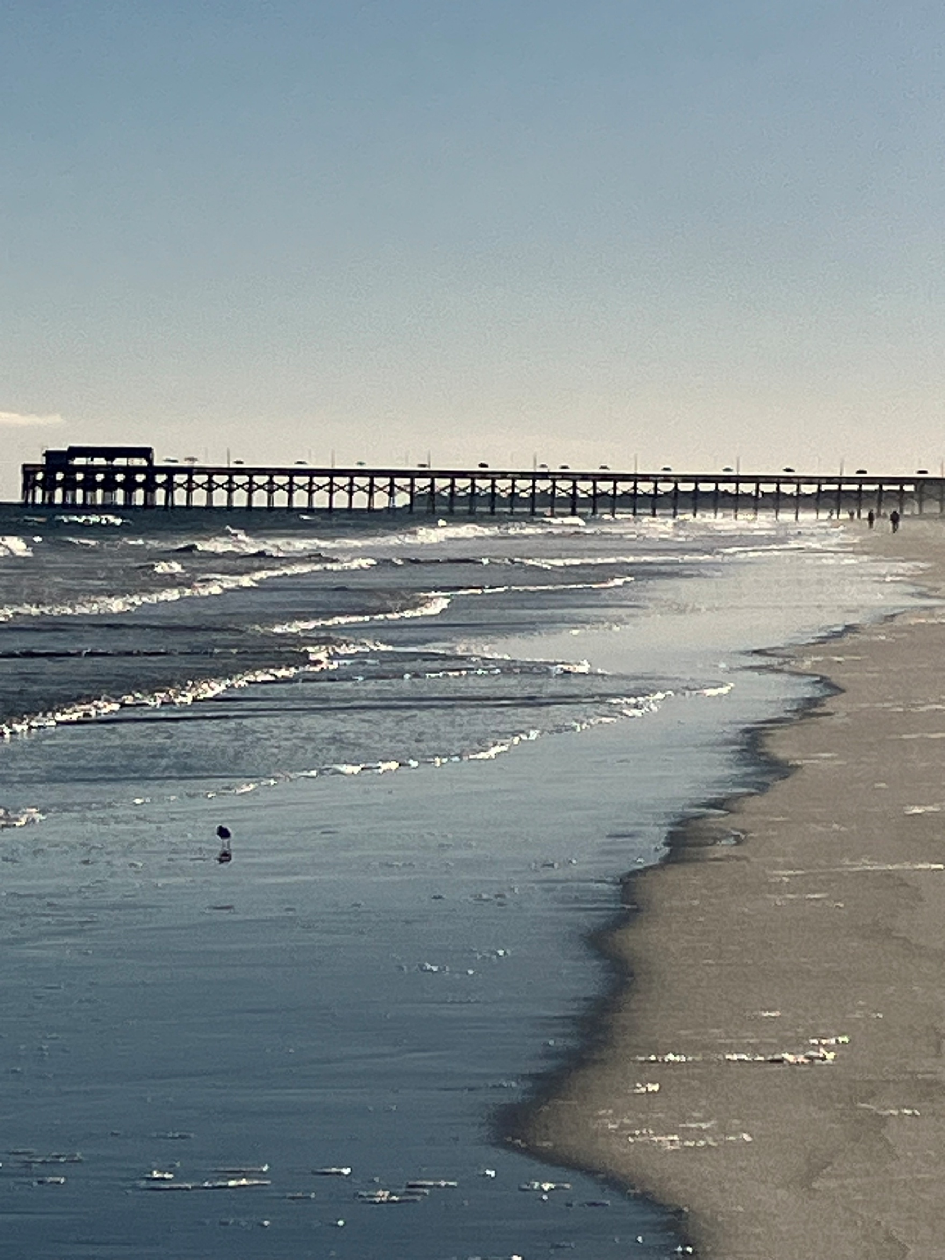
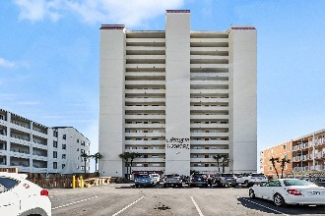
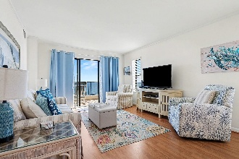
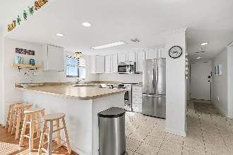
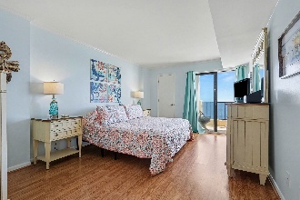
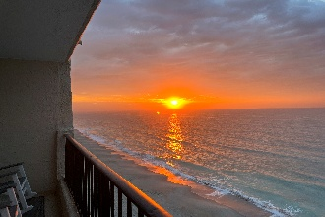


JUST ANOTHER DAY AT THE BEACH!
912 N Waccamaw Drive #806
Murrells Inlet, SC 29576
MLS# 26001423 | $490,000
Welcome to paradise my friends! A Spectacular oceanfront 8th floor corner unit featuring BREATHTAKING panoramic views of the Atlantic and nearby marsh! Meticulously maintained, this prime time property also features a Master Suite that opens to a private oceanfront balcony where saltwater breezes and sandy beach views are a sensational piece of this flawless floor plan! A custom walk in tile shower also part of the primary suite package. The kitchen features stainless steel appliances and breakfast bar. The living room-dining room combo flows seamlessly back out to that beautiful balcony where Sunrise & Sunset views will always leave you in awe! 3br, 2ba, being sold fully furnished and stocked! Fresh paint, new window treatments, new beds, new washer & dryer, even the toilets are new!
Move in ready you betcha! Atalaya Towers features an indoor pool, outdoor pool, hot tub, and plenty of parking. The Garden City Pier is a short walk away with live entertainment, food choices, an arcade and much more. Come get your piece of paradise, your happy place awaits!
John Nugent
(843) 304-2061
john.nugent@carolinaone.com
nugentknowsrealestate.com
Carolina One Real Estate | 717 Folly Rd | Charleston, SC 29412

