Slide 1
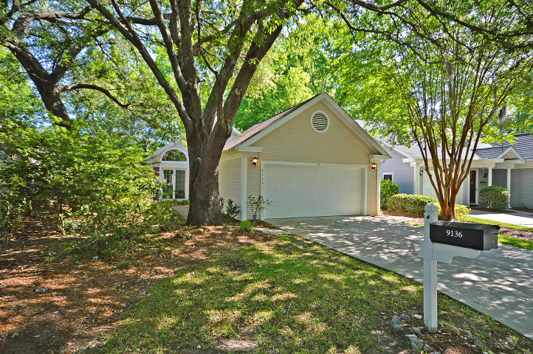
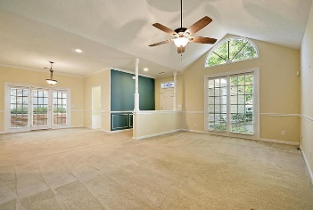
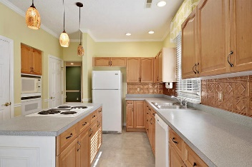
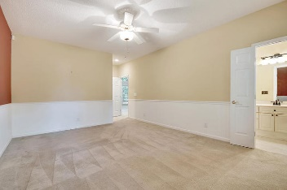
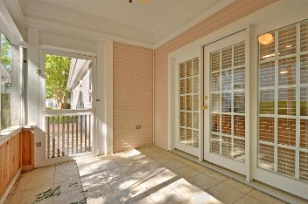
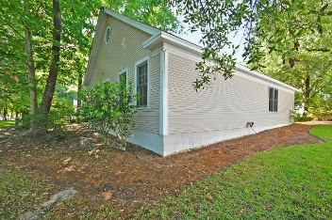
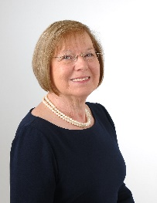

SELLER SAYS SELL
9136 Delancey Circle
Elms of Charleston
N Charleston, SC 29406
MLS# 18012445
$219,900
Offering a $1,500 decorating allowance to make this home perfect for you.
Adorable cottage is light filled with cathedral ceiling in living room dining room combo. Great kitchen with island downdraft cooktop, wall oven, microwave and breakfast area with sliding doors to patio.
Two spacious bedrooms, two baths and walk in closets. Two car garage, screened porch, great yard and 2 car garage. Active 55+ community with lush landscaping and so convenient.
Age, square footage, taxes, acreage, HOA Dues and schools are approximate. Buyer to verify any and all information deemed important.
Mary W Stanley
(864) 982-1271
marystanley2015@gmail.com
www.remaxprorealty.net
Mason Thurber
Realtor
Mobile - (843) 709-5109
Office - (843) 576-2699
mason@theeverettgroup.net
RE/MAX Pro Realty, 9209 University Blvd, Charleston, SC 29406

