Slide 1
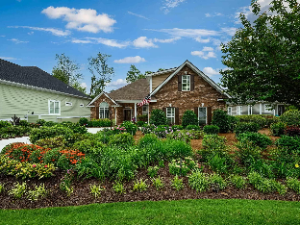
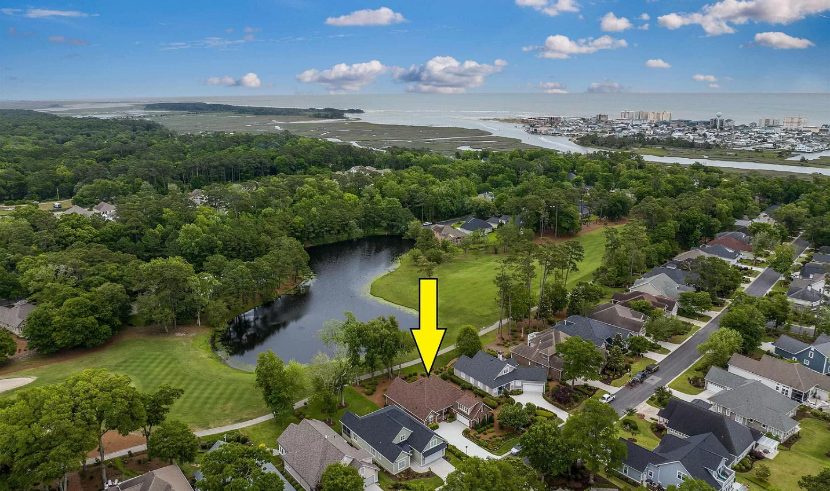
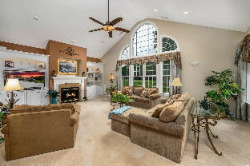
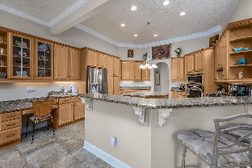
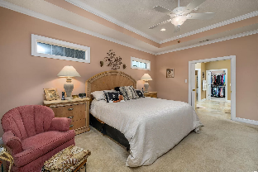
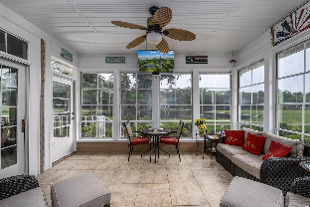
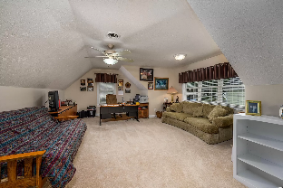
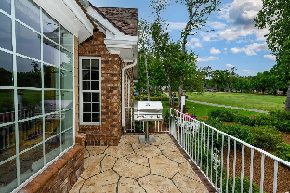
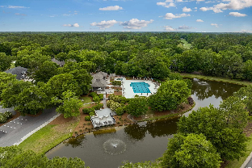
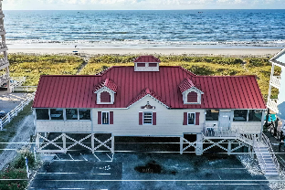
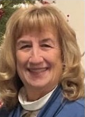

Beautiful All Brick Home
On The 14th Hole Of Tidewater Golf Club
913 Morrall Dr
Tidewater Plantation | North Myrtle Beach SC 29582 | MLS# 2411175 | $845,000
Welcome to Tidewater, a gated community, nestled in between the Intra Coastal Waterway and the Cherry Grove Marsh. Beautiful all brick home located on the 14th hole of the World Class Tidewater Golf Club, with views of the pond and the green. This 3 bedroom, 2.5 bathrooms with large bonus room features a large great room with built in bookshelves and a gas fireplace to be cozy on a cool night.
Brand new (May 2024) in ground propane tank has been installed for fireplace, cooking, and Rinnai (hot water on demand). Large bay window was added to dining area to enjoy the views. Roof was replaced in 2020. The home was built with an oversized garage for extra storage. Master bath has been upgraded with large walk in shower and water closet. Screened porch has been updated to 3 season room.
Ownership in The Bluffs neighborhood allows you access to 3 pools, bocce, tennis and pickle ball courts and Fitness center for all ! The BEST amenity yet is Tidewater Cabana on the OCEAN FRONT with gated parking, bathrooms and a kitchen only STEPS to the ocean. Tidewater is in the process of building a new amenity center where we have live music concerts, dances, trivia and dinners. There have been a few weddings here too. Let's talk about all Tidewater has to offer! Schedule your private tour today!
Enjoy a Virtual Tour
Helen Ashby
804-426-7758
hhashby@gmail.com
NEW WAY PROPERTIES MYRTLE BEACH

