Slide 1
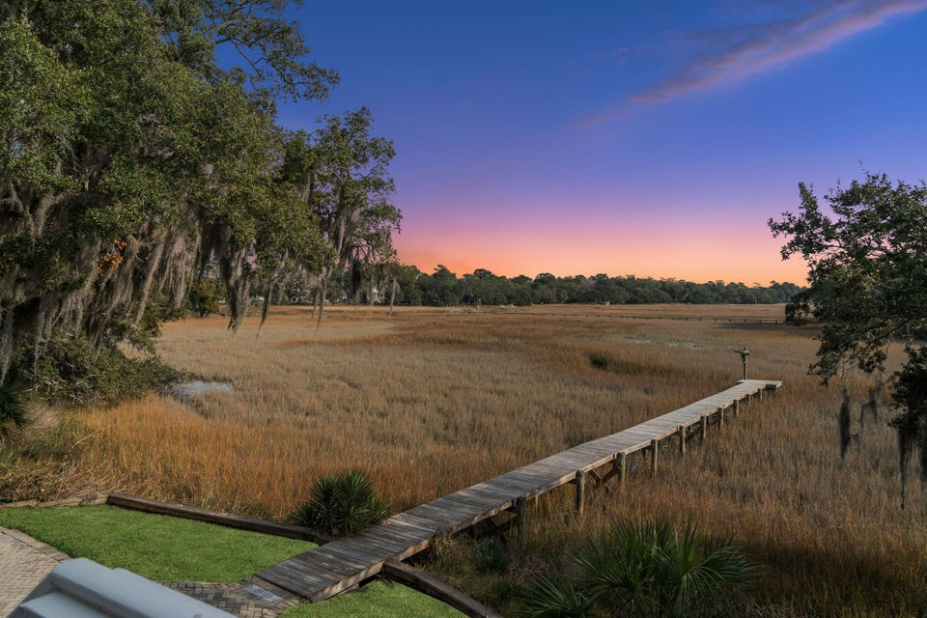

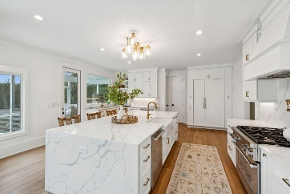

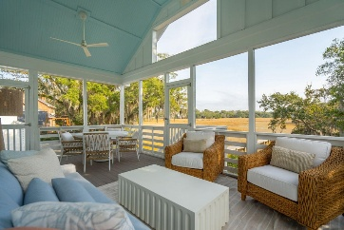
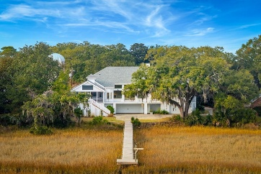
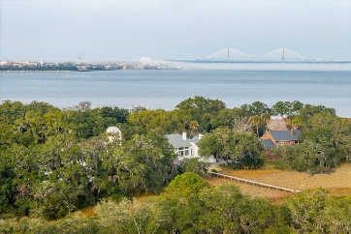


Open House Sunday 3/22 1-3:30 pm
913 Paul Revere Drive
Stiles Point | Charleston, SC 29412
MLS# 26006161 | $2,995,000
Tucked away at the end of a quiet street in the Harbor Section of Stiles Point Plantation, this marsh front home offers wide views across the Lowcountry marsh and direct access to a tidal creek with a private dock. The setting provides an ever-changing backdrop of water, wildlife, and coastal landscape while remaining just minutes from Downtown Charleston. The main living level is centered around an open floor plan with vaulted ceilings and a wall of floor-to-ceiling windows that frame the marsh and fill the home with natural light.
Edmund Major
843-343-6666 C
edmund@flywaysc.com
www.flywaysc.com
Flyway Real Estate, LLC
1630 Meeting St.
Bldg 1
Ste 302
Charleston, SC 29405

