Slide 1
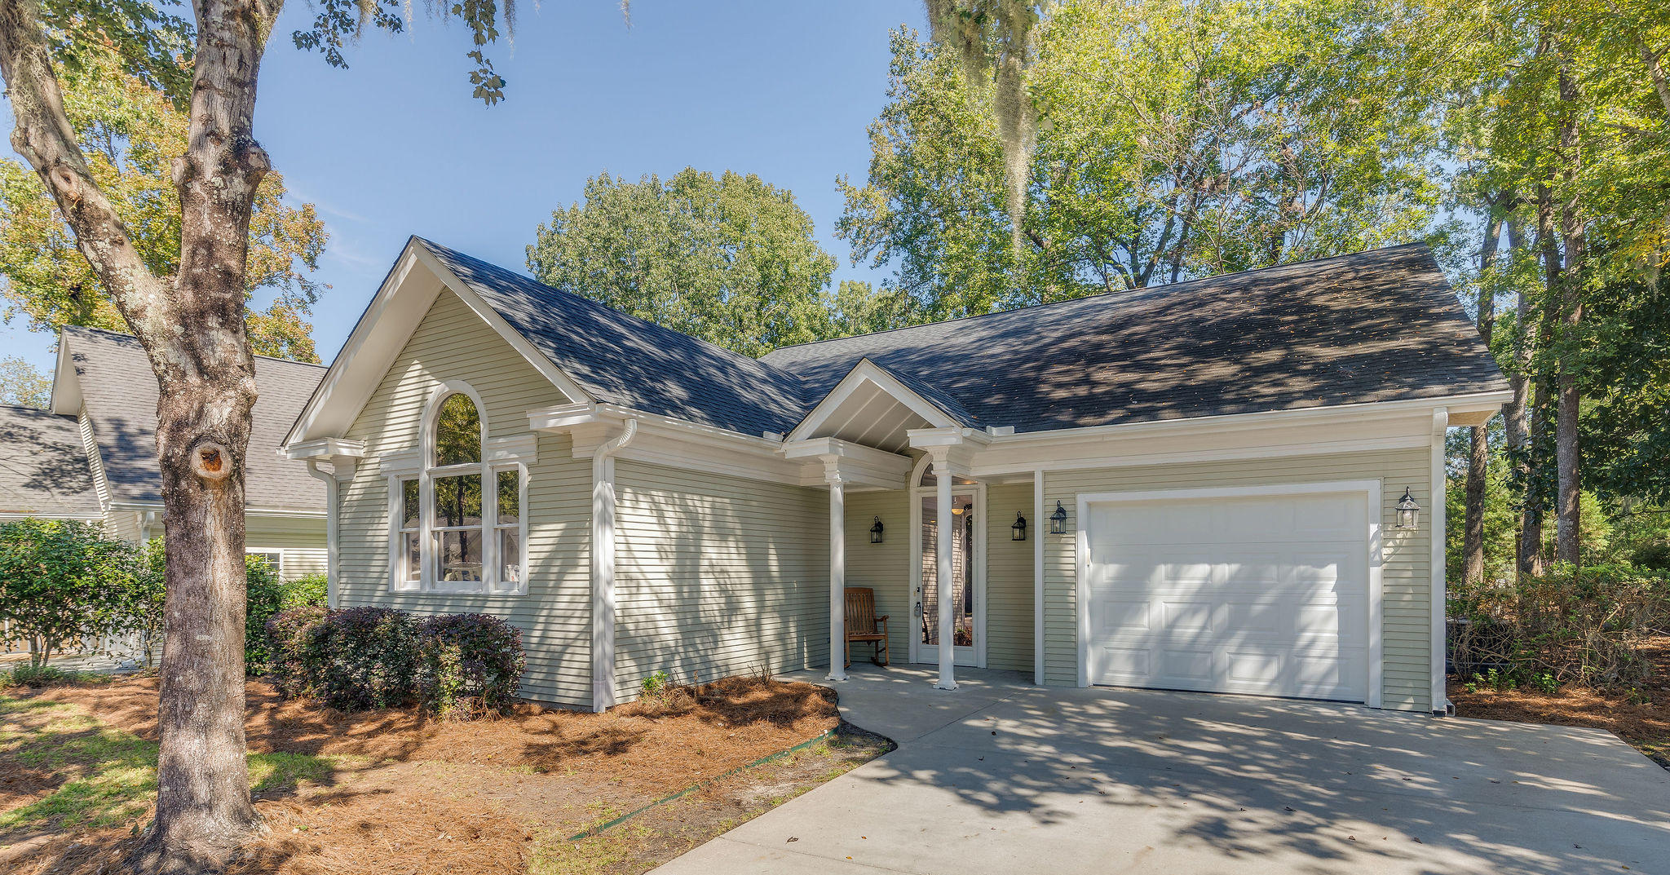
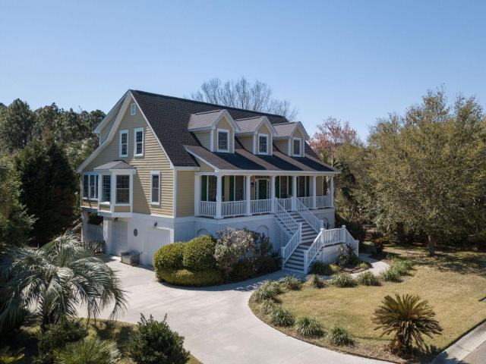


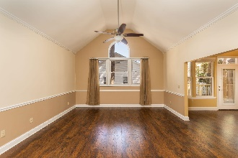
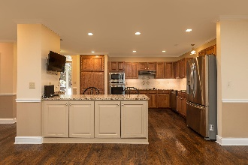
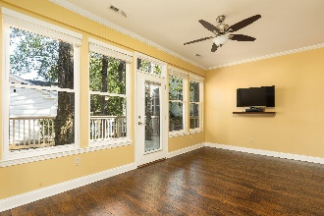
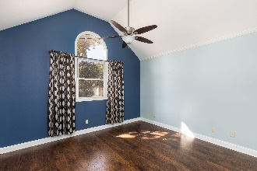
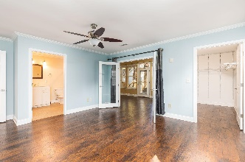
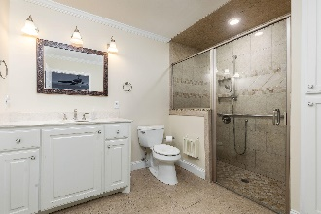
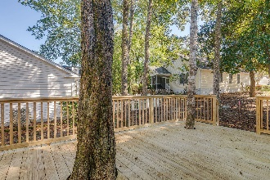
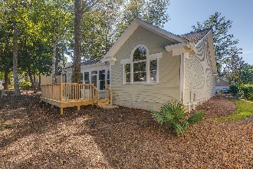

Fully Renovated In 55+ Community With Pool
9146 Spring Branch Court
Elms of Charleston · North Charleston · MLS# 20027895 · $275,000
Beautifully renovated home in the highly sought after Elms of Charleston. This home is in one of the few 55+ retirement communities in the Charleston area. The home boasts an open floor plan and has been updated throughout. The kitchen has granite countertops, high-end Kenmore stainless steel appliances, under cabinet lighting, a deep sink, and an island w/ plenty of counter space. The large living room leads into a sun-room that opens up onto the back deck built around mature trees. The master suite has an updated master bath with a spacious walk-in shower and large walk-in closet. The second bedroom is on the opposite side of the house and boasts tall ceilings and gets plenty of natural light. The neighborhood has a communal pool, tennis court, and club house. This is a must see!
Bryan Thompson
(843) 452-1686
bryan.thompson@agentownedrealty.com
Greg Gelber
(843) 494-2354
greg.gelber@agentownedrealty.com
AgentOwned Charleston Group | 902 Savannah Hwy | Charleston, SC 29407-7802

