Slide 1

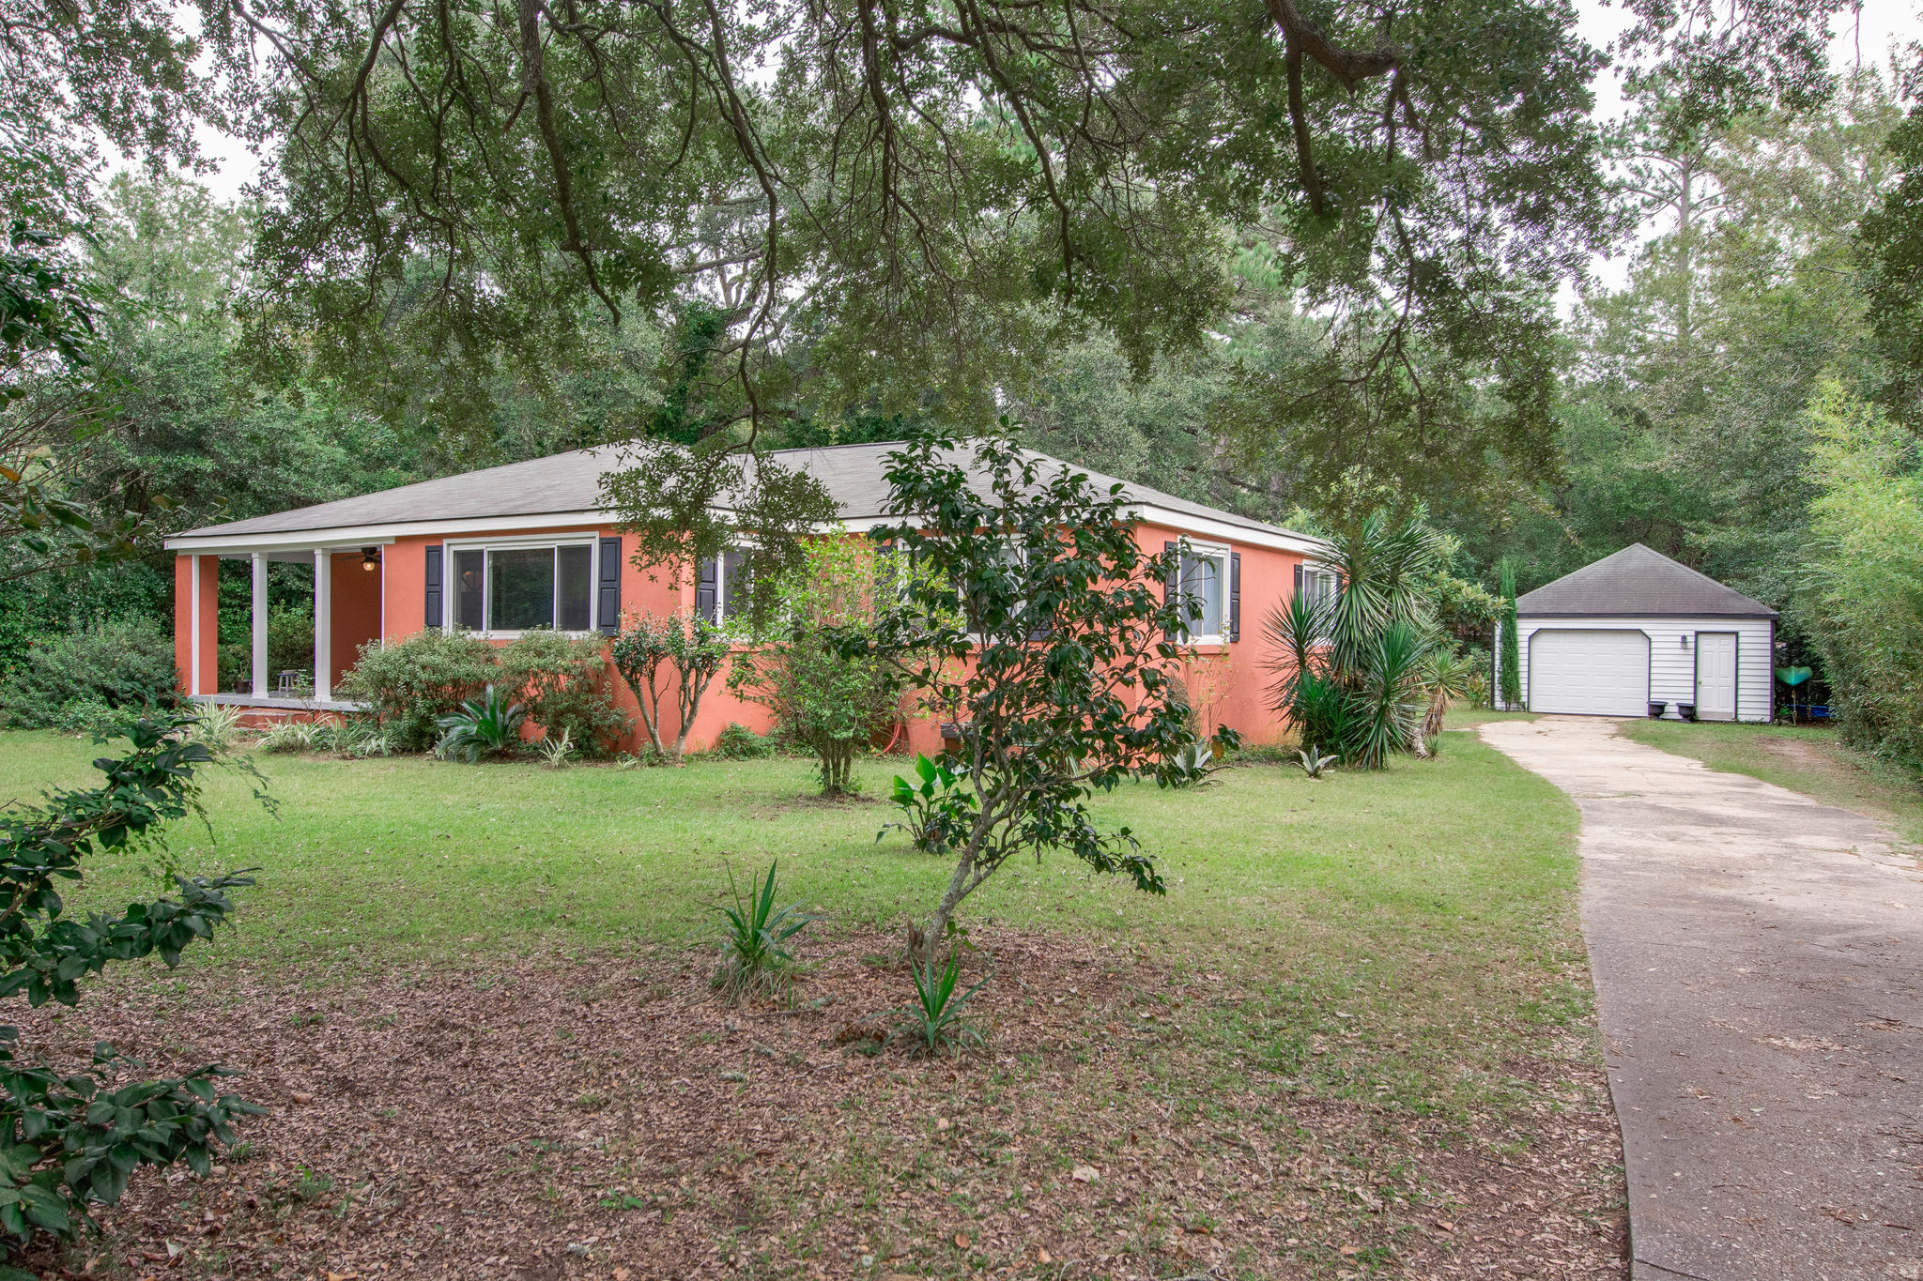
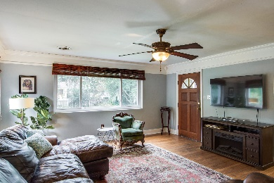
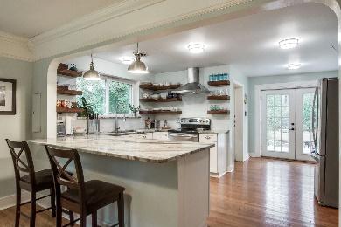
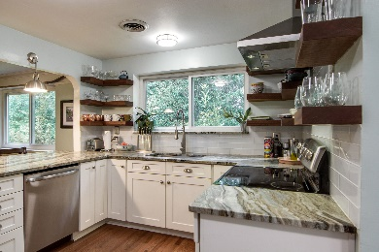
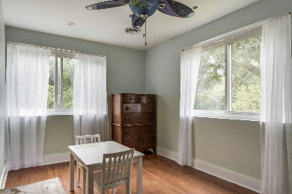
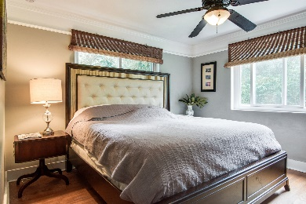
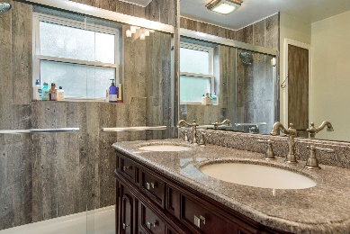
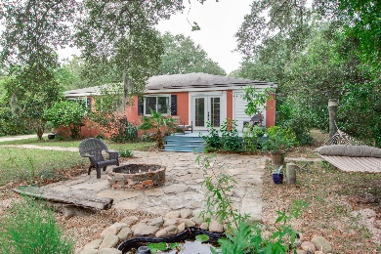
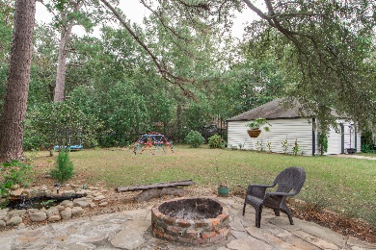


$5,000 Agent Bonus* Updated James Island Cottage
914 Julia Street
MLS# 18029118 | $344,900
Single story cottage with nice updates and NO HOA fees! Central location on James Island with a large .46 acre fenced yard full of beautiful oaks, flowering camellias and azaleas. Kitchen has been opened and updated with beautiful granite counters, white cabinets and stainless appliances. Great floor plan with updated bathrooms, original wood flooring, insulated windows, smooth ceilings, expanded closets and a laundry room. A large wood deck off the rear connects with the stone patio, fire pit and Koi pond. The detached one car garage is oversized (27 x 21) with room for parking, workshop and storage. The entrance has an electric gate and the exterior is true masonry stucco - NO EFIS or synthetic stucco. All information is believed correct but should be verified by buyer.
*Bonus applies to ratified contract by 11/19/18
Lori Claussen loric@nvrealtygroup.com | (843) 224-8506
NV Realty Group | 91 Broad St, Ste A | Charleston, SC 29401
www.LoriClaussen.NVRealtyGroup.com

