Slide 1
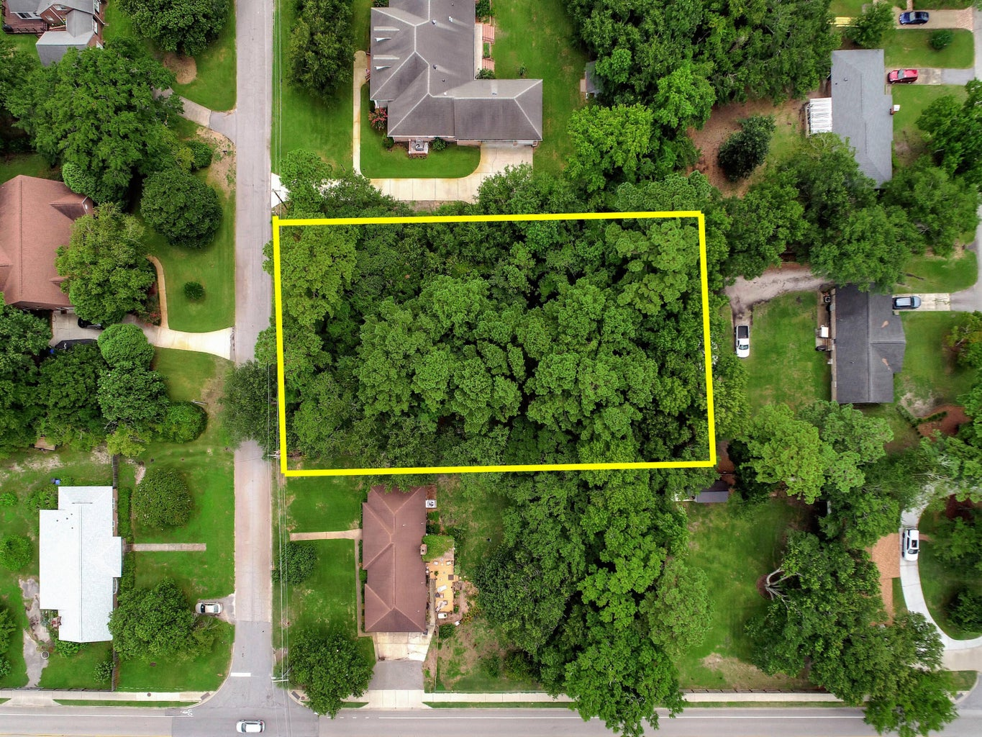
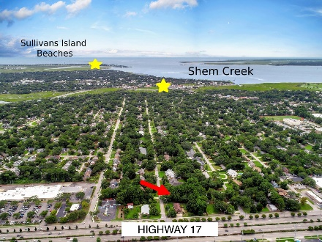
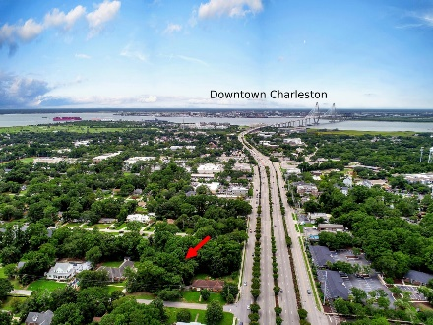
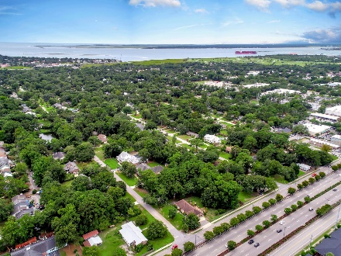
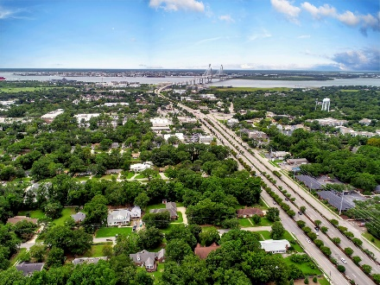



Last LOT in The Groves, Mount Pleasant!
914 Lakeview Drive
The Groves
Mt Pleasant, SC 29464
MLS# 24019972
$1,200,000
0.53 Acres
Discover the LAST AVAILABLE LOT in The Groves subdivision, located in the heart of Mount Pleasant, SC. This expansive 0.53-acre parcel offers a unique opportunity to build your dream home in one of the most sought-after neighborhoods in the area. Enjoy the perfect blend of tranquility and convenience, as The Groves is known for its serene atmosphere, mature trees, and proximity to top-rated schools, shopping, dining, beautiful beaches, and downtown Charleston. The Groves is renowned for its friendly community feel, with tree-lined streets and a mix of charming historic homes and modern residences. A comprehensive tree survey has been completed and is available. Utilities available at street! Don't miss this rare opportunity to secure the last lot in The Groves to create your dream home!
Nick Mazzilli
(843) 640-5575
nick@themazzilliteam.com
nickmavencharleston.com
Maven Realty
2180 McMillan Ave
#71672
Charleston, SC 29405

