Slide 1
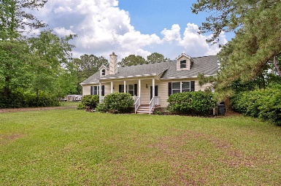
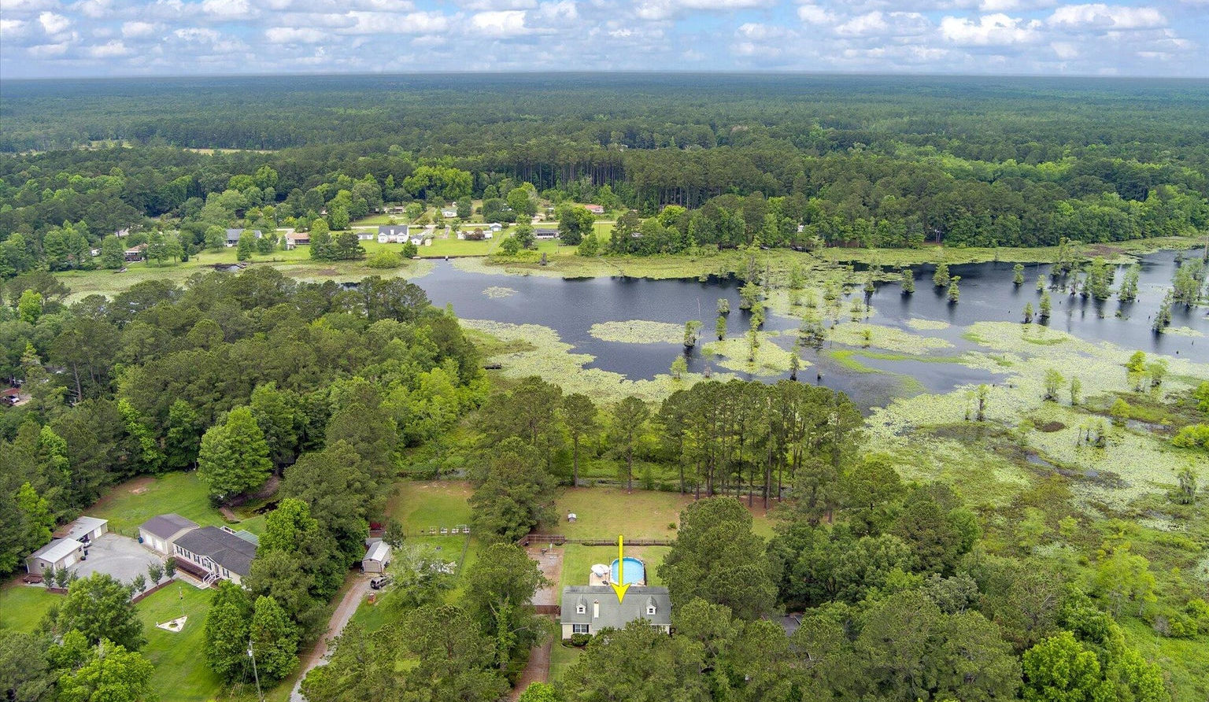
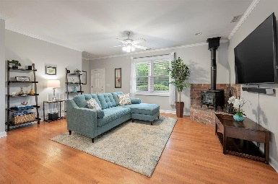
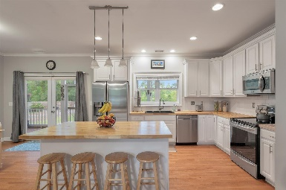
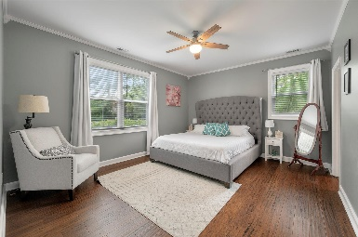
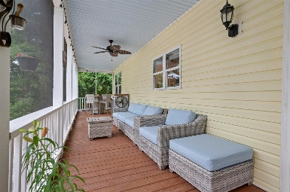
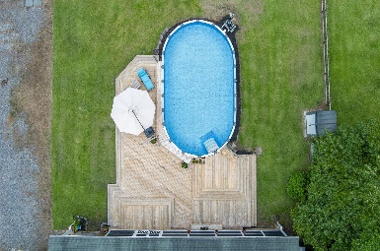
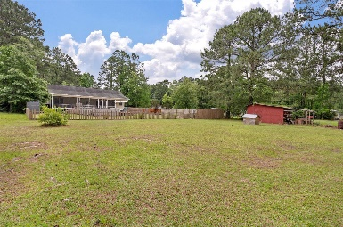


914 Tracy Road
Bates Estates · Huger, SC 29450 · MLS# 24011977 · $550,000
New Listing in Huger on Gorgeous Lot!
This gorgeous property boasts over 1/2 of an acre on one of Huger's best kept secrets....Bates Pond Estates. This home has 3 bedrooms and 2 full baths and boasts a lovely open floor plan. The kitchen has been recently updated to include painted cabinetry, butcher block countertops, a subway tile backsplash, a large kitchen island with a butcher block top and stainless steel appliances.
Just off of the kitchen is a large utility room/laundry room which is very spacious making it a good area for extra storage. The kitchen is also open to the family room that includes a wood burning stove. The master bedroom is just off of the family room and offers an ensuite bathroom with double sinks and a shower/tub combo. The walk in closet has been updated with a built in closet organization system. Back through the family room and kitchen area is a hallway that leads to two more bedrooms and another full bath.
The home has no carpet with bamboo flooring and vinyl plank floors. There is crown molding throughout for a more updated feel. Off of the kitchen are double doors that lead out onto a recently added screened in porch which offers a great space for outdoor entertaining! The porch then leads out onto a huge deck that is connected to the gorgeous salt water pool. The crawl space has also been encapsulated with a dehumidifier installed as well.
The house has views of beautiful Bates Pond that is great for kayaking, fishing, paddle boarding, bird watching, etc. This home has no hoa so you can store your boat, RV, trailers or even build an outbuilding or two for more storage. This property is located approximately 20-30 minutes away from Mt. Pleasant and it is an easy drive to Harris Teeter on Hwy. 41 or Publix on Clements Ferry Road.
Carey Nikonchuk
843-276-1701
cnikonchuk@gmail.com
www.brennamangroup.com

