Slide 1
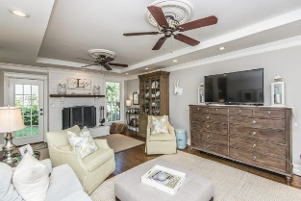
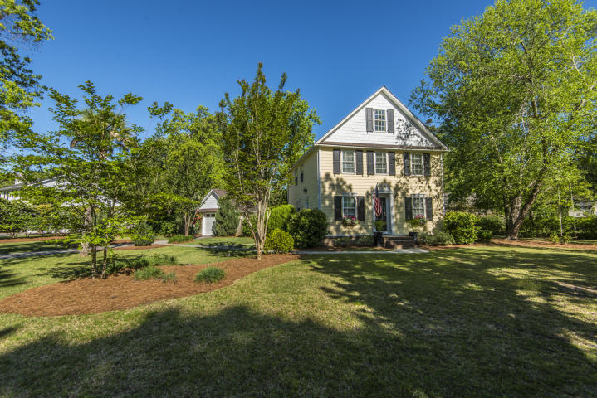
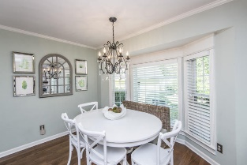
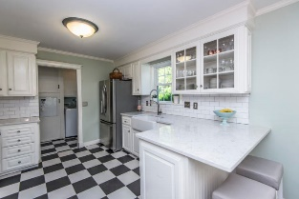
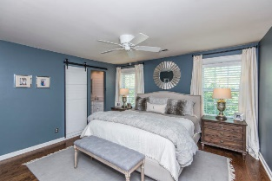
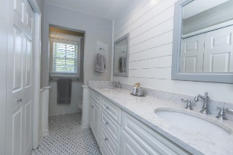
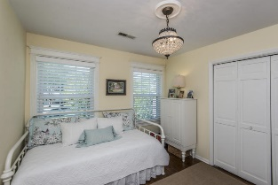
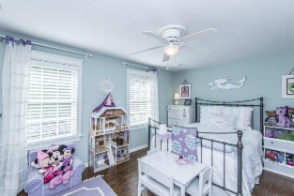
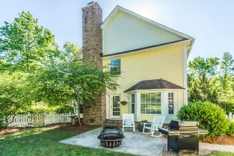
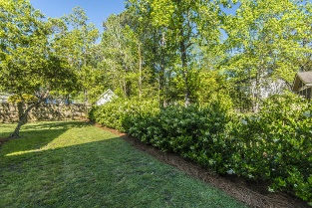


915 Law Lane
Mt Pleasant ~ MLS# 19011267
Snee Farm Open House Sunday 1-3
Just Reduced to $525,000
Beautifully updated, charming Southern colonial home on a one-third acre corner lot in desirable Snee Farm. The character of this home sets it apart with hardwood floors throughout, detailed moldings, glass door knobs, and elegant light fixtures. Enter through a formal foyer with powder room, which leads into a large living room anchored by a painted, white brick fireplace. An updated kitchen with white cabinets, quartz counters and sun-filled attached dining area complete the first floor. Upstairs, there is a large master bedroom and renovated en-suite bath featuring a double sink quartz vanity, custom shiplap and barn door, as well as two secondary bedrooms which share a newly updated hall bath. You will find ample closet space throughout with extra stand-up storage space in the attic, which could be converted to a 3rd floor (plan available). The manicured exterior landscaping and fully fenced backyard features a grilling patio ideal for entertaining. The exterior of the home was painted in 2018 with new exterior shutters added, and the crawl space is encapsulated (2017).
Kristin Schatmeyer
Cell - (843) 697-7370
kristin.schatmeyer@carolinaone.com
www.KristinSchatmeyer.com
Carolina One Real Estate
2713 Highway 17 North
Mt. Pleasant, SC 29466

