Slide 1
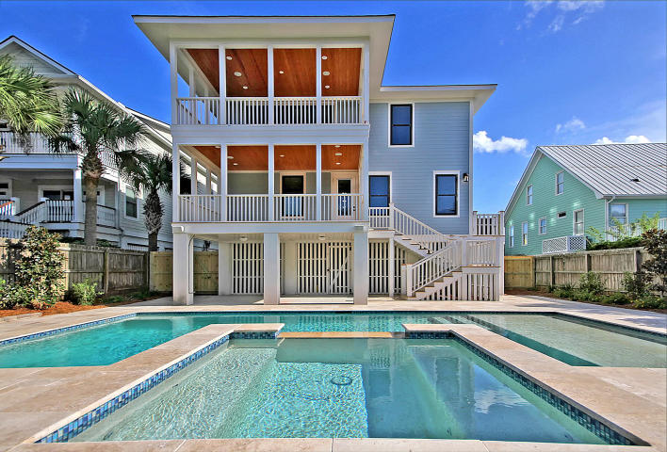
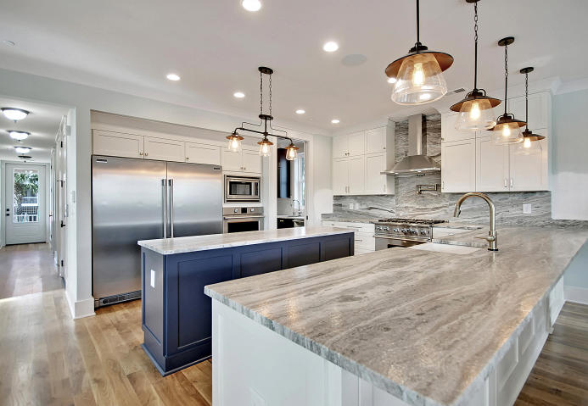
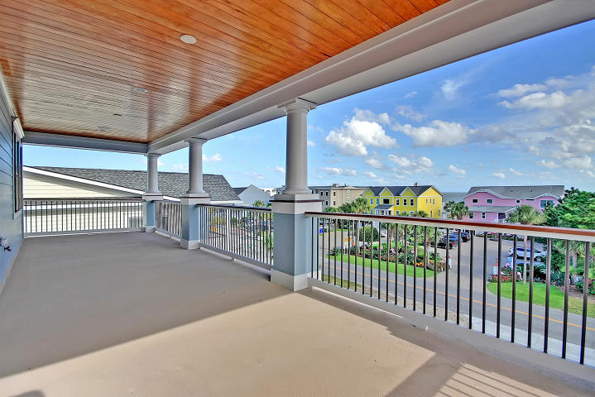
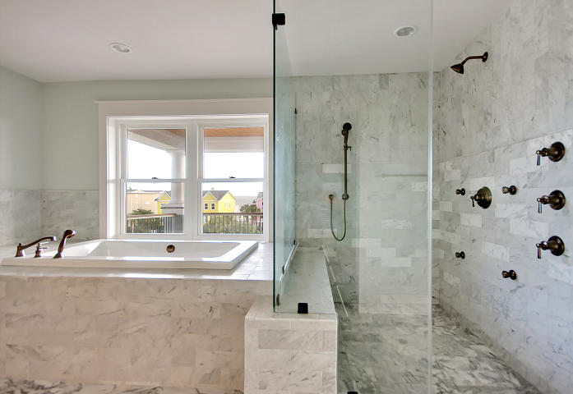
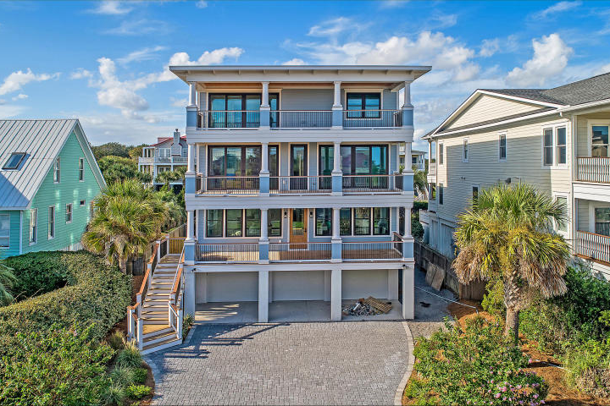
Price Reduced!
Price Reduced!
915 Ocean Boulevard
Isle of Palms, SC 29451 ~ MLS# 18027455 ~ $3,188,000
Be the first to experience this breathtaking new construction on Isle of Palms that is literally steps from the beach, Windjammer, shopping and ocean front dining. This 2nd row, luxurious beach residence with ocean views can get the job done whether you're looking for a full time place to call home, a vacation destination for your whole family or if you've been looking for the ideal income property, this is it! There was no corner cutting when it came to the construction and finishes in this home from the gourmet kitchen, hardwood floors, lighting fixtures and resort style pool and spa in the fenced-in backyard, this home exudes high end living and relaxation. The water views are best enjoyed from the expansive, master balcony! Be prepared to make memories here that will last a lifetime!
Tyler Hawkins tyler@mattoneillteam.com (843) 908-2734

