Slide 1
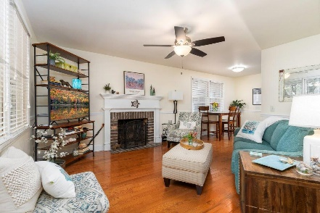
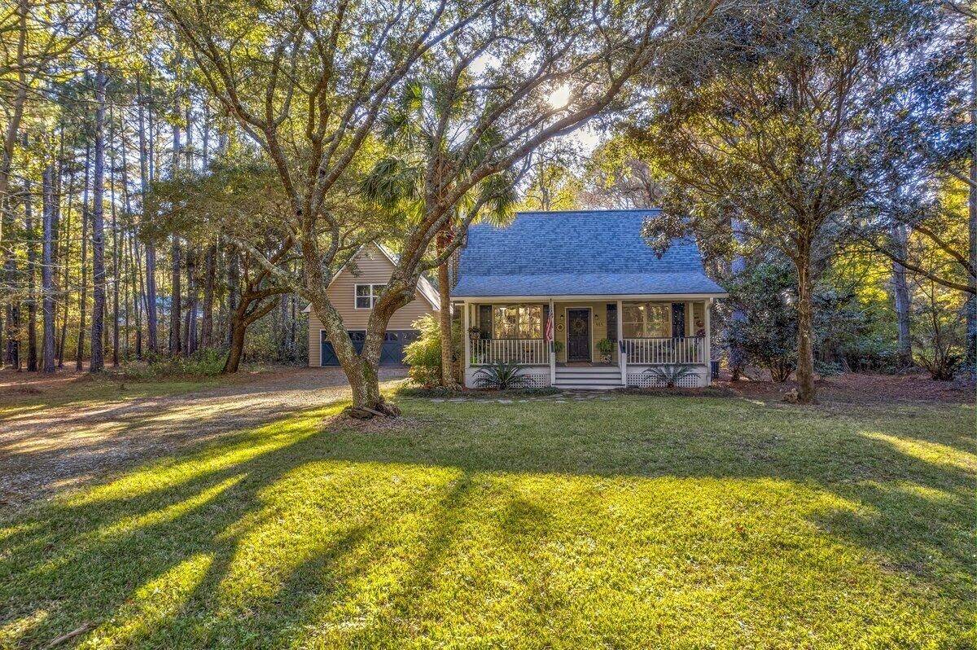
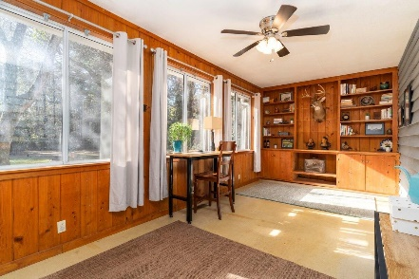
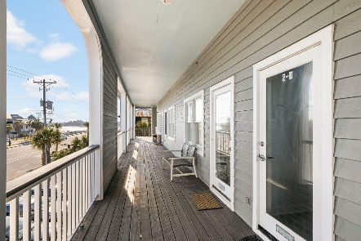
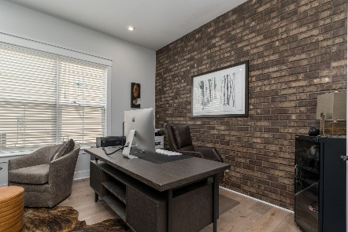
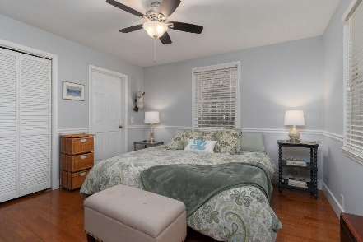
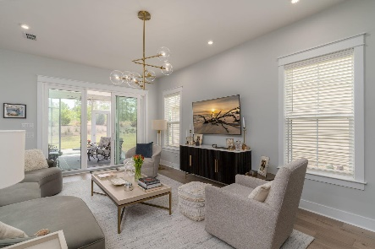
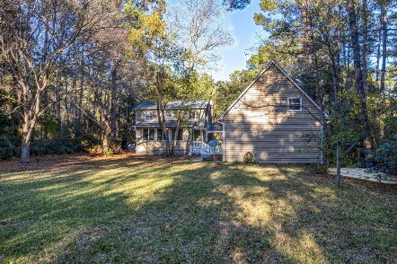

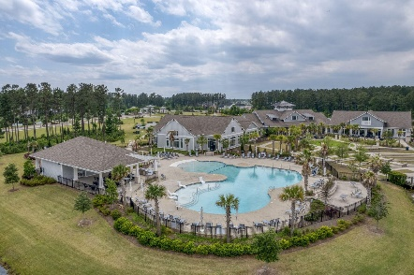
915 Gypsy Lane Silver Hill | McClellanville, SC 29458 MLS# 23026903 | $525,000
Darrell Creek Elevated Home With Elevator & Salt Pool
$20,000 Price Improvement in McClellanvile
Co-sponsored by
Offering $3000
Lender Credit
$2500 LENDER CREDIT for Closing Costs or Rate Buydown with preferred Lender
Come Home for the Holidays to 915 Gypsy Ln! This Country Charmer is truly a 4-bedroom, 3-bath, as it has a separate apartment over the garage (496 SF)! The home is nestled on a 1-acre cul-de-sac lot in Historic McClellenville. The first thing you notice is the expansive front yard and mature trees. Sip your morning coffee or sweet tea on the full front porch. As you enter the home, you are welcomed with a cozy cottage feel, as you notice the hardwood floors and wood-burning fireplace in the Living Room. The Kitchen & Dining Area have been remodeled with new gas stove installed in 2021. The Master Bedroom is conveniently located downstairs with En-Suite Bath that was remodeled with new walk-in Shower and Washer & Dryer in 2023. To the back is a Fully Finished Sunroom where natural light comes pouring in all day long! Upstairs you will find 2 Large Guest Rooms, with lots of storage, as well as another Full Bath.
Not to be missed is the HUGE Detached Garage with 1- bedroom Apartment above it, which has its own Full Bath and Kitchenette. Use it as an In-Law Suite or even as a Rental, as it is metered separately. NO HOA, so you can park your boat in the driveway and the possibilities are endless with this big, beautiful backyard. Other upgrades include a New Roof and Gutters in 2020, New Ceiling Fans in every bedroom and Living Room, and rebuilt back porch.
The home is walking distance to Award- Winning CREECS Charter School. It is also 25 minutes to Mt. Pleasant and Historic Georgetown and only 1 mile from the Water and Community Boat Launch. Come make this slice of paradise yours TODAY!
House Tour
Elissa Campbell
843-853-1433 | elissa.campbell@agentownedrealty.com
AgentOwned Realty Preferred Group | 824 Johnnie Dodds Blvd | Mt Pleasant, SC 29464

