Slide 1
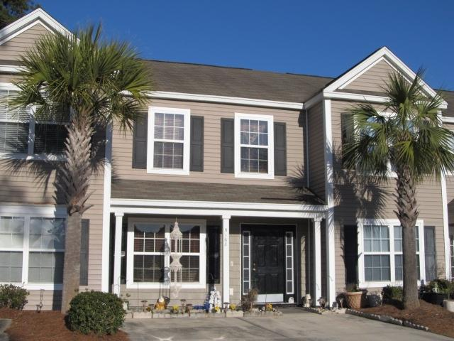
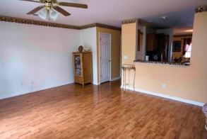
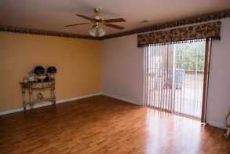
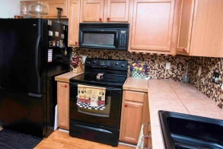
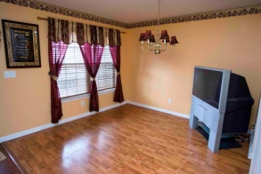
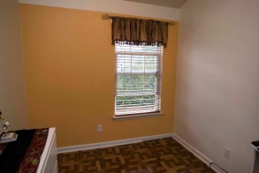
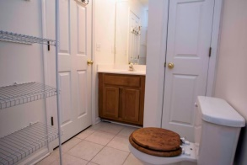
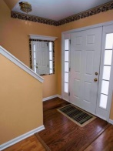
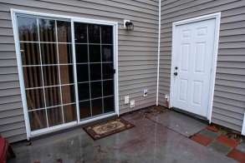
Open House!
Sunday March 1
1pm-4pm
9168 Maple Grove Dr
Wescott Plantation
Summerville, SC 29485
MLS# 15004702
$110,000
First time home buyers and investors!! Enjoy exterior maintenance free living and spend more time enjoying all the advantages of living in Wescott Plantation. This townhome has been well taken care of and is priced to sell. Laminate wood flooring throughout the first floor. Kitchen has been upgraded with new cupboards and extra countertop space has been added! Spacious master bedroom with new paint. Enjoy the back patio which has plenty of room for a grill and entertaining! Dorchester District II schools. Located close to Boeing, JB Charleston, and everything else you will ever need!
David Hickman | 843.505.0456 | davidisyouragent@gmail.com | www.omnicarolinarealestate.com
Omni Carolina Real Estate | 126 Eston Dr | Goose Creek, SC 29445

