Slide 1
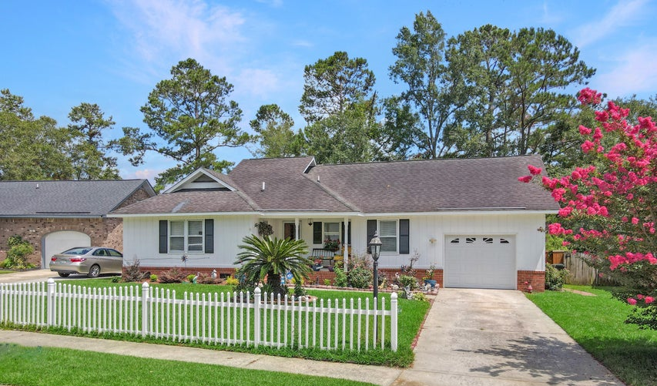
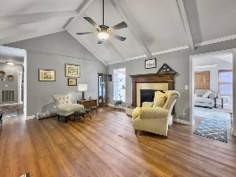
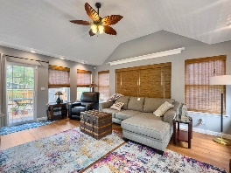
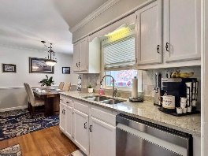
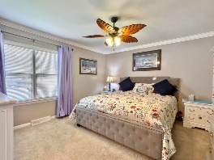
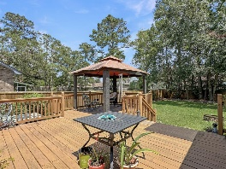
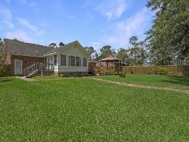


917 Aleppo Drive Tall Pines | Ladson, SC 29456 | MLS# 24011830 | $362,500
No HOA! One-story Updated Home With Large Yard
This charming brick ranch home with no HOA is a must-see! The kitchen features newer appliances, granite countertops, and extra cabinet and counter space. Both bathrooms have been nicely updated, and the living room boasts gleaming hardwood floors. Don't look past the substantial added bonus / sunroom off the living room leading to the outside. The spacious deck and covered gazebo are perfect for entertaining. Adding a cool and refreshing pool would still leave yard space. There is a separate shed for storage. No need to clutter up the garage. The upstairs bonus room offers endless possibilities and privacy - from a home office, game room, kids room to a movie room. Don't miss out on this beautifully updated NO HOA home with an amazing backyard!
Michelle Riser
(843) 860-1229
mriser@ccim.net
Palmetto Group of AgentOwned | 597 Old Mt Holly Rd Ste 202 | Goose Creek, SC 29445

