Slide 1
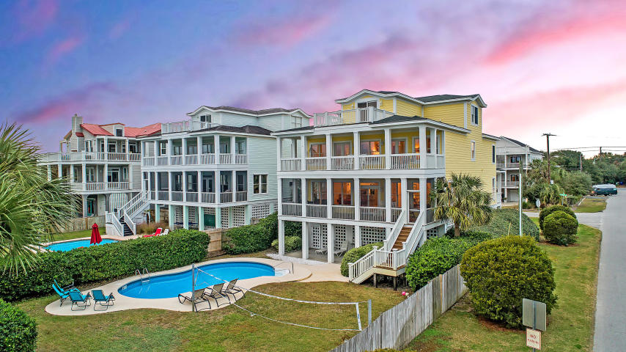
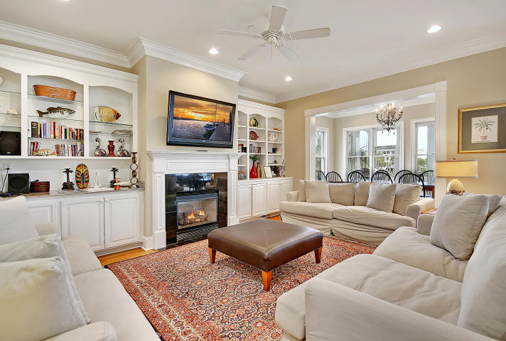
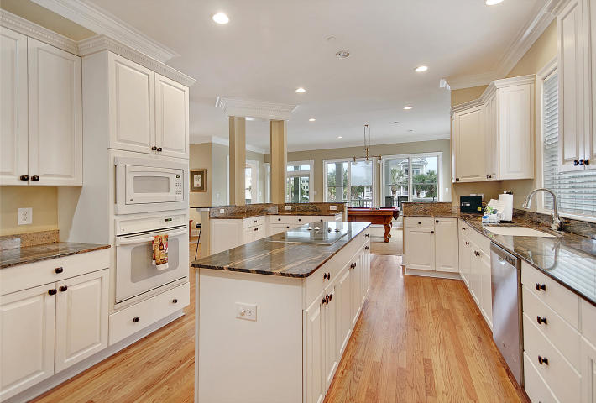
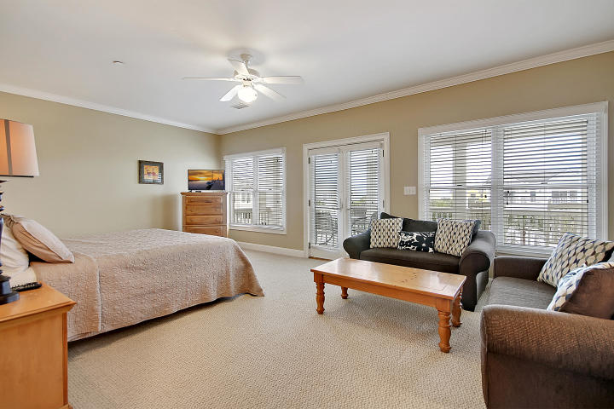
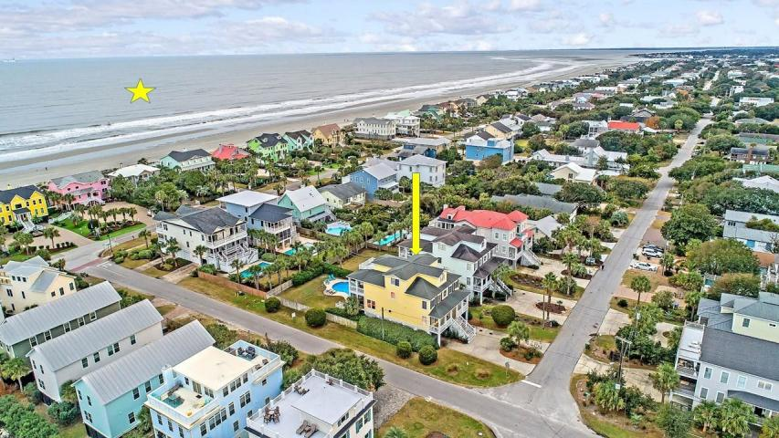
Amazing Beach Living
Price Reduced!
918 Carolina Boulevard
Isle of Palms, SC 29451 ~ MLS# 18031825 ~ $1,845,000
Third row from the beach on Isle of Palms, this incredible home has one of the best locations on the island and is waiting for more memories to be had! You can literally walk to the Windjammer, Coconut Joe's, Ben & Jerry's and of course the beach in minutes from this corner lot that has a fenced-in backyard with an in-ground pool. A full front porch, covered patio and two decks are great outdoor living spaces to enjoy. Take the elevator from the garage all the way up to the third level where the balcony shows off beautiful ocean views. The open floor plan on the main level features a fireplace with built-ins, a spacious kitchen game area and formal dining room. With a fantastic rental history, this could be your next great investment, full time home or perfect vacation spot.
Tyler Hawkins tyler@mattoneillteam.com (843) 908-2734

