Slide 1
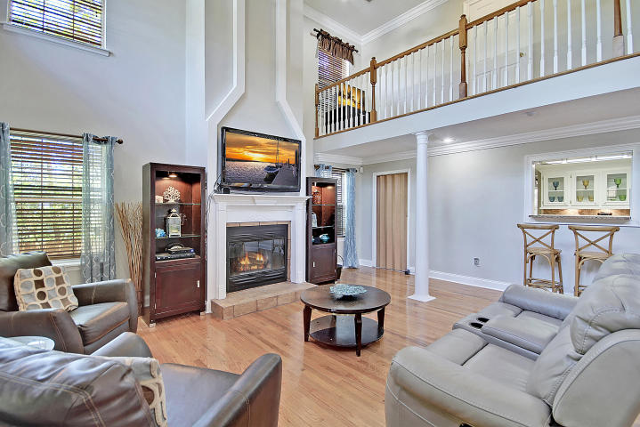
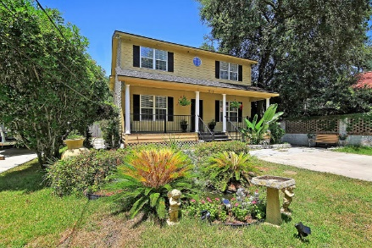
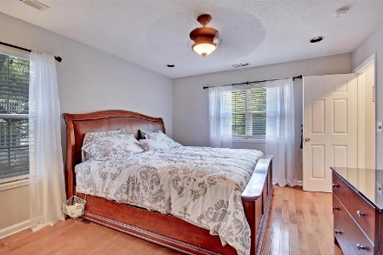
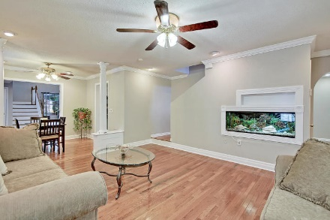
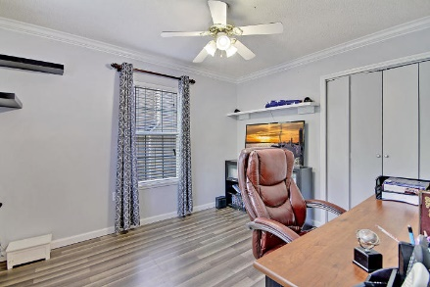
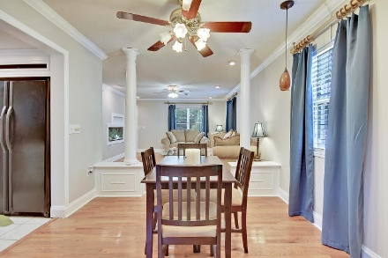
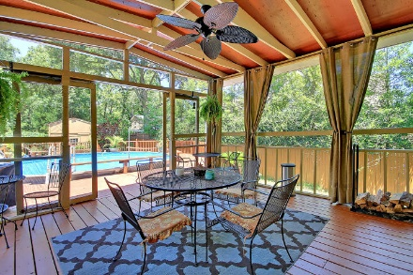
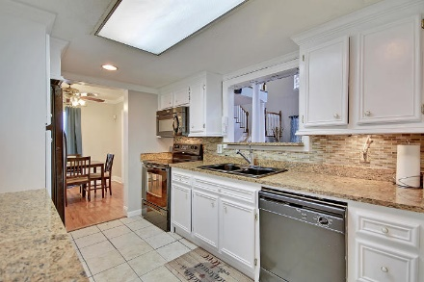
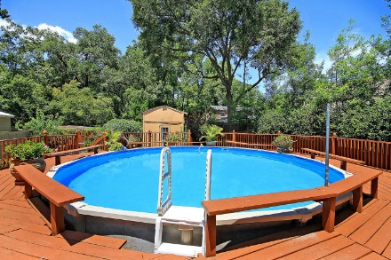
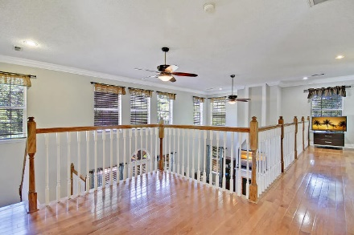
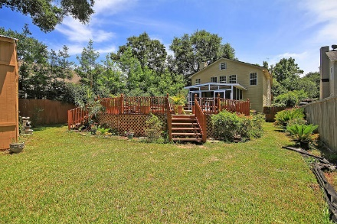

New Price!
Price Reduced
For Quick Sale
Open House Saturday 12-3
918 Mathis Ferry Road
Hobcaw ~ Mount Pleasant, SC 29464 ~ MLS# 19022229 ~ $485,000
Location, location, location! Incredible opportunity to own a custom built home with a pool in highly desirable Hobcaw in South Mt Pleasant inside I-526. Located just off Mathis Ferry Road, a quick drive to Shem Creek, Beaches, Downtown, & Town Center! Zoned for the brand new Lucy Beckham High School & conveniently located near amenities, stores, & highly-rated schools plus Trader Joes, Whole Foods & popular restaurants and retail. Situated on half an acre with mature trees in the heart of Mount Pleasant, the grand entry through the gate down the long driveway brings you right up to the covered front porch. The spacious, two story family room with fireplace, columns & soaring ceilings is inviting and warm with tons of natural daylight.
Step out into the screened in porch from the living room & see the sparkling pool with surrounding deck & built-in seating. This private backyard oasis is your very own escape & outdoor retreat. There is fresh paint throughout the interior as well. This is a great home and unbelievable location! No HOA!
Book your showing today!
Katie Wishneff kwishneff@mattoneillteam.com 843-870-8784

