Slide 1
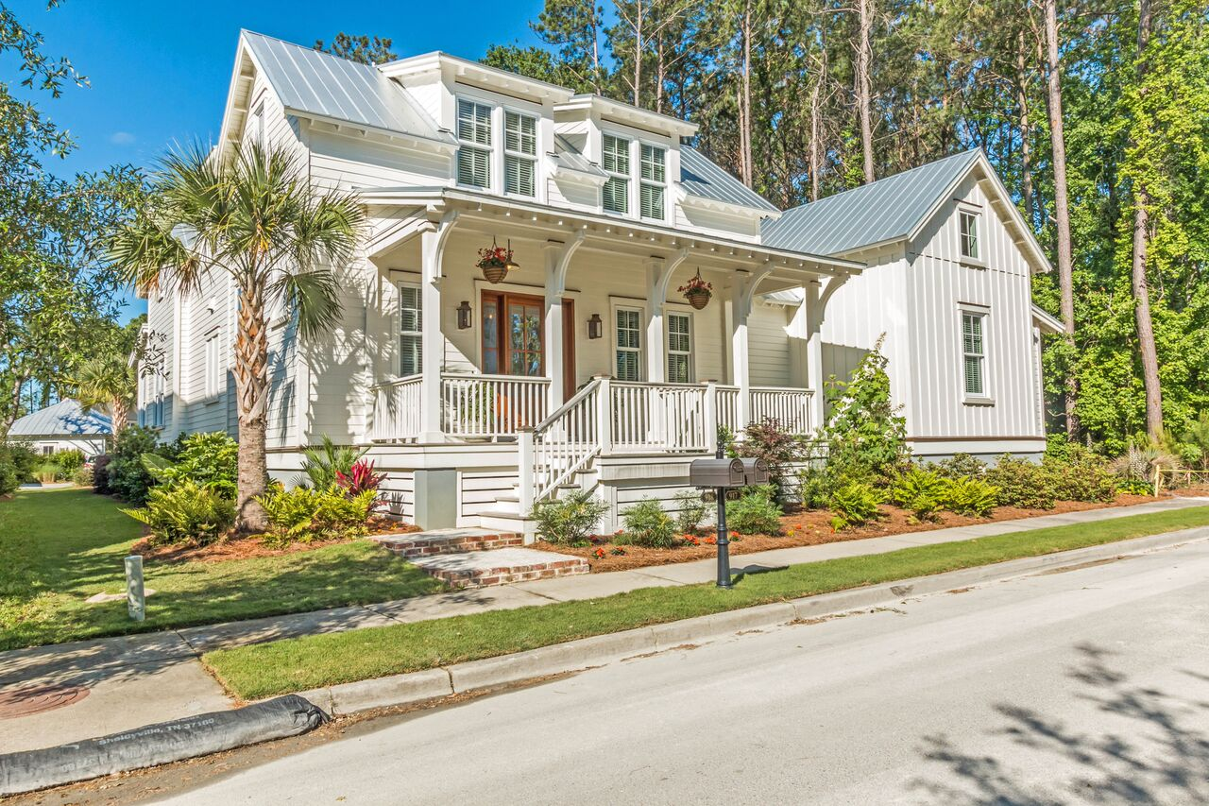
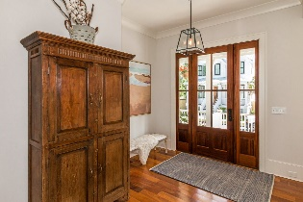
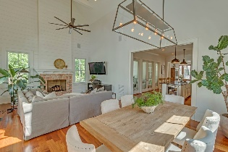
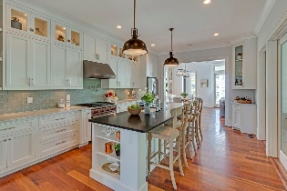
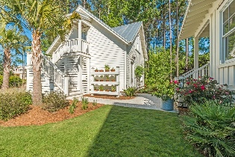
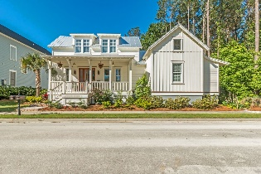


918 Tupelo Bay Drive Mount Pleasant SC 29464 Hibben Of Belle Hall Plantation Offered At $945,000
Broker Only Open House
Thursday May 19th 11:00am - 1:00pm
Dessert Will Be Served And Enter To Win $100 Gift Card
This property is not listed on the MLS.
Fine custom home built in 2014.
Featuring 4 bedrooms including 1st floor master suite.
Approx. 3,200 sqft
State of the art kitchen, top of the line appliances.
Open floor plan, 1st floor laundry room.
Screened porch, outdoor gas fire pit and patio.
Detached 2 car garage features finished apartment & full bath
Luxury finishes and details throughout.
Crissy Rowell
Mobile - (843) 377-5177
crissy.rowell@carolinaone.com
www.crissyrowell.com
Carolina One Real Estate | 195 W Coleman Blvd | Mt Pleasant, SC 29464

