Slide 1
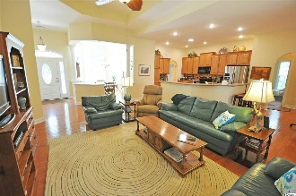
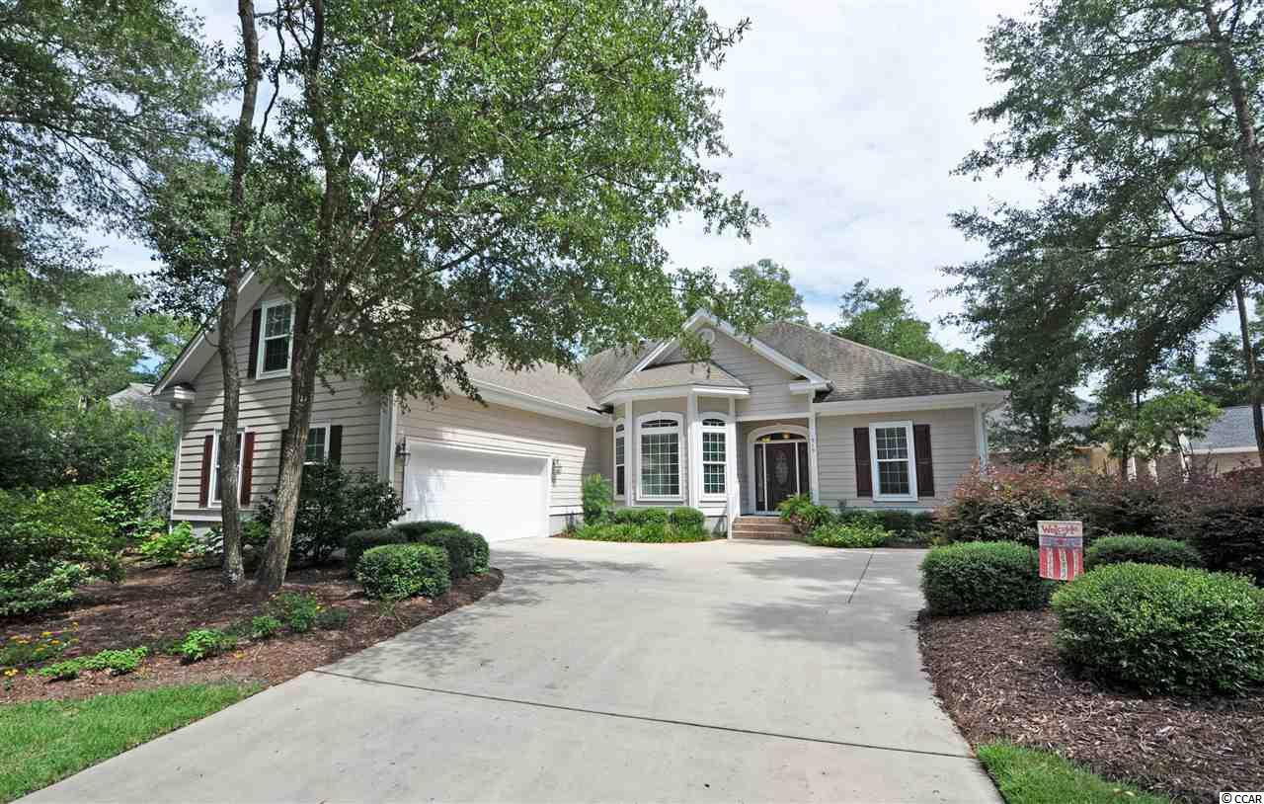
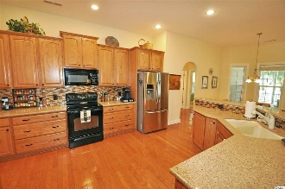
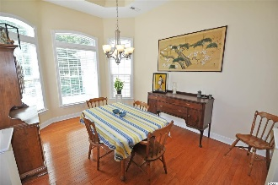
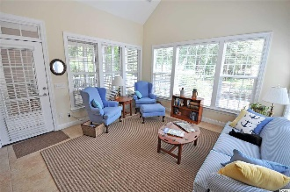
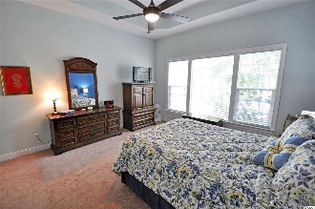
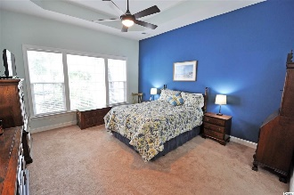
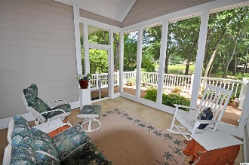
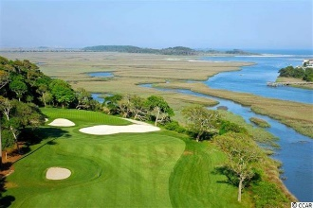
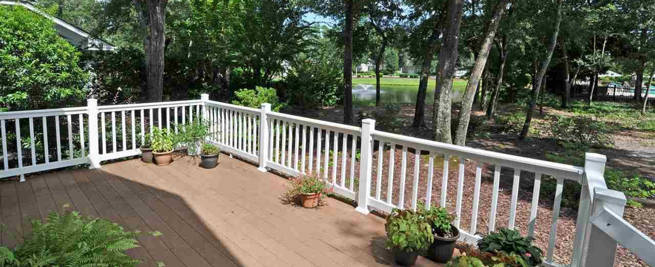
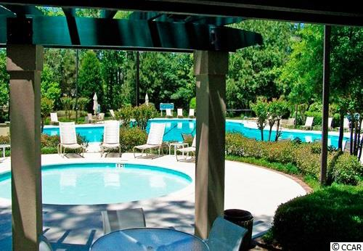
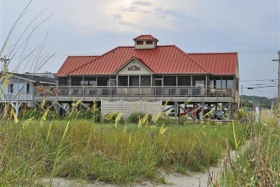


919 Frinks Court
Tidewater Plantation Resort ~ North Myrtle Beach
MLS# 1817079 ~ $419,900
Fall in love first with the home, then with the singular Tidewater Plantation golf-beach-community lifestyle. It has everything at a BIG VALUE, and this is a BIG! house, 4 bedrooms in a split-bedroom floor plan on the first floor, a bonus room upstairs with attic storage on the second level and 3 full baths. The second and third bedrooms are good size with interesting lay-outs to maximize space and utility such as office nooks. They are near the kitchen and share a convenient full bath with tub and shower. There are lots of closets throughout and more storage on each level and in the over-sized 2-car, side-load garage. Nice traffic pattern, too, from the garage to kitchen, features large laundry, bath with shower for returning beach-goers and others along a convenient entry hall. That bath serves the fourth bedroom as well. Upon entering the kitchen, or the living room from the front foyer, there is an amazing panorama of the Bluffs of Tidewater Lake and its indigenous wildlife such as heron, egrets and turtles.
Deborah Collins
843-424-9013
dctidewater@yahoo.com
Connie Ross-Karl
702-306-2643
conniesross@aol.com
NEW WAY PROPERTIES MYRTLE BEACH

