Slide 1
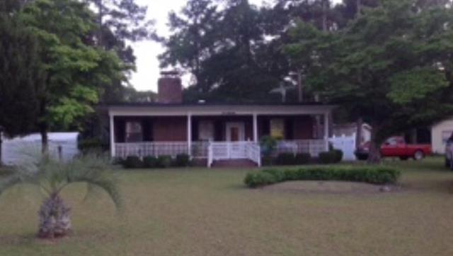
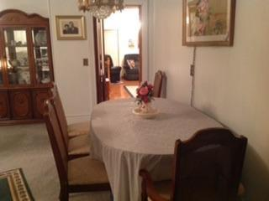
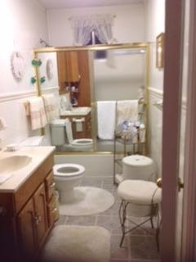
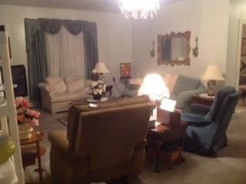

919 Saint Julien Drive
Eutawville, SC 29048 | MLS# 15012522 | $99,900
2 Beds | 1½ Baths | 1,840 Square Feet
Cute cottage nestled on nice lot across the street from shores of Big Water on Lake Marion.
Perfect as a starter home or weekend getaway!
Property is sold as is.
Carla C Davis
Mobile - (843) 437-4873
gaweber@tds.net
AgentOwned Premiere Group
141 A N. Main Street
Summerville, SC 29483

