Slide 1
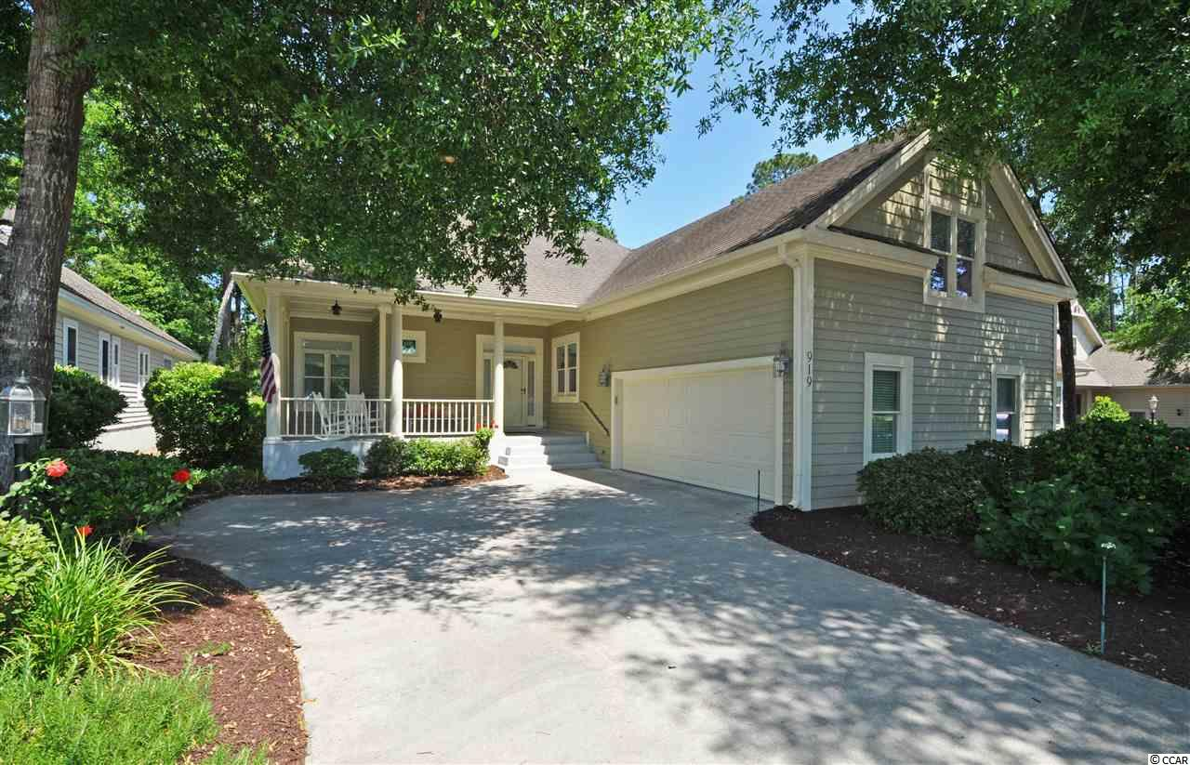
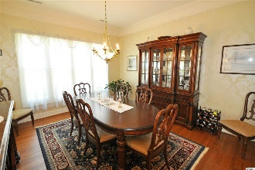
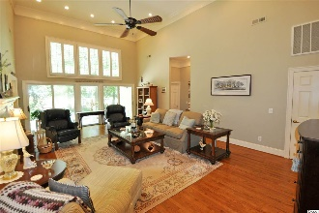
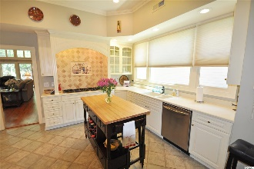
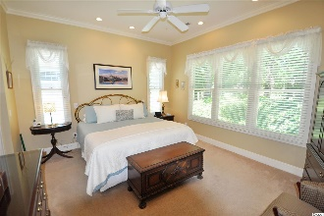
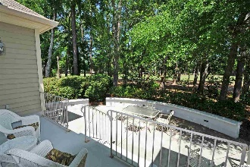
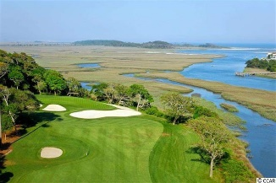
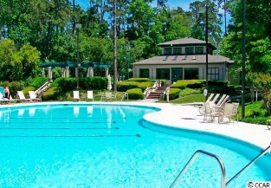
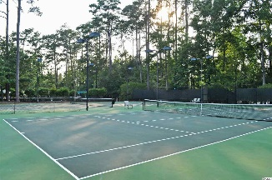
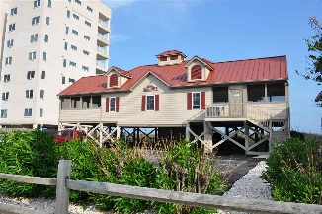


919 Tidewater Dr
Bluffs of Tidewater Plantation Resort
North Myrtle Beach SC 29582
MLS# 1911982 ~ $415,000
Walk to Bluffs private pool and amenities, including cabana, grilling area, bocce courts and horseshoes. The Bluffs pool is exclusive to residents of the Bluffs; however, they may use two other pools on the Plantation side. The Bluffs of Tidewater borders the Cherry Grove Inlet where the Atlantic Ocean rolls into the marsh. You can hear the ocean from both the front and back porches! No flooding issues ever! This remarkable home undoubtedly has the best of everything -- overall design, the integrity of fine upgrades, location and incomparable condition. The lot views the Bluffs pond from the front and walks easily to the Bluffs pool and amenities. There is a large Southern-style front porch with breezes and large overhead fans to enjoy those views and a multi-level back porch and deck with views of the signature second hole of world-class Tidewater Golf course and its indigenous natural surroundings. The main entry is a spacious driveway and over-sized side-load garage with separate rear entry to the well-manicured yard. Come on to the porch and find a beautiful front door to a wide, welcoming entry foyer opening to the heart of the home. The inviting breakfast room nook is to the left. Great for coffee, reading and catching up on morning emails. The kitchen may be accessed from the great living space or directly from the nook. The foyer affords a separate powder room with lovely stained-glass window for guests as well. So this home has 3 full and 1/2 baths, along with four nice-sized bedrooms, 3 of which are on the main level! We cannot forget the gathering-size formal dining room. Stately and beautiful but warm and inviting for families and for entertaining. Bring on the holidays! And, speaking of wonderful space, the living room is breathtaking with enhanced architectural detail, moldings, hardwood floors, and high style, yet comfortable and inviting; tall,16-ft.-ceilings, custom-framed gas fireplace and plantation shutters on upper transom-like windows bath that area in light and warmth. Subtle recessed lighting serves the living, dining, kitchen and master-bed rooms. The kitchen is equally top-notch. It features a 6-burner gas stove, double-wall oven, Travertine tile back-splash, and custom cabinets. You must linger there to enjoy the many more special touches...The laundry room with entry from the garage has the preferred back-entry pattern directly to the kitchen and has a sink and newer stainless steel washer/dryer. The bedrooms are in the also-preferred, split-bedroom configuration with the two guest rooms sharing a jack & jill bath and separate from the roomy master with ensuite which includes a large walk-in shower, his & her closets and with those views of the golf course and wildlife. It is private, charming and a perfect retreat. The upstairs bonus room is big and has lots of storage. It can be a fourth bedroom, office or family room & has another full bath. Tidewater is on an elevated peninsula of live oaks and southern pines between the ICW and the Cherry Grove Inlet to the Atlantic Ocean. The plantation also preserves the singular look of its own historic origins. It is minutes from the beach, shopping, medical services, entertainment and access to major highways. Amenities include the jewel in the crown, an oceanfront beach cabana on the Cherry Grove Beach for owners' use with open/screened porches, bathrooms, showers, and kitchen. In fact, the Cherry Grove Beach was just named one of the best in the nation! Plus, residents enjoy the use of several pools/hot tubs. Other amenities include a driving range, putting green, golf shop, clubhouse with bar/dining and event facilities, clay & hard-surface tennis courts, pickle ball court, fitness center overlooking a pool, the bocce courts and amenity center for events. Tidewater has a gated storage yard for boats, jet skis, motorcycles, and kayaks. Tidewater Resort reflects the best-of-everything, classic golf/beach lifestyle in safe, popular North Myrtle Beach.
Deborah Collins
843-424-9013
dctidewater@yahoo.com
Connie Ross-Karl
702-306-2643
conniesross@aol.com
NEW WAY PROPERTIES MYRTLE BEACH

