Slide 1
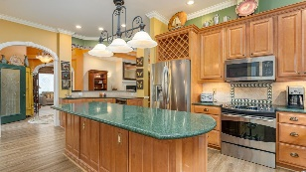
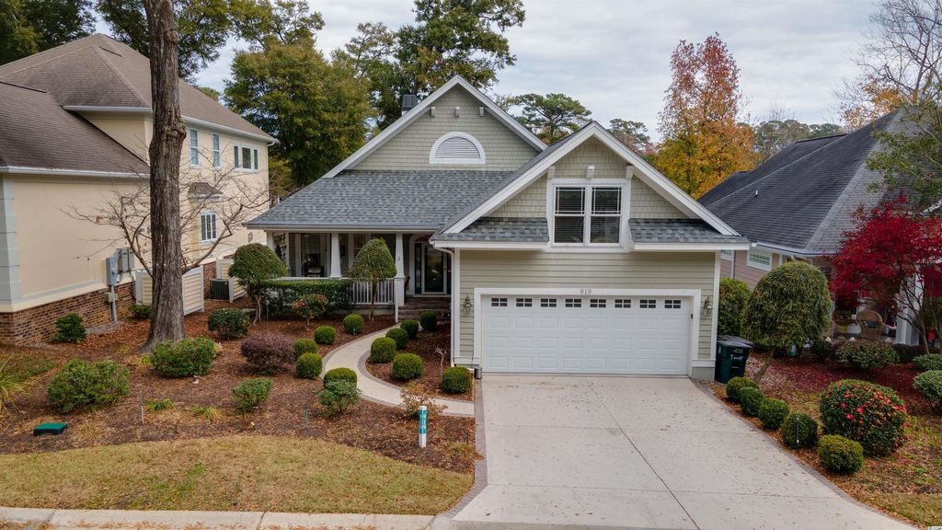
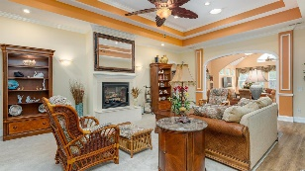
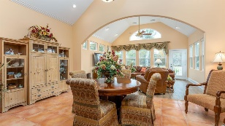
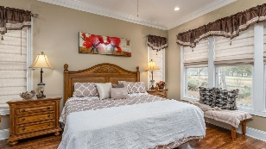
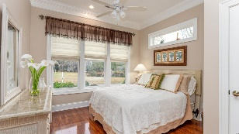
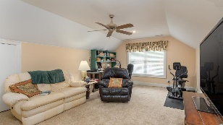
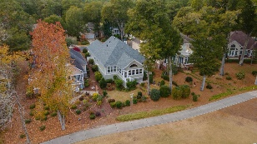
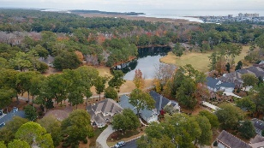
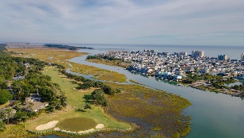
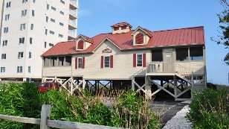



Rare, Custom-built Beauty With Great Golf Course & Lake Views!
919 Morrall Dr
The Bluffs of Tidewater Plantation | North Myrtle Beach SC 29582
MLS# 2127309 | $650,000
This rare, custom-built beauty enjoys clean and simple architecture with innate elegance and sophistication. This is a traditional Mediterranean-inspired home which has pleasing decor and is immaculately maintained inside and out, with some of the best golf-course and lake views in the area. Located on the signature 14th hole of world-class Tidewater Golf Course, this home is a best, too, of the prestigious Bluffs of Tidewater! Notice first how stately brick formally decorates the new drive, walk and porch, a subtle but important inclusion to its fine masonry work. The well-proportioned about quarter-acre lot has singular views of the fairway of the 14th hole and of the lake, stunning from the patio, sun room, second bedroom and the master ensuite. Speaking of bedrooms, it is a preferred split-bedroom floorplan; the two baths with walk-in showers are unforgettable! Prepare for more perfection, too! The entry is a true Southern front porch, wide and welcoming. Enter into a spacious foyer providing a panorama of the open, flex floor plan of the heart of the house. The great/living area is straight ahead, has high tray, vaulted and cathedral ceilings, tube lighting, an inviting fireplace, and custom built-in wet bar/breakfast bar with wine refrigerator, separating it from the grand kitchen – unbelievably spacious – much room for entertaining and for family gatherings. To the left is a charming half bath and cozy study/office with etched glass windows for light and beauty and an impressive dome ceiling treatment. Unique glass and lots of great architectural window and other features dominate this upscale beauty! To the right is a massive eat-in kitchen with gorgeous granite work island and a full cadre of stainless steel appliances. The utility room and ingress to the amazing over-sized 2-car garage with lots of storage and work shop are off the kitchen as are the steps to the upstairs bonus room which could be a 4th bedroom and which is currently being well used as an office. It is large and offers multiple uses. Roomy and even more unfinished storage space is also upstairs; marvel also at the impressive, perfectly maintained HVAC system close up. Returning to the main floor, go from the living room with fireplace to the dining area with cathedral ceiling and natural light from the new sun room, which steals the show with vaulted ceiling, lots of windows and the best, close-up lake views anywhere. There is outdoor storage underneath. And the outdoor landscaping is mature and with many pretty flowering bushes. Landscaping is also functional for optimum water drainage. There is even a whole house generator and so much more... But see it all for yourself soon. Virtual and real-time video walk-throughs offered of the home & of Tidewater which enjoys many upscale amenities, including owners' beach cabana on the Cherry Grove Beach, pools & spas, clay- & hard-surface tennis courts, pickle ball, bocce, horseshoes, amenities center, fitness center, driving range and putting green, 24-hour gated & manned security and clubhouse with bar & restaurants. There is even a complimentary gated storage yard for boats, campers, recreational vehicles and the like. The convenient HOA building has rooms for business and other meetings and events and a lending library. Tidewater itself is on a tree-lined road to oceanfront Anne Tilghman Boyce Coastal Reserve, a nature conservancy. It is minutes to the beach, shopping, dining, entertainment, medical services, outstanding schools & parks & access to major highways. It represents a lifestyle, to do as much as you desire or to just relax in the pristine surroundings. The jewel in the crown of the development is that private owners' beach cabana on the wide, white sand of Cherry Grove Beach, named the 11th best in the nation, in popular, safe North Myrtle Beach, a top-5 beach town in the U.S. The jewel in the crown of the Bluffs of Tidewater is this incomparable Mediterranean beauty. Welcome home!
Video Tour: https://youtu.be/BBWlp2H-Bw4
3D Virtual Tour: https://my.matterport.com/show/?m=GnNF1YAwG7i
Connie Ross-Karl
702-306-2643
conniesross@aol.com
Ronnie Nichols
Realtor / BIC
ronnienichols8@aol.com
NEW WAY PROPERTIES MYRTLE BEACH

