Slide 1
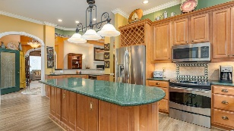
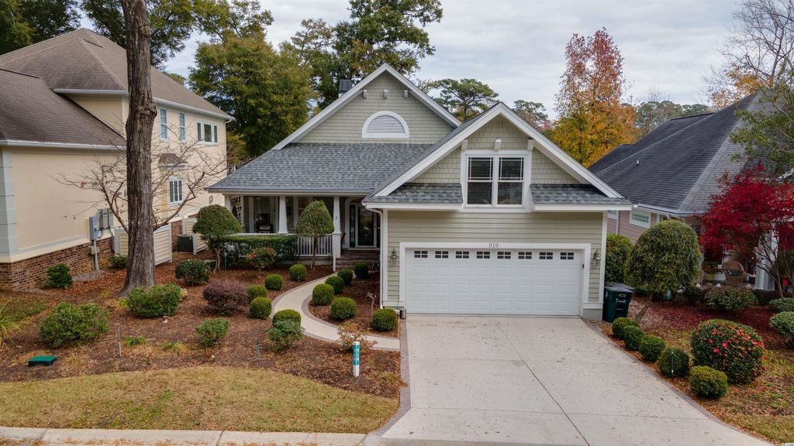
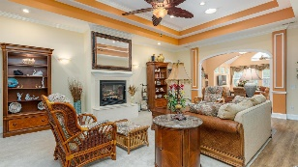
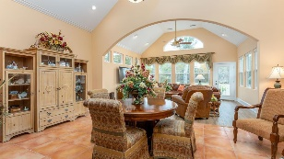
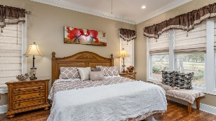
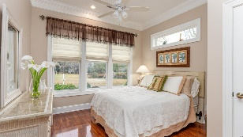
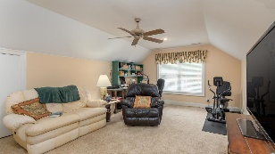
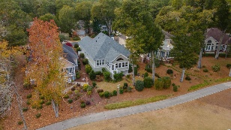
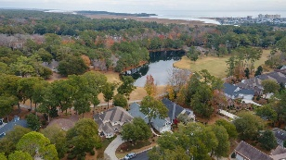
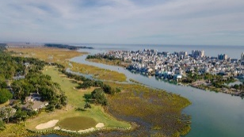
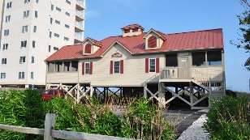



Beautiful, Traditional Luxury Home Immaculately Maintained With Incomparable Features And Upgrades!
919 Morrall Dr
The Bluffs of Tidewater Plantation | North Myrtle Beach SC 29582 MLS# 2127309 | $650,000
To fully appreciate the full scope of feature offerings in this one-of-a-kind, custom, completely upgraded home, see the list below. Please also note there is a top of the line home warranty and transferable termite bond, as well as plans available to buyer after closing. The jewel in the crown is the sophisticated and well maintained HVAC system, truly impressive!
Video Tour: https://youtu.be/BBWlp2H-Bw4
3D Virtual Tour: https://my.matterport.com/show/?m=GnNF1YAwG7i
UPGRADES
• New 35 year roof - 2021
• Generac Generator/whole house - 10 year contract, transferable
• Separate Mitsubishi heatsystem for bonus room and garage
• New 3 year old back Sunroom with hurricane windows and storage below
• High tech nylon fabric storm panels for back bedrooms and Corrugated polycarbonate
shutters for rest of house
• Manicured backyard with sprinklers and view of lake
• Sprinklers on cart path for grasses to prevent erosion
• Water containment system for roof out to lake
• All gutters with Gutter Helmet Leaf Guards
• Coated driveway with brick border and slate porch by VersaCover
• Double insulated garage walls and door
• Walk up attic - fully floored with 4 large lights
• Double insulated attic ceiling with closing vent doors
• Attic rafter insulated with 3/8 space foil insulation
• New vinyl waterproof plank wood flooring throughout and new carpet
• Pergo vinyl flooring in bedrooms
• Two Solar tubes in great room
• Ethched Glass Front door and sidelights and office
• Two Rennai Insta Water Heaters, cleaned 10/19 with outdoor drains
• In-Ground filtration water filter installed 2020, front of house with 15 year filter
• Replaced driveway apron with steel reinforced concrete
• Built-ins in 3rd bedroom, easily removed, all trim intact
• Bath #2 redone 2019
• Master bath redone 6 yrs ago
• Ceiling fans in all rooms
• Bar sink & wine cooler - 1 year old
• Two propane 250 gallon tanks, rented yearly from AmeriGas
• Automatic exterior light for front entry
• Upgraded foyer fixture
• Upgraded larger fan & light in Great Room
• Upgraded Sun Room light and fan
• 3 feet of gravel bed around sides of house for fire prevention
• Upgraded HVAC 20 seer unit, 2012, new AC drain pan installed 11/21, Full
yearly maintenance contract includes parts & labor & yearly maintenance paid
on 11/15/2021 includes Special ultra-violet light to kill germs and humidifier
• New exhaust roof fans installed 5/2021
• Parging if all exterior lower walls
• House repainted in 2015
Connie Ross-Karl
702-306-2643
conniesross@aol.com
Ronnie Nichols
Realtor / BIC
ronnienichols8@aol.com
NEW WAY PROPERTIES MYRTLE BEACH

