Slide 1
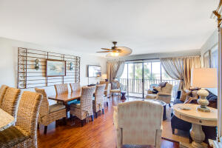
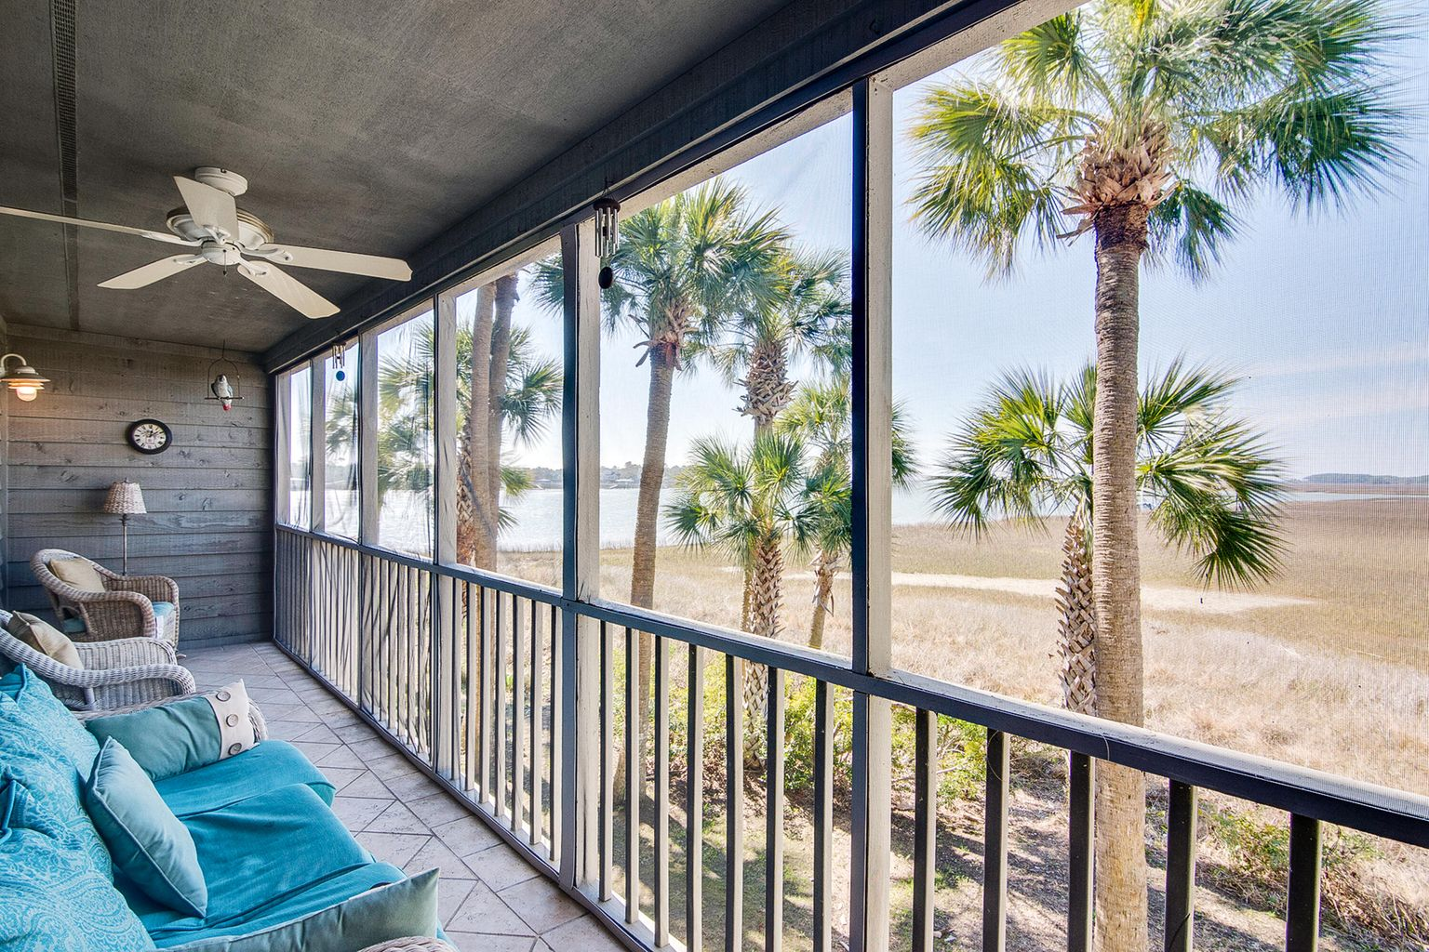
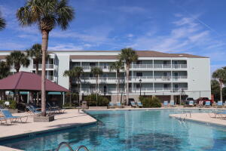
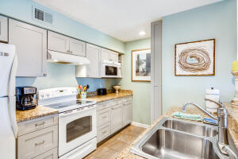
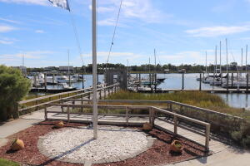
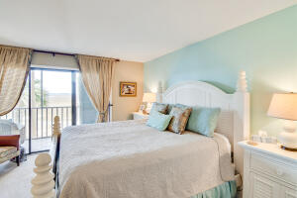
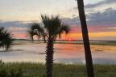


JUST LISTED Breathtaking Marshfront Condo in Folly Beach
91 Mariners Cay Drive
Mariners Cay | Folly Beach, SC 29439
MLS# 21028395 | $542,500
Welcome to "Sunset Heaven", where the unobstructed 180 degree views of Folly River and Folly Creek provide the most awe inspiring sunset views. Rarely is there an opportunity to get into the Sunset Building at Mariners Cay, a gated resort style community at popular Folly Beach. The current owners patiently waited three years to get into the Sunset Building, and are only selling their "home away from home" because they purchased a permanent residence in nearby Charleston. If you have dreamed of your own deep water boat slip just outside your door, the current owners may consider selling theirs. The unit is perfectly perched to allow its residents the most serene views of two rivers, an expansive marsh, the adjacent bird sanctuary and the ocean beyond. Kiawah Island can be seen in the distance. It also is the only building in Mariners Cay with an elevator and all of the units are one story flats. Residents can access the first floor property via elevator or stairs for maximum flexibility. Upon entering the home, you will be impressed with the renovations completed by the current owners. New wood flooring throughout the main living areas are not only beautiful but easy to maintain. The kitchen has been updated with new cabinets and granite countertops. All appliances will convey including the stackable washer dryer duo. Both bathrooms have been renovated with stunning designer selections. The coastal color palate is soothing to the soul. This unit is perfect for entertaining and was designed to maximize your enjoyment of magnificent views. Whether you are in your kitchen washing dishes, siting with guests in the family room, relaxing in the master bedroom or sitting on the screened-in porch you will be able to take in the views and watch the tides roll in and out! The porch runs the entire width of the one story unit with access from both the main living area and the master bedroom. This will surely be your favorite spot - at high tide you will feel like you are floating on top of the water and at both low and high tide, you can take in the sights of a variety of birds enjoying the lively marsh. Whether drinking your morning coffee or watching the sunset on the porch, dolphins can be easily spotted frolicking in the Folly River. Should you desire to leave your serene piece of paradise, you can swim and sunbathe at the beautiful community pool, play tennis, or walk along the docks (perfect for fishing and crabbing) at the marina in Mariner's Cay. There is a boat launch in the community for residents' use and a club house as well. Take a 5 minute walk over the Folly River and let the fun start at the numerous hot spots along Center Street. Better yet, hop on your bike and pedal to the beach or Historic Morris Lighthouse only moments away! Historic Downtown Charleston is a mere 15-20 minute drive as well. The gated community of Mariners Cay provides resort style living perfect for a primary residence or vacation home for its fortunate new owners.
Ellen O'Neil
Broker/Owner, ABR, e-PRO, CNE
Charleston Realtor of Distinction
(843) 300-8530
www.EllenONeilProperties.com

