Slide 1
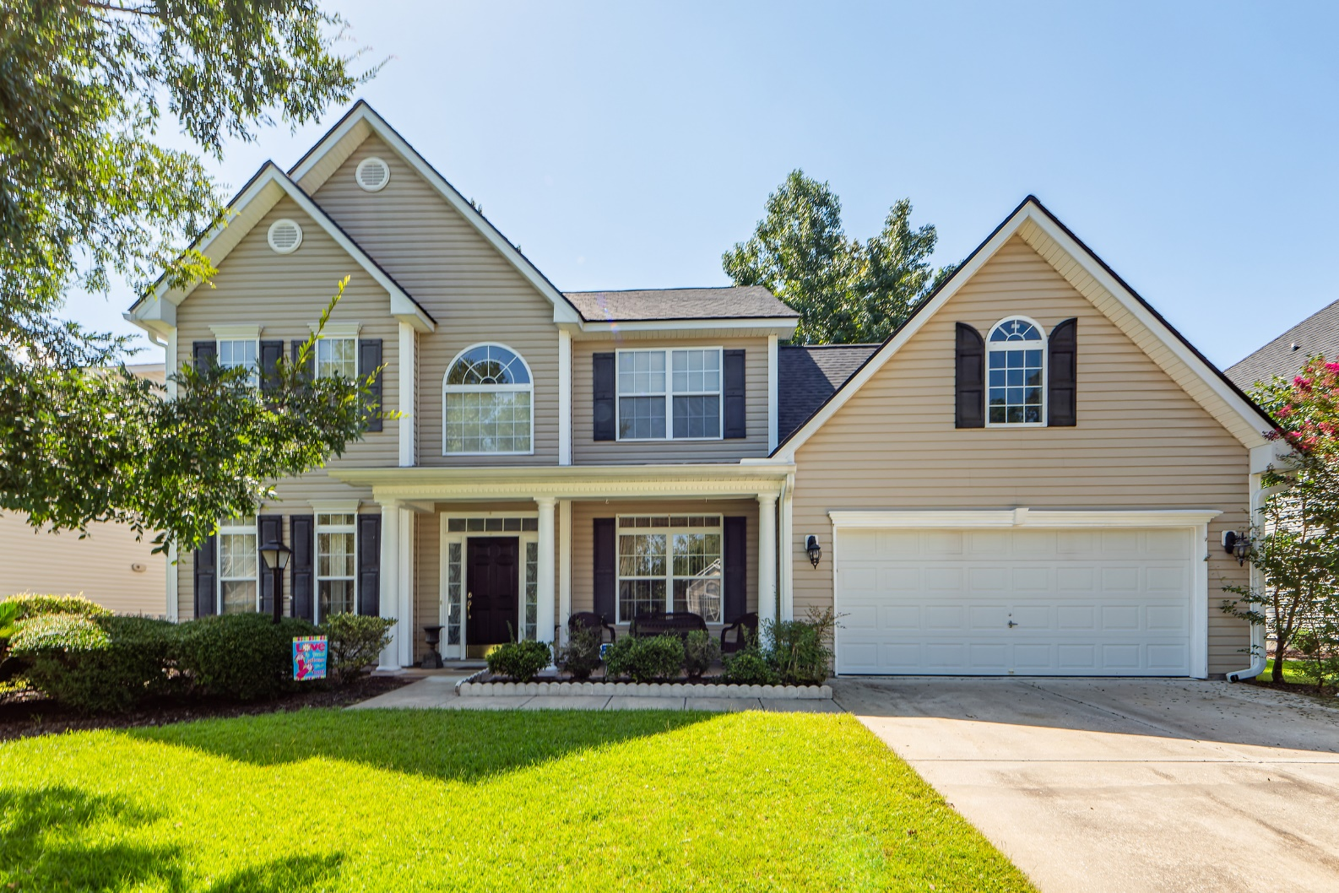
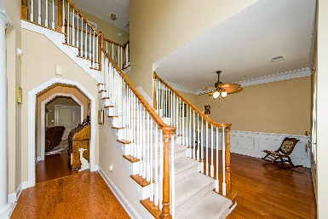
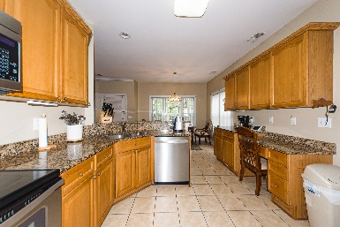
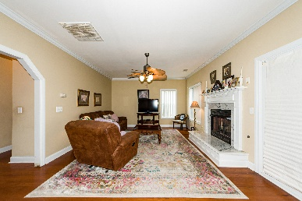
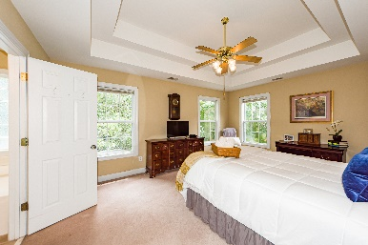
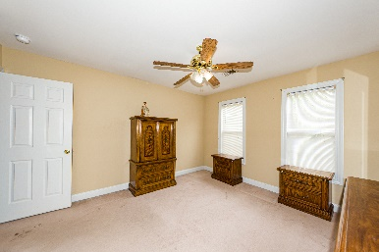
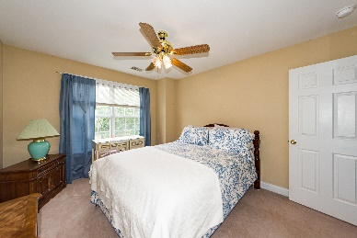
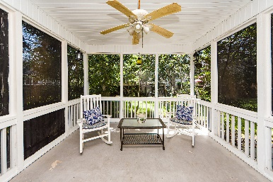
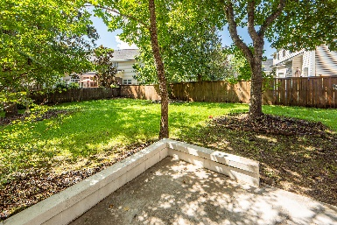


9209 Markleys Grove Boulevard Summerville, SC 29485 | MLS# 22020011 | $400,000
$35K Price Reduction Wescott 4BR/2.5BA
$1,000 Buyer's Agent Bonus
For Ratified Contract That Can Close By 9/27/2019
Seller is ready to move and will also consider a 2% closing cost contribution for a buyer. *** Welcome Home - 4BR/2.5BA traditional 2story home in Wescott. Columns adorn the formal living room, and wainscoting adorns the dining rm. There is crown moulding throughout most of the downstairs living area. The family room is spacious & welcoming & has a raised hearth gas fireplace. There's plenty of room for entertaining guests & family. The kitchen features a sunny breakfast area, a breakfast bar, ample cabinets, granite countertops, a built-in desk, a pantry, built-in microwave, & an extra quiet dishwasher. Upstairs, the owner's suite features a double tray ceiling, remote controlled ceiling fan and an upgraded bath with dual vanities, garden tub, separate shower, water closet, block window for light and privacy, & a large walk-in. There are 2 nicely sized secondary bedrooms upstairs with ceiling fans and plenty of closet space. The 4th bedroom is a tremendous bonus room (w/ closet). This room could also be used as a media room, playroom, office, workout room, etc. All baths have ceramic tile floors. The laundry room is conveniently located upstairs. This home has tremendous storage -- the owner installed pull down stairs and floored and insulated a 10' x 18' storage area with carpet and shelving over the garage. The garage also features garage door opener, a storage room, a work bench, and additional built-in shelving. The over-sized 12 x 16 ft. screen-in-porch extends the living space inside to the outside, and overlooks the spacious, beautifully shaded back yard. The 10 x 10 patio is bordered by a bricked-in seating area, and the yard is fully fenced-in. The roof was just replaced last year. The HVAC was replaced in 2015, and is serviced annually. The seller installed brand new 2" faux wood blinds in the formal living room & dining room in October. The home is protected by a transferable termite bond. Wescott Plantation features sidewalks, a neighborhood pool, playgrounds, a public golf course and clubhouse with restaurant, and is conveniently located close to Joint Base Charleston, Palmetto Commerce Parkway, Bosch, shopping, restaurants, and I-26. This home is also located in the much sought after, highly acclaimed, award winning Dorchester District II school district. Bonus! :) MacLauren Floor Plan. Don't miss your opportunity to own this beauty - schedule a showing today!
Take a Virtual Tour: https://www.charlestonvirtualhomes.com/2220310/
Tammy Thompson
843-412-1856
tammylthompson@live.com
https://www.coldwellbankerhomes.com/
Coldwell Banker Realty | 4969 Centre Pointe Dr. Ste 103 | Charleston, SC 29418

