Slide 1
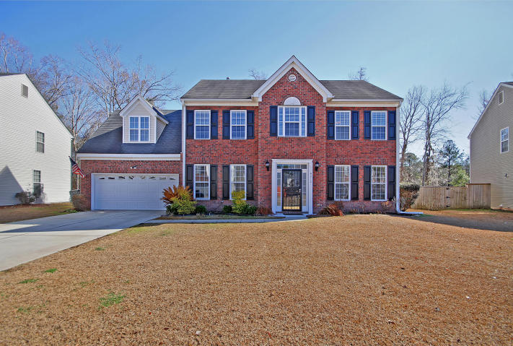
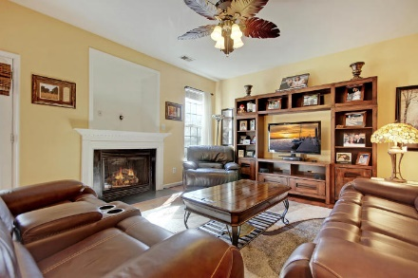
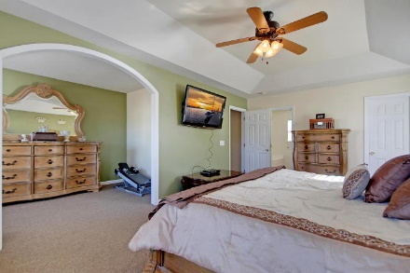
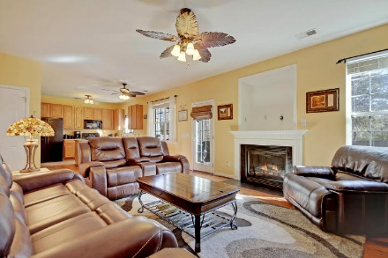
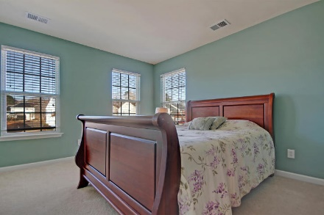
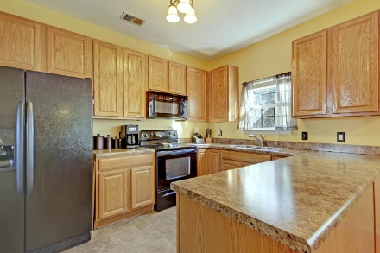
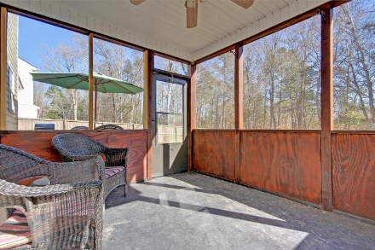
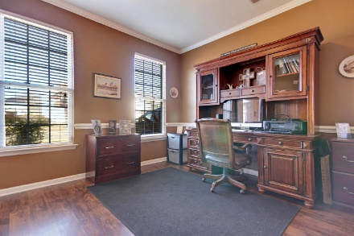
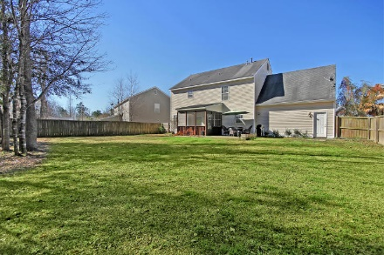
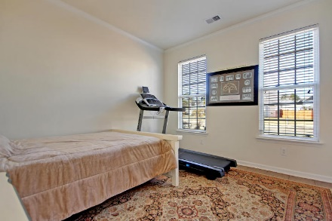
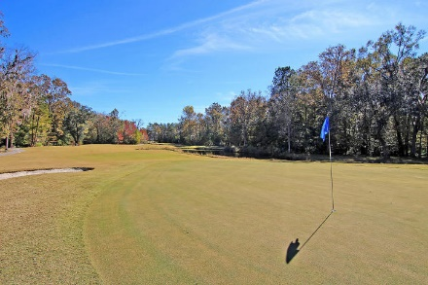
Price Reduced!
Open House ~ March 3rd From 2-4!
9212 N Moreto Circle
Wescott Plantation ~ Summerville, SC 29485 ~ MLS# 18002863 ~ $274,900
NEW HOT WATER HEATER!
PRICED TO SELL!
Peacefully situated in the gorgeous golf community of Wescott Plantation, this two story brick front home is one you don’t want to miss! After a day on the links or sitting poolside at the community pool or playing at the playground, you can kick back and relax with some drinks on the screened-in porch that looks out to the huge, fenced-in backyard. Then let the sound of the crackling fireplace sooth you as you prepare dinner, and the open floorplan allows you to converse with guests in the family room and eat-in area. Every night you get to retreat to the master suite oasis with its spacious sitting area, en-suite full bath and walk-in closet. The FROG is an amazing additional space that you can use as another bedroom, media room, playroom or whatever space you need! Come by today!
Additional features include:
All new flooring on the first level
French doors lead to the formal living room
Great location close to Boeing, airport, shopping, dining, 26 and 526
Book your showing today!
Chip Walsh chip@mattoneillteam.com 843-822-4663

