Slide 1
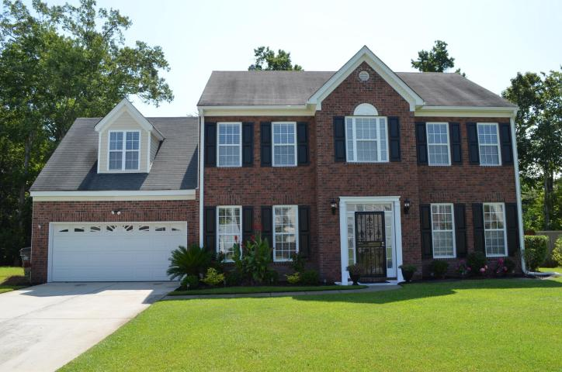
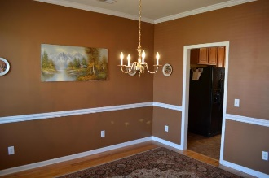
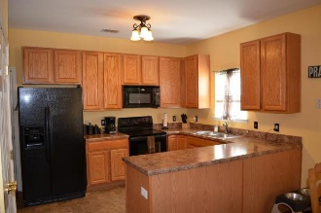
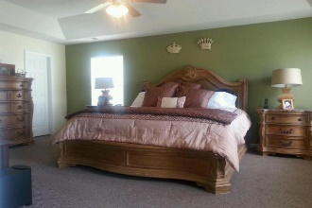
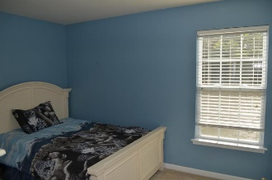
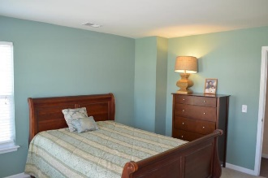
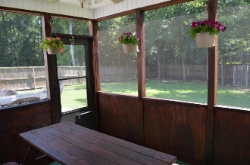
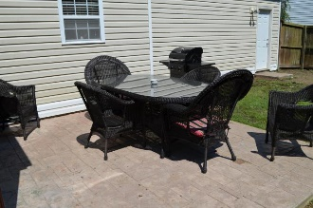
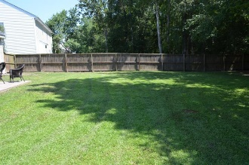
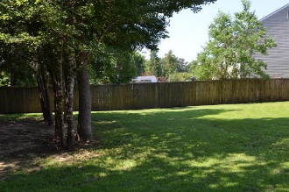
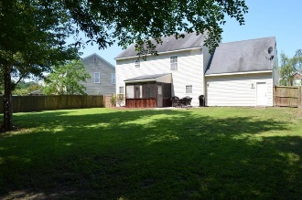

Just Listed!
9212 N Moreto Circle
Wescott Plantation
Summerville, SC 29485
MLS# 16019929
$265,000
Welcome to this meticulously cared for home in desirable Ashley Ridge section of desirable Wescott Plantation. From the moment you enter this home, you will feel the "newness" of this home as the current owner just had a home inspection done on this property and fixed or replaced everything on the list! From brand new birch hardwood floors, brand new garage door, new lighting throughout, new smoke and alarm system and all freshly painted. Also, new Italian tile in entrance way and office. Brand new tile in half bath and kitchen that resembles the look of ceramic tile. Wonderful berber carpet throughout the hallway and stairs to the second floor. The extra large Master is upstairs and comes complete with a sitting or workout area along with a large walk-in closet. The oversized Master Bath comes complete with stand-up shower and separate large soaking tub. The additional bedrooms are also located upstairs and the furnished room over garage is a large additional room that could be a great man-cave, a she-room, or teenage retreat!
The beautiful kitchen comes with an oversized pantry, new formica countertops and is the ideal entertainers kitchen, as it is open to the rest of the downstairs allowing for guests to flow freely from the breakfast area, living area (complete with a beautiful, gas log fireplace) or the dining area. Off of the kitchen is a backdoor that opens up to a screened porch that has been newly stained and a new ceiling fan has been installed. The screen door opens to a huge backyard that offers a parklike setting and a separate area ideal for bringing guests out to a fire pit, or some nice outdoor furniture to overlook your beautiful private backyard complete with privacy fence. This home will NOT last long so schedule your showing of this pristine home today located on 1/4 mile from schools, Lowe's, and Harris Teeter shopping center!!!
Wendy Deitsch
O - (843) 491-1445
M - (843) 270-0433
wendy@lifetreeliving.com
LifeTree Real Estate, LLC
3094 Hwy 17 North
Mt. Pleasant, SC 29466
www.lifetreerealestate.com

