Slide 1
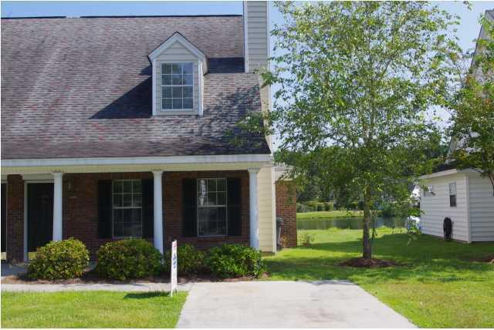
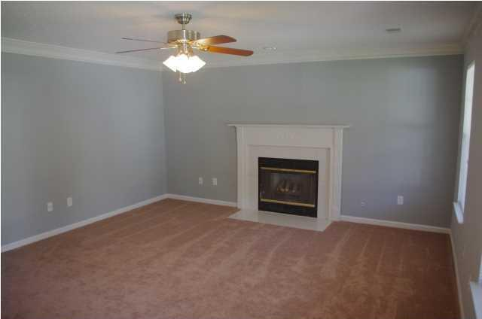
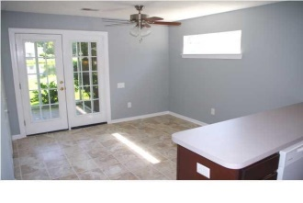
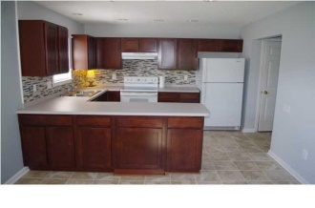
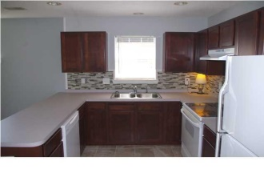
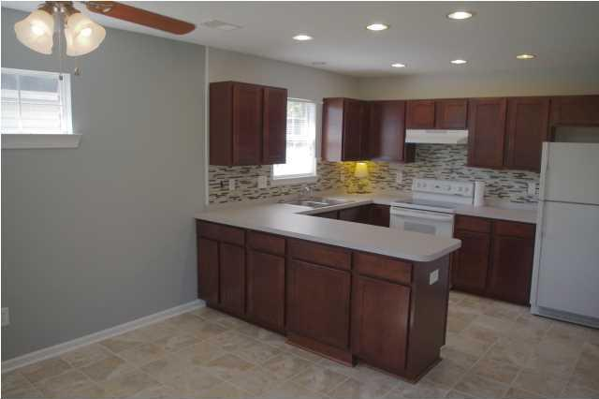
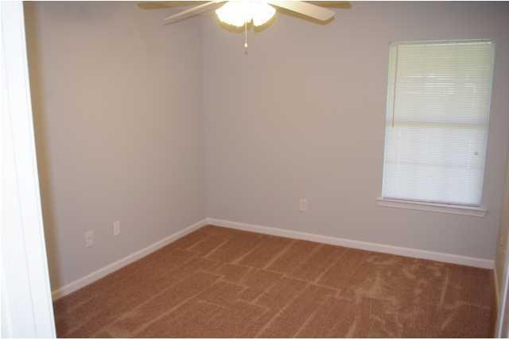
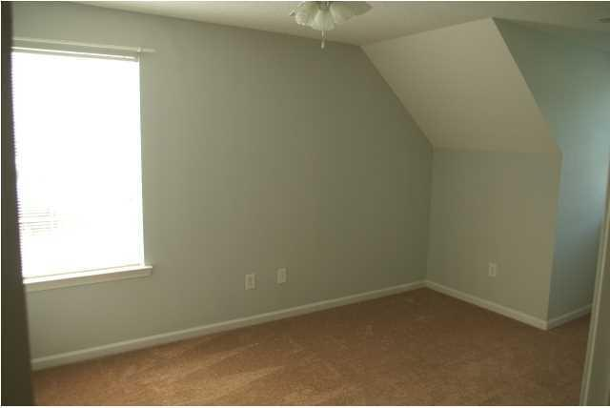
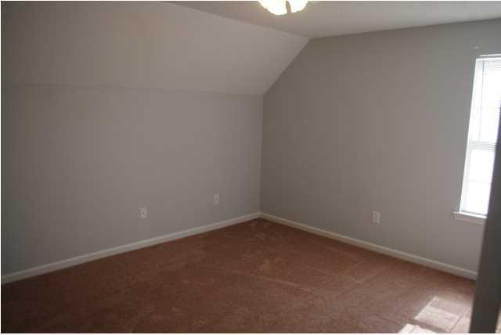
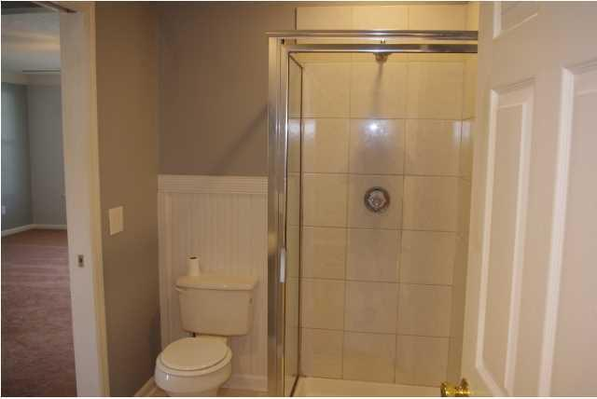
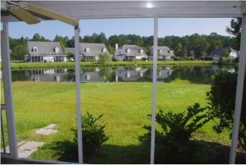

9239 Ayscough Dr Wescott Plantation Summerville, SC MLS# 1422472 $126,400 3 Bedrooms | 2 Baths | 1,450 sf
Open House Lunch ~ Friday, Oct 3 from 11 - 1
Handyman Special… Bring your hard hats!
Must See To Appreciate!
Great investment property potential. This home sports a full front porch and backs up to a pond with a fountain. Owner has fully renovated just about everything! Home was sold at $130,000 and seller has put in another $16,000 in beautiful renovations. Brand new Stain master carpet with high end pet pad throughout the home. The completely overhauled kitchen is amazing... New upgraded cabinets, new counter tops, new glass tile back splash, new appliances will astound you in the nice/bright kitchen and eat-in area. Entire home has been tastefully painted with designer colors. Enjoy lazy evenings in the cold weather by the wonderful gas log fireplace. There is a full bedroom and bathroom on the first floor. The master suite is airy, sunny and features a walk-in closet, bath with soaking tub and shower stall. The second bedroom upstairs is a good size. There is ample storage in this home and no wasted space. The AC unit has been serviced faithfully and the compressor was replaced 2 years ago. Wescott is a great community with walking/biking trails, golf, great schools and a pool. Going to go fast!
Hillary Jones
843-709-4666 hillaryjones67@gmail.com www.agentownedrealty.com
AgentOwned Realty Co. Preferred Group, Inc. | 824 Johnnie Dodds Blvd | Mt Pleasant, SC 29464

