Slide 1
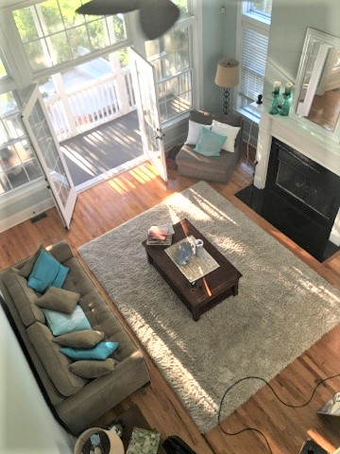
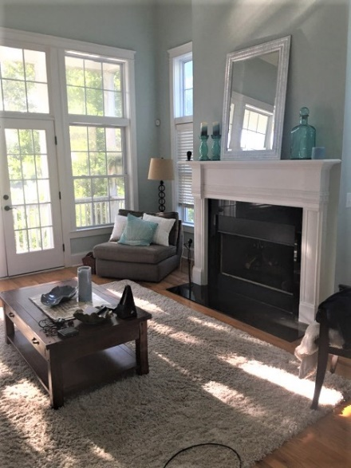
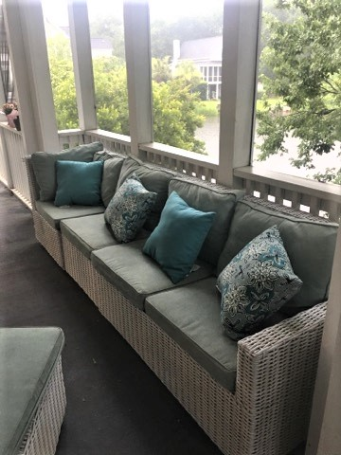
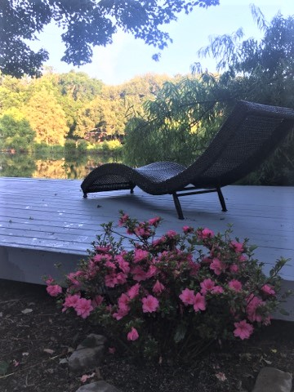


Coming Friday June 22!
923 Misty Lake
Lakeside Village ~ Charleston, SC 29412
Features
Move-in ready with all inclusive appliances including the washer/dryer/refrigerator as well as the gas stove/dishwasher/garbage disposal/built-in microwave
4 bedrooms/3 baths
Front porch, screened-in back porch, Master bedroom porch, lakeside deck
Granite counter tops in the Kitchen
Soaring Family Room ceiling
Custom mantle and gas fireplace
Year Built 2007
Elevated construction with garage parking for 3-4 cars
Cement Plank siding
Large Laundry room
Great price for this spacious home
Hardwood floors and new carpeting
42" kitchen cabinets, built in microwave
Screen Back Porch Living, Lakeside Deck Entertaining!
Harborview Elementary Public School District
10 minutes to Folly Beach
Wall of Windows overlooking the back porch to the Lake
Tucked away amongst trees and shrouded in morning mist
Uniqueness of a quiet, hidden lake 10 minutes from Historic Charleston
Stunning lake views
Kay Kennerty
MBA, ABR, CRS, GRI
843-345-5011
KKennerty@aol.com
www.KayKennertyHomes.com
The AgentOwned Realty Company
824 Johnnie Dodds Blvd, Mt. Pleasant, SC 29464

