Slide 1
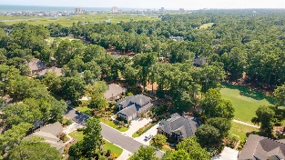
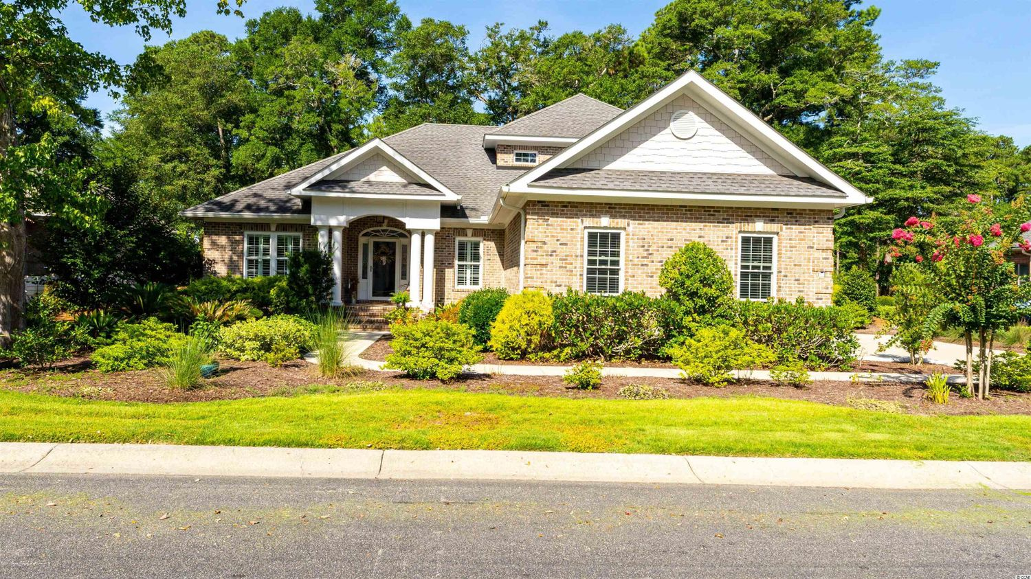
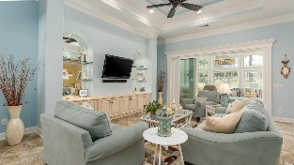
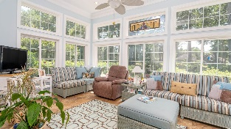
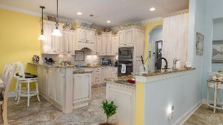
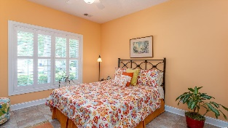
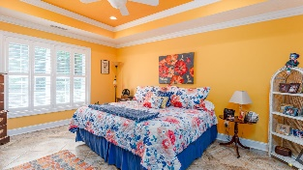
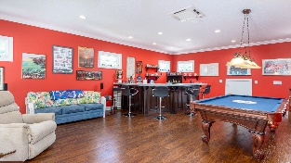
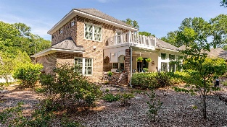
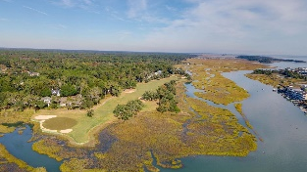
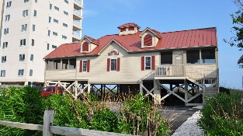



PERFECT! FROM THE FIRST IMPRESSION TO THE UNBELIEVBLE PRICE!
924 Heshbon Dr
Tidewater Plantation | North Myrtle Beach SC 29582 | MLS# 2222612 | $699,000
Perfect! From the first impression of the beautiful mature landscaping and stunning golf-course views to the welcoming stately front porch and entry foyer, this large, custom-built beauty has it all. It is all brick with a side-load larger two-car garage; even the driveway is custom, and a pretty path leads to the backyard with a big outdoor kitchen in a private courtyard. Along the way is a wonderful surprise, an outdoor shower, perfect for sandy grandchildren or to cool off from a neighborhood jog. If you look up, a super-sized second-story porch invites further curiosity to go inside! There are 3 spacious bedrooms, a dedicated study, an inclusive great room-dining-kitchen combo, and 2 and a half well-planned baths. Ask about remarkable features throughout... perfect, too. And there is a quintessential southern Carolina room as a bonus! Off of the u-shaped upscale kitchen is the entrance to the garage and laundry room with a walk-in pantry along a private hallway to the very spacious master suite with lots of closet space and even a magnificent walk-in shower. Nice-sized guest rooms are in the popular split-bedroom floodplain with a jack 'n Jill-guest bath. There is impressive architectural detail, tray ceilings, arches inside and out, and wonderful windows. Note especially the remarkable luxury granite. Notable also is the perfect, huge bonus room being used as a recreation room upstairs that walks out on the enormous porch overlooking the entire expanse of the entire second hole of Tidewater Golf Course, just named the best golf course in the state! Perfect! In addition to golf and being in an ICW community near the beach, Tidewater boasts many other rich, upscale amenities, including owners' beach cabana on the Cherry Grove Beach named the 11th best in the nation, pools & spas, clay & hard-surface tennis courts, pickle ball, bocce, horseshoes, amenities center, fitness center, driving range and putting green, 24-hour gated manned security, and clubhouse with bar & restaurants. There is even a complimentary gated storage yard for boats, campers, recreational vehicles and the like. The on-site, convenient HOA building has rooms for business and other meetings and events and a lending library. There are many clubs and activities year round. In Tidewater, you can do it all, or just relax in the luxurious Tidewater lifestyle. The Bluffs of Tidewater is contiguous along the Cherry Grove Inlet where the Atlantic Ocean rolls into the marsh. This home, therefore, is highly sought after by the investor or primary or vacation home owner who desires to acquire an extraordinary golf/ICW/beach property at today's market price. Tidewater itself is on a tree-lined road to oceanfront Anne Tilghman Boyce Coastal Reserve, a nature conservancy, including Waties Island, with access for managed recreational use. Tidewater, a historic plantation, is on an elevated peninsula of live oaks and southern pines between the Intracoatal Waterway and the Cherry Grove Inlet to the Atlantic Ocean. The plantation also preserves the unique look of its own origins. It is close to the beach, shopping, entertainment, medical services, outstanding schools and parks and access to major highways. The jewel in the crown of the development is that private owners' beach cabana on the wide, white sands of the Cherry Grove Beach, just a few minutes drive. Be sure to ask for the list of amazing features including a whole-house stationed generator and a remarkable garage that lives like another roon. This charming, livable and really fun home also enjoys a lovely, indigenous peaceful environment, along with the excellent reputation of the Tidewater Golf Course, the Pebble Beach of the East. Tidewater Plantation, in one of the U. S.' s top-5 beach towns, North Myrtle Beach, truly reflects a "way of life." Do not let this versatile, immaculate home get away. Welcome to the the best of the beach. Select furniture may convey, too. Did we say PERFECT? Even the price. Yes!
Video Tour: https://youtu.be/Z4nBgOB_Lks
3D Virtual Tour: https://my.matterport.com/show/?m=h2W6a6hByut
Connie Ross-Karl
702-306-2643
conniesross@aol.com
Ronnie Nichols
Realtor / BIC
ronnienichols8@aol.com
NEW WAY PROPERTIES MYRTLE BEACH

