Slide 1
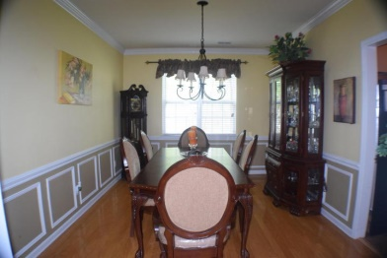
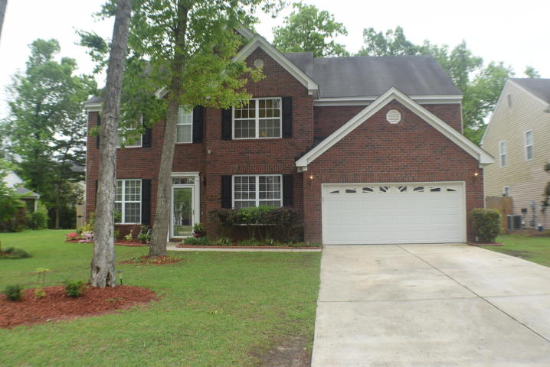
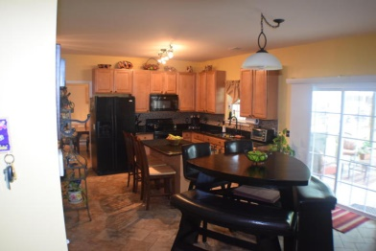
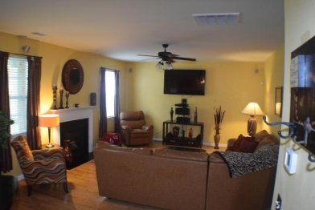
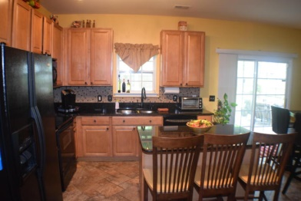
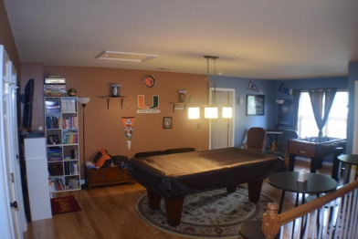
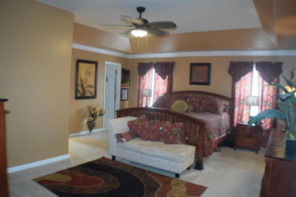
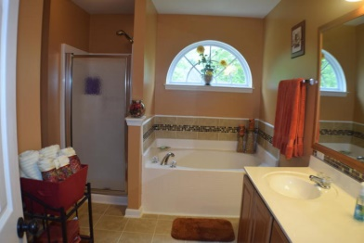
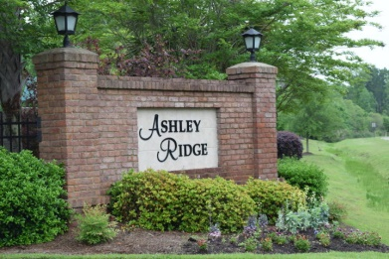

The entire interior of the home is freshly painted!
$2,500 Agent Bonus
for a contract that closes by August 30th
$500 Bonus
$1,000 Bonus
9257 N Moreto Circle
Wescott Plantation ~ Summerville ~ MLS# 15010069 ~ $279,900
Say hello to this absolutely, phenomenal five bedroom home with a huge loft. When you walk in the front door you are greeted by a 2 story foyer with gleaming hardwood flooring and double crown moulding that continues through the formal living and dining rooms. The family room has a gas fireplace and custom surround sound system for movie enjoyment. The family room is open to the kitchen that is ideal for any chef in the family. The upgraded kitchen includes granite countertops with backsplash, maple cabinets, extra deep sink with custom hardware, top of the line GE Profile dishwasher, and a glass-top electric range w/ built in microwave. The spacious master bedroom w/ tray ceiling is upstairs and is big enough for a sitting area. The master closet offers tons of space and the owners have installed a second closet in the master bedroom for him. The master bath includes separate shower, garden tub and double sinks. The owners use upstairs as their family rec room. So you have 3 additional bedrooms upstairs and a large loft that is great for entertaining. The backyard is a peaceful retreat. The privacy fenced backyard is a great place to relax and also enjoy the great 6-seater hot tub. While you are relaxing in the spa you can enjoy the outdoor sound system that is already wired. Take advantage of all the hard work these owners have put into this house. Don't let this one get away! Won't last long!
Corwyn J. Melette
Accredited Buyer Representative
(843) 364-3095
corwyn@corwynmelette.com
Exit Realty Lowcountry Group
3618 Ashley Phosphate Rd. #3
North Charleston, SC 29418
exitlowcountry.com

