Slide 1
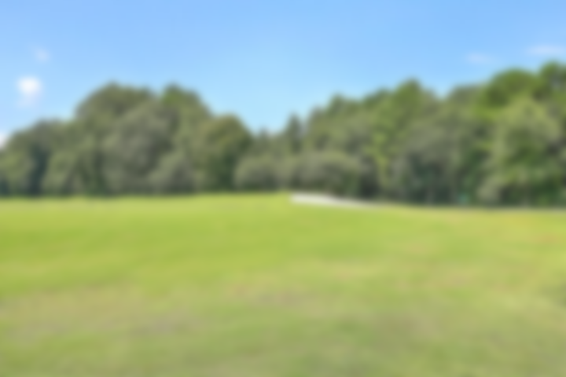
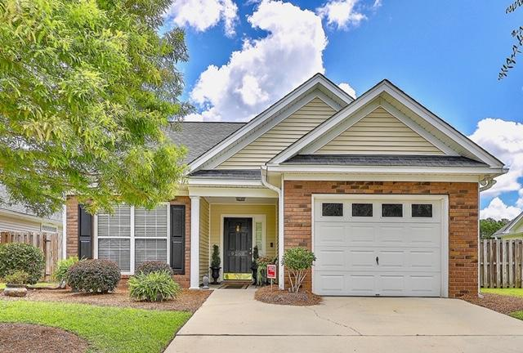
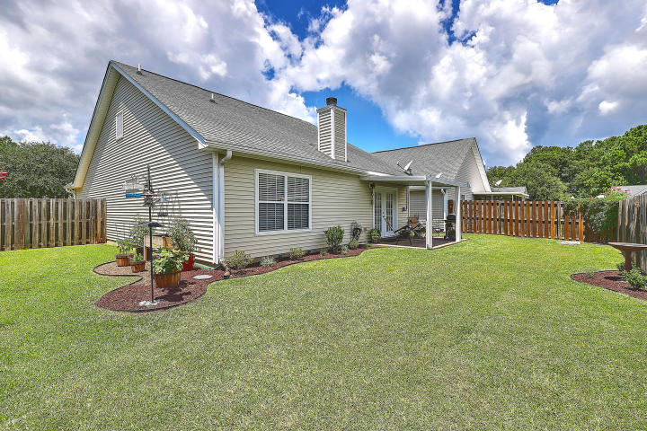
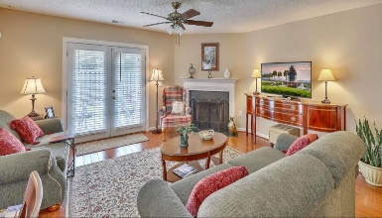
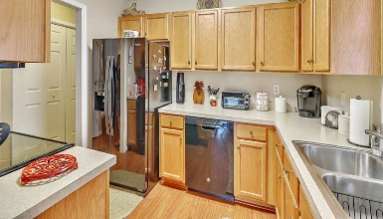
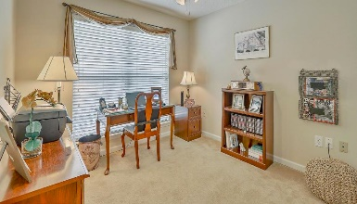
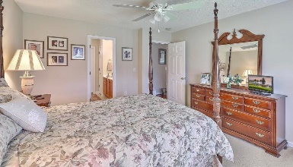
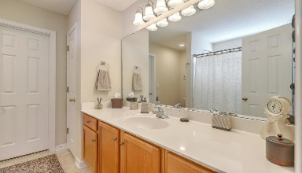
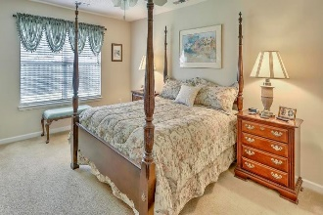
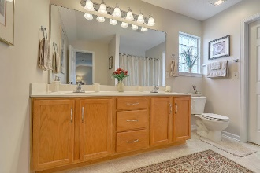
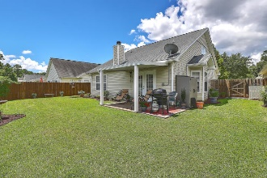

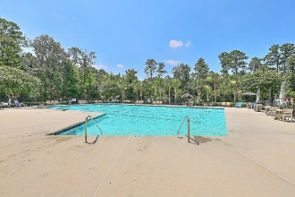


Dual Masters!
9267 Ayscough Road
Wescott Plantation | Summerville, SC 29485 | MLS# 20020270 | $254,500
Welcome to this Beautiful, well-maintained, inviting and unique ONE STORY & 1/2 home with DUAL MASTER BEDROOMS. Three Bedrooms and THREE FULL BATHS Total! This home is located in the highly desirable Wescott Plantation Golf Course Community!! This inviting cozy home sits on a beautifully landscaped homesite backing up to a large pond with a fountain. Located in the award-winning Dorchester District 2 school system. The wide front porch entrance is perfect for a bench and plenty of flowers. The wide foyer entrance leads you into bedroom #1 that can also be used as an office. This room has a closet, nice size windows, and plenty of natural light. The hallway includes tons of closet space to include a walk-in pantry & linen closet. The kitchen includes lots of cabinet space, electric range, microwave, and a dishwasher. Beautiful hardwood floors throughout the first floor add to the beauty of the home in the hallway, kitchen, and family room area. The kitchen opens up to a nice size eat- in kitchen area with a lovely bay window. The large family room area has an amazing feel of a traditional lowcountry home complete with a wood burning fireplace. Off of the family room are classic double French doors, both sides fully operable; & deadbolts for additional security! These doors welcome you to a newly built, garden-inspired covered backyard patio that has sufficient load-bearing capacity to withstand hurricane force winds! The backyard is a gardeners dream which is meticulously landscaped. A variety of plants are growing to use for your meals! This custom beautifully done patio overlooks a nice sized yard and fenced for plenty of privacy. The pond is a nice addition for extra privacy & serene living. Backyard has a nice-sized shed for storage and a generator inside that is used in case of power outage! This amazing extra feature is called a portable generator circuit. This system is wired into the home so you do not have to have wires running in through your doors if your power should go out ever during a storm, etc...! Both Owners Baths include Garden-tub/ shower combos. 2nd Owners bath located upstairs has a dual zoned heat pump unit for amazing temperature control! The impressively large master bedroom upstairs also has a large bathroom with a large walk in closet. Home also includes a security system. Walking distance to schools, neighborhood pools and parks, wonderful shopping and restaurants puts this home in the perfect area! Close to Mercedes-Benz Van works, Boeing, Charleston Air Base, Charleston International Airport and other multiple growing businesses. This super clean home has been well cared for. Enjoy the Amenities Center, which includes the large pool, playground, walking/jogging trails and more!!! Golf Memberships available to those interested. This house is a must-see!
Lane Gregory
843-737-1541
lanesellscharleston@gmail.com
The Boulevard Company, LLC
806 Johnnie Dodds Blvd Ste 100
Mt Pleasant, SC 29464

