Slide 1
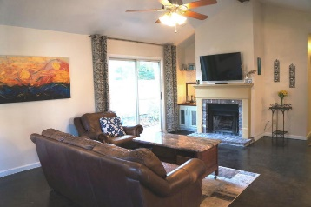
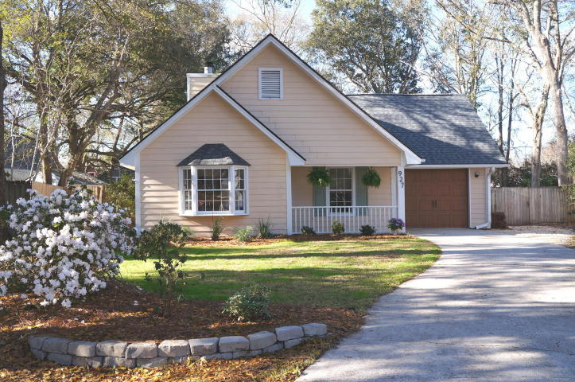
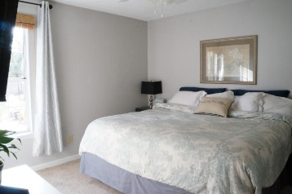
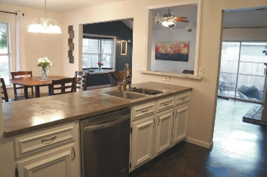
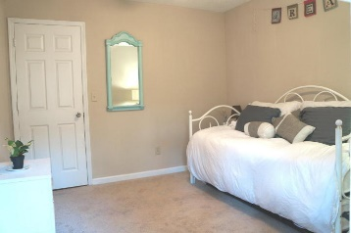
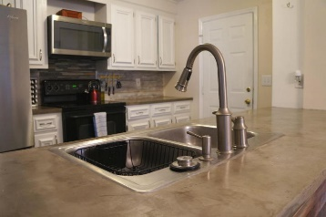
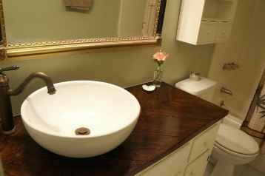
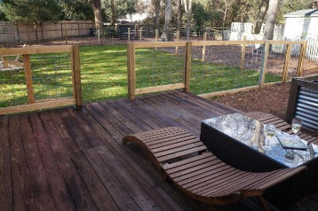
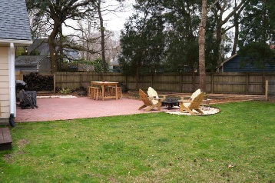


James Island Charmer
Price Reduced!
927 Billfish Court
Harbor Woods III ~ Charleston ~ MLS# 16004770 ~ $269,000
NEW TO MARKET well maintained James Island charmer. Nestled at the end of a quiet cul-de-sac in DESIRABLE HARBOR WOODS III (no HOA!). Minutes to the beach and downtown! Inside find an open concept with VAULTED CEILINGS, stained concrete floors, and practically new stainless steel appliances! Outside is the HUGE BACKYARD complete with PRIVATE GARDEN AREA, an OVERSIZED BRICK PATIO, separate fenced dog area and raised WOODEN DECK. On ALMOST 1/3 ACRE it is a fantastic yard for pets, kids, and entertaining! Mature oak trees dot the perimeter along with a 6' PRIVACY FENCE. NO FLOOD INSURANCE required here! EXCELLENT SCHOOLS nearby: Stiles Point Elementary, James Island Middle, and James Island Charter High. NEW HVAC and ROOF installed in 2014!!
Dream home for someone with large dogs and/or kids who still desires a nice home! Concrete floors are nearly indestructible and completely mess proof (also great if you have allergies.) Separate dog area allows little Jimmy to play on the lush green lawn without fear of being knocked over.
Walking distance to the high school and public soccer fields. Less than a mile to the closest grocery store, 15 minutes (7 miles) to the beach and 10 minutes to downtown Charleston.
Come see this dream of a home today--it won't last long!
Appliances may convey with acceptable offer.
Listing agent is owner.
Melissa Lukas
(843) 408-3851
realtormelissasc@gmail.com
ERA Wilder Realty, 125-F Wappoo Creek Dr, Charleston, SC 29412

