Slide 1
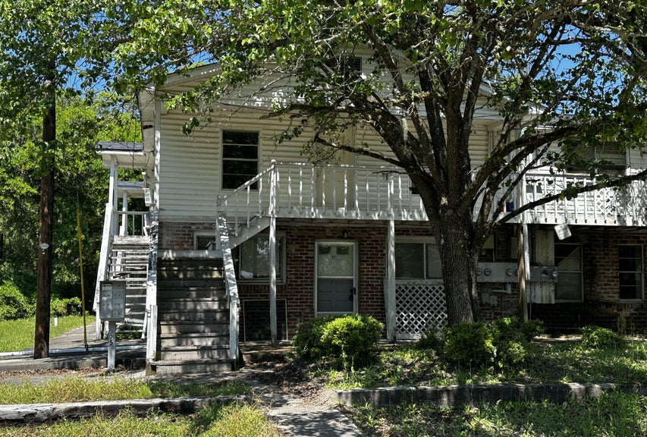
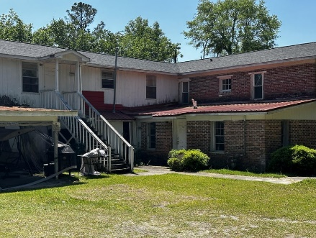
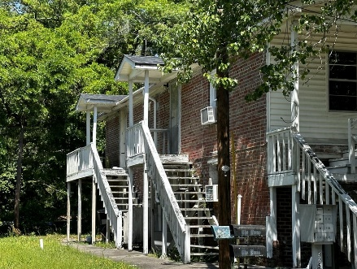
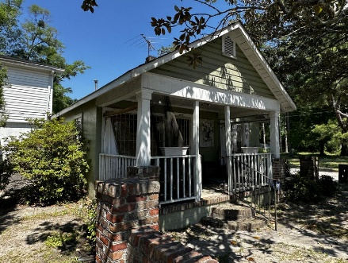
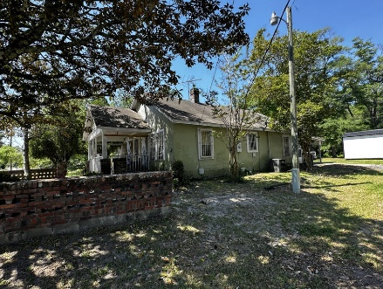



~ Handyman Special ~
8-Unit Multifamily Property
927 N Lemacks Street
Walterboro, SC 29488
MLS# 24025397
$450,000
Unit 1: Bedrooms: 1; Baths: 1
Unit 2: Bedrooms: 1; Baths: 1
Unit 3: Bedrooms: 1; Baths: 1
Unit 4: Bedrooms: 1; Baths: 1
Unlock the potential of this unique investment property in the heart of Walterboro, SC! Total of 8 units! This opportunity offers 7 one-bedroom, one-bathroom units under one roof, perfect for rental income or a multi-family project. The building features a brand-new roof as of 2023, saving you a major expense while you focus on interior renovations. In addition to the multi-unit building, this parcel includes a separate 2-bedroom, 1-bathroom single-family home with its own address. The home also needs some TLC, making this a fantastic opportunity for investors looking to customize or flip. Sitting on a half-acre parcel, you have endless possibilities to maximize your return on investment. Take advantage of this rare opportunity to own an income-producing property in a growing area
Nick Mazzilli
843-640-5575
nick@themazzilliteam.com
nickmavencharleston.com
Maven Realty
2180 McMillan Ave
#71672
Charleston, SC 29405

