Slide 1
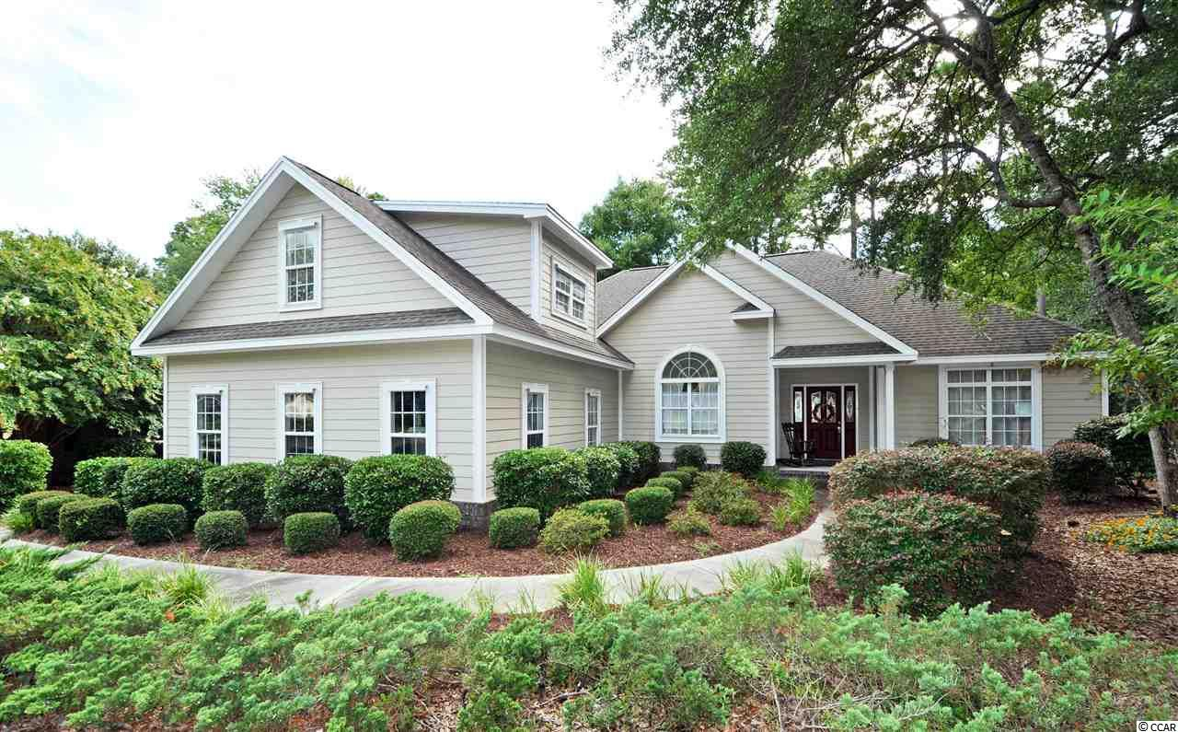
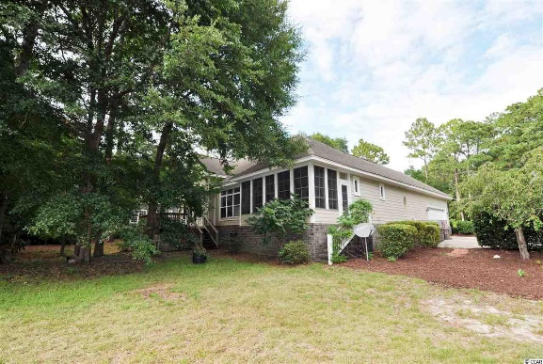
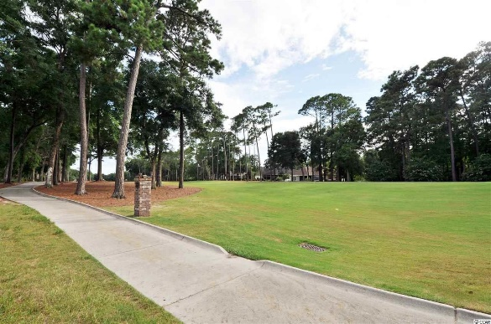
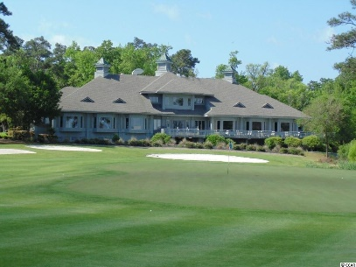
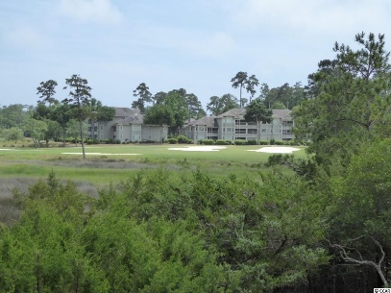
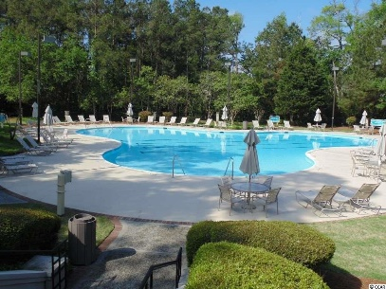
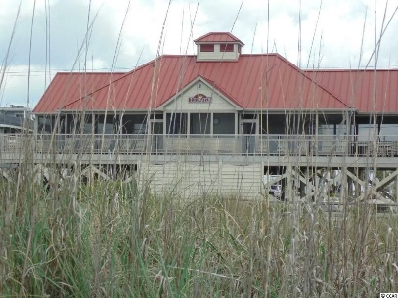


Big Family Home in Tidewater on the Golf Course!!
928 Heshbon Dr
North Myrtle Beach, SC 29582 ~ MLS# 1917018 ~ $389,900
Walk to Bluffs private pool and amenities, including cabana, grilling area, bocce courts and horseshoes. The Bluffs pool is exclusive to residents of the Bluffs; however, they may use two other pools on the Plantation side. The Bluffs of Tidewater borders the Cherry Grove Inlet where the Atlantic Ocean rolls into the marsh. You can hear the ocean from this distinctive property, but there are NO flooding issues...ever! This remarkable home undoubtedly has the best of everything -- overall design, the integrity of fine upgrades and location. The lot views the 11th hole from the front porch and the fairway of the signature 2nd hole of world-class Tidewater Golf Course and its indigenous natural surroundings from the Carolina room and the back views from the home. The main front entry is a spacious driveway and over-sized side-load garage with separate rear entry to the well-manicured, mature-landscaped yard. Come in to the porch and find the inviting front door to a wide, welcoming entry foyer opening to the heart of the home. This home has 3 full and 1/2 baths, along with three - four nice-sized bedrooms, 3 of which are on the main level! We cannot forget the gathering-size formal dining room...stately and beautiful but warm and inviting for families and for entertaining. Bring on the holidays! And, speaking of wonderful space, the living room is breathtaking with enhanced architectural detail, moldings, lovely hard-wood floors, and high style, yet comfortable and inviting; tall ceilings and custom-framed gas fireplace add light, comfort and coziness. Subtle recessed shelving/cutouts enhance the living area and provides unique decorative opportunities. The kitchen is equally top-notch, with breakfast bar and nook, upscale cabinetry and good functionality, too. You must linger there to appreciate the many more special touches enjoyed from the open concept of the great, main-living level of the home...The laundry room with entry from the garage has the preferred back-entry pattern directly to the kitchen also. The bedrooms are in the popular, preferred, split-bedroom configuration with the two guest rooms sharing a jack & jill bath and separate from the roomy master with en suite. It is private, charming and a perfect retreat. The upstairs bonus room is roomy and has lots of storage. It can be a fourth bedroom, office or family room. This BIG, wonderful family home is being cleaned and refreshed due to the lengthy illness of the owner. If a buyer would like to personalize before the renovations are begun/completed, please consider making an offer accordingly. The asking price is post-clean-up/renovation. Tidewater is on an elevated peninsula of live oaks and southern pines between the ICW and the Cherry Grove Inlet to the Atlantic Ocean. The plantation also preserves the singular look of its own historic origins. It is minutes from the beach, shopping, medical services, entertainment and access to major highways. Amenities include the jewel in the crown, an oceanfront beach cabana on the Cherry Grove Beach for owners' use with open/screened porches, bathrooms, showers, and kitchen. In fact, the Cherry Grove Beach was just named one of the best in the nation! Plus, residents enjoy the use of several pools/hot tubs. Other amenities include a driving range, putting green, golf shop, clubhouse with bar/dining and event facilities, clay & hard-surface tennis courts, pickle ball court, fitness center overlooking a pool, the bocce courts and amenity center for events. Tidewater has a gated storage yard for boats, jet skis, motorcycles, and kayaks. Tidewater Resort reflects the best-of-everything, classic golf/beach lifestyle in safe, popular North Myrtle Beach. And this remarkable home undoubtedly reflects one of the best buys in Tidewater.
Deborah Collins
843-424-9013
dctidewater@yahoo.com
Connie Ross-Karl
702-306-2643
conniesross@aol.com
NEW WAY PROPERTIES MYRTLE BEACH

