Slide 1
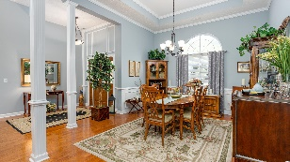
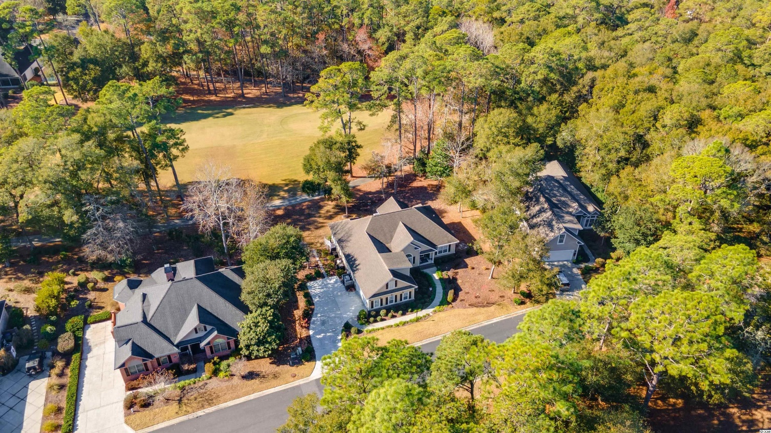
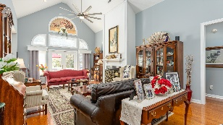
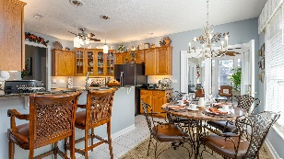
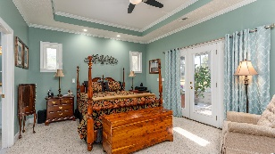
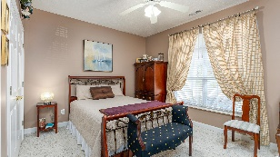
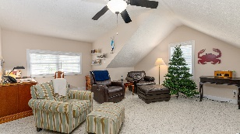
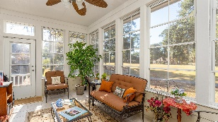
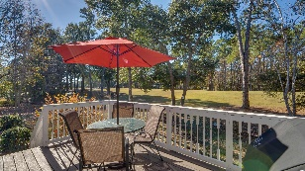
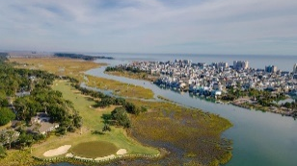
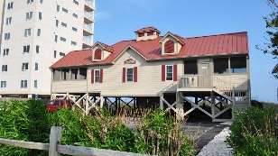



This Remarkable Home Undoubtedly Has The Best Of Everything
928 Heshbon Dr
The Bluffs of Tidewater Plantation | North Myrtle Beach SC 29582 MLS# 2127594 | $619,900
Walk to Bluffs private pool and amenities, including pool cabana, grilling area, bocce courts and horseshoes. The Bluffs pool is exclusive to residents of the Bluffs; however, they may use two other pools on the Plantation side. The Bluffs of Tidewater borders the Cherry Grove Inlet where the Atlantic Ocean rolls into the marsh. You can hear the ocean from this distinctive property, but there are NO flooding issues...ever! This remarkable home undoubtedly has the best of everything -- overall flex floor plan design, the integrity of fine upgrades, and location. The lot views the 11th hole from the front porch and the fairway of the 2nd hole of world-class Tidewater Golf Course and its indigenous natural surroundings from the Carolina room, back porch and other back window views from the home. The main front entry is a spacious driveway and over-sized side-load garage with separate rear entry to the well-manicured, mature-landscaped yard. It is a big, .35-acre lot! Come in to the front porch and find the inviting front door to a wide, welcoming entry foyer opening to the heart of the home. This home has 4 full baths, along with three - four nice-sized bedrooms, 3 of which are on the main level! We cannot forget the gathering-size formal dining room...stately and beautiful but warm and inviting for families and for entertaining. Bring on the holidays! And, speaking of wonderful space, the living room is breathtaking with enhanced architectural detail, moldings, lovely hard-wood floors, and high style, yet comfortable and inviting; tall ceilings and custom-framed gas fireplace add light, comfort and coziness. Subtle details such as unique window treatments enhance the living area and provide decorative opportunities. The kitchen is equally top-notch, with breakfast bar and nook, upscale cabinetry, and granite countertops, too! You must linger there to appreciate the many more special touches enjoyed from the open concept of the great, main-living level of the home...The laundry room with entry from the garage has the preferred back -entry pattern directly to the kitchen also. The bedrooms are in the popular, preferred, split-bedroom configuration with two private guest en suites separated from the roomy master, also with fabulous en suite and a shower to die for! It is secluded, charming, a perfect retreat, with walk out to the relaxing Carolina room. Upstairs bonus room is roomy and has lots of storage. It can be a fourth bedroom, office or family room. This is a large, wonderful home, pretty much completely renovated inside and out! It is in a very large but private location with a zen garden and bench on the left side of the home for relaxation and viewing the signature fairway, just one of the many personal touches the owners have added for the enhanced enjoyment of the home. You will notice many other upgrades and special touches. List in Associated Documents. Tidewater is on an elevated peninsula of live oaks and southern pines between the ICW and the Cherry Grove Inlet to the Atlantic Ocean. The plantation also preserves the singular look of its own historic origins. It is minutes from the beach, shopping, medical services, entertainment and access to major highways. Amenities include the jewel in the crown, an oceanfront beach cabana on the Cherry Grove Beach for owners' use with open/screened porches, bathrooms, showers, and kitchen. In fact, the Cherry Grove Beach was just named one of the best in the nation! Plus, residents enjoy the use of several pools/hot tubs. Other amenities include a driving range, putting green, golf shop, clubhouse with bar/dining & event facilities, clay & hard-surface tennis courts, pickle ball court, fitness center overlooking a pool, the bocce courts and amenity center for events. Tidewater has a gated storage yard for boats, jet skis, motorcycles, and kayaks. Tidewater Resort reflects the best-of-everything, a classic golf/beach lifestyle in safe, popular North Myrtle Beach.
Video Tour: https://youtu.be/8USr0W3XpRI
3D Virtual Tour: https://my.matterport.com/show/?m=qRug38kUYB5
Connie Ross-Karl
702-306-2643
conniesross@aol.com
Ronnie Nichols
Realtor / BIC
ronnienichols8@aol.com
NEW WAY PROPERTIES MYRTLE BEACH

