Slide 1
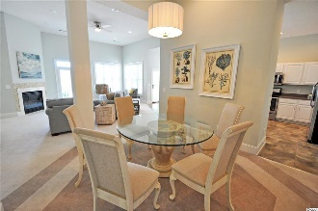
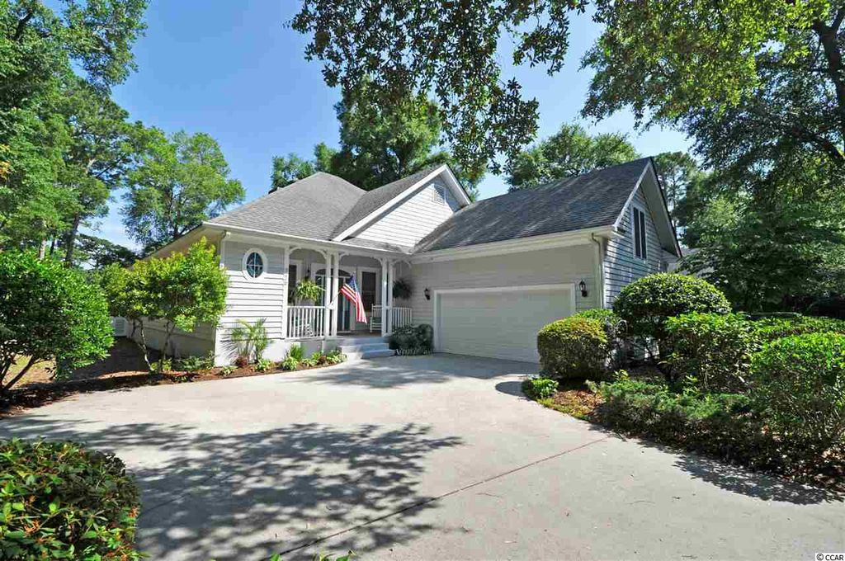
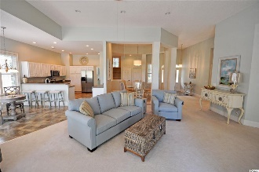
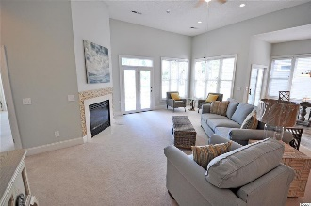
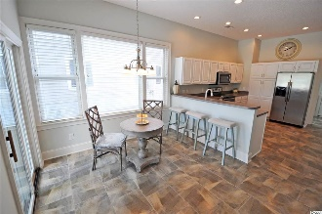
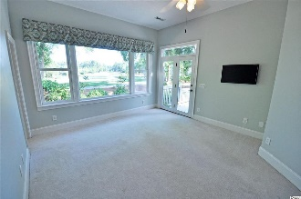
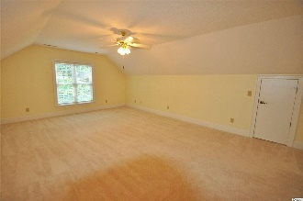
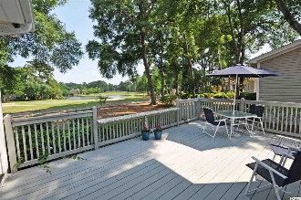
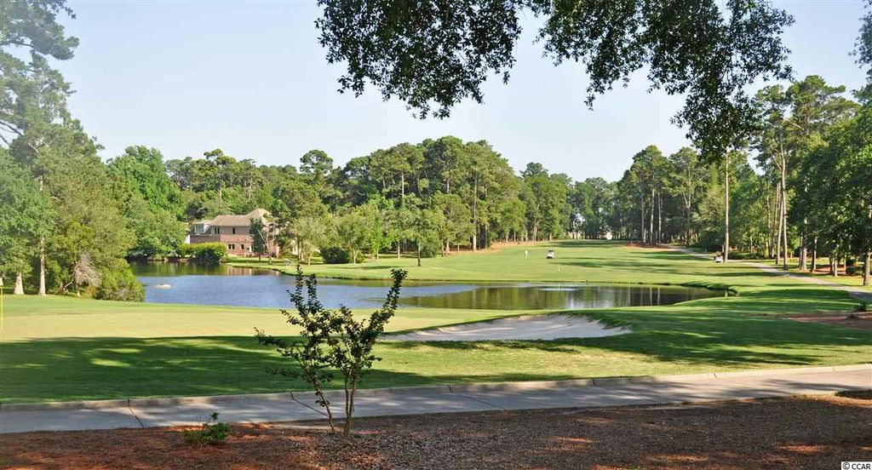
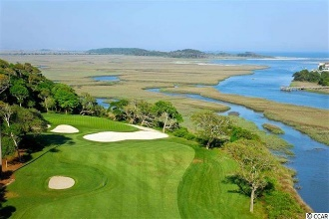
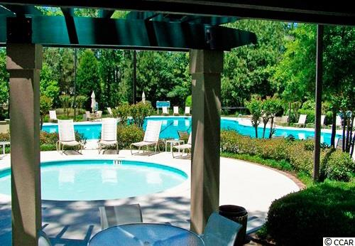
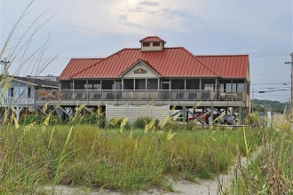


929 Morrall Drive
Tidewater Plantation Resort ~ North Myrtle Beach
MLS# 1812570 ~ $359,900
Feel like you are on vacation at a world-class resort every day! This easy-living, charming, one-level traditional-styled house with spacious upstairs bonus room is set back on a premier golf-course and lake-view lot in amenity-rich Tidewater Plantation. It is well located also on two inviting cul-de-sacs of like luxury homes in the prestigious Bluffs of Tidewater. The more than memorable full tee-to-green magnificent sweeping view of the classic 14th hole, with its beautiful lake, invites egrets, heron and other indigenous wildlife and provides an ever-changing scenic panorama any time of day or season. It is really all about the VIEW -- immediately captivating, from the entry foyer throughout the great room, kitchen, dining and master bedrooms.
Deborah Collins
843-424-9013
dctidewater@yahoo.com
Connie Ross-Karl
702-306-2643
conniesross@aol.com
NEW WAY PROPERTIES MYRTLE BEACH

