Slide 1
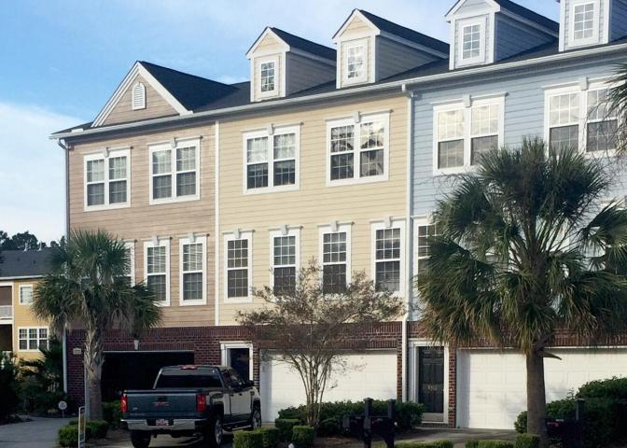
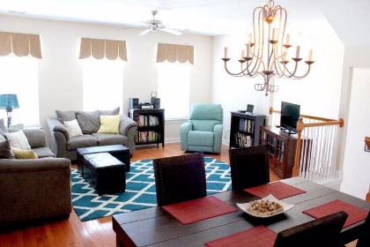
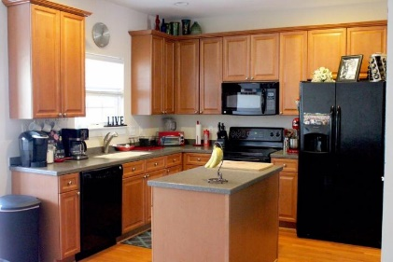
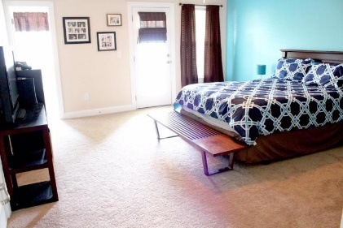
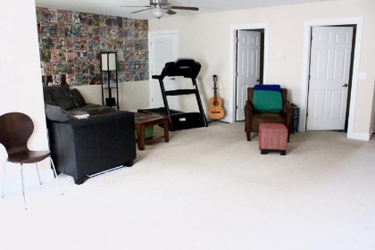

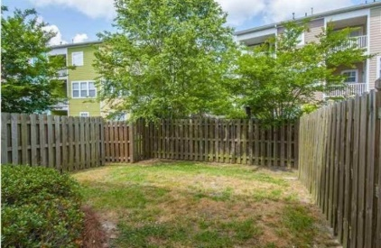
9314 Sweetbay Ct
Tranquil Hill Plantation
Ladson, SC 29456
MLS# 15021447
$179,990
3 Bedrooms
3½ Bathrooms
2,617 Sq Ft
NOT A SHORT SALE and CAN CLOSE QUICKLY!
The Savannah is a gorgeous floor plan with over 2,600 sqft of open living space. As you enter the home, you'll find a dramatic 2 story foyer and split staircase! The bonus room is enormous and has a full bathroom, storage and access to the patio and backyard. The main floor has gorgeous 3/4'' hardwood flooring throughout, beautiful trim detail, an awesome kitchen with 42'' maple cabinets with hardware and crown molding, GE appliances including the refrigerator and smooth top range, solid surface counter tops, a spacious pantry and access to the first of two decks! Upstairs, you'll be blown away by the master bedroom! The walk in closet is incredible and you'll have direct access to the other deck right off of your bedroom! The master bathroom has double split sinks, a soaking garden tub, a separate shower and a water closet, all with ceramic tile flooring! The secondary bedrooms are on the front of the home and have a lot of natural light. This home is on a low traffic cul-de-sac, and the community is one of the most beautiful in the area with grand majestic moss draped oaks that are a must see! The amenities in the community are equally amazing including a junior Olympic sized pool and cabana with extra seating for community (or personal) functions! The exterior is fiber cement and is custom painted, so it has a really unique feel as compared to other communities! Come see this home today!
Meg Hopkins Kandik
Cell - 843-814-5137
meg@holycityre.com

