Slide 1
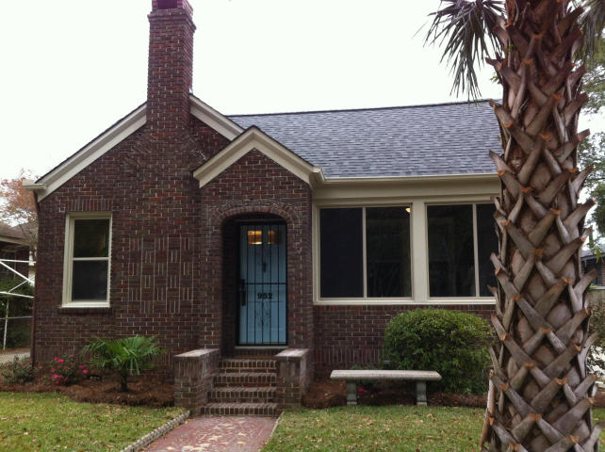
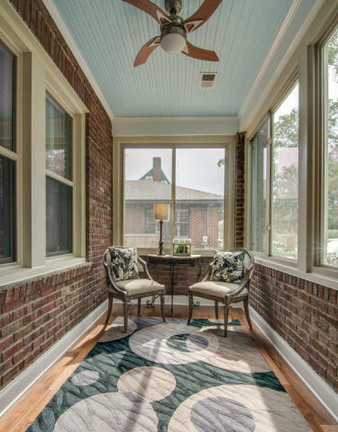
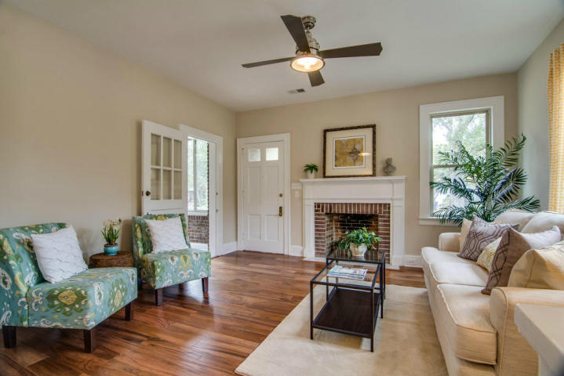
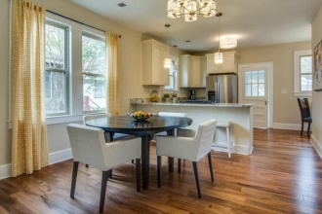
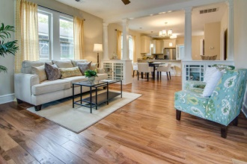
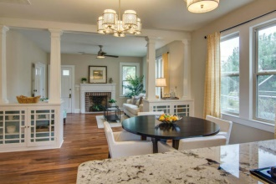
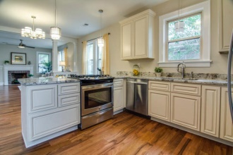
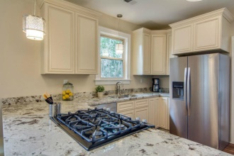
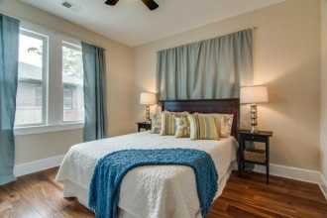

932 Ashley Avenue Charleston, SC 29403 MLS# 14029392 $395,000
Charm and Character are evident through out this charming home that has had a full professional renovation. 9Ft ceilings add to the feel of this spacious and open floor plan with a great flow for entertaining and daily living. The gourmet kitchen has new stainless steel appliances, solid wood cabinets with quiet close drawers and doors, breakfast bar, and Granite counters. Office/Desk area in kitchen. Fully enclosed climate controlled front porch is perfect for relaxing. Beautiful Carra marble tile in the main bath. New wood flooring, new plumbing, new HVAC and a new roof. New double pane windows in climate controlled areas. Minutes to downtown Charleston!!!Floored attic with pull down stairs offer an abundance of extra storage area. Agent/Broker is co-owner
John Lloyd
Lloyd Building and Restoration
Lloyd Realty
740-703-6755 | 843-732-1607
john_lloyd@hotmail.com

