Slide 1
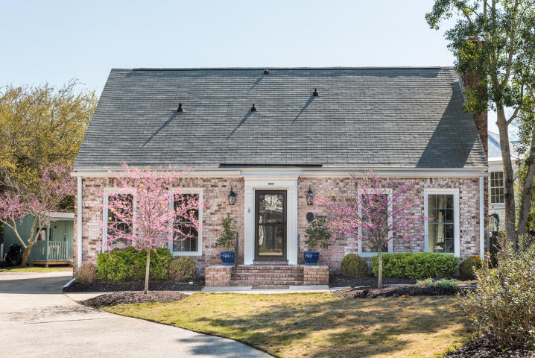
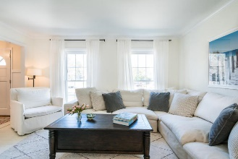
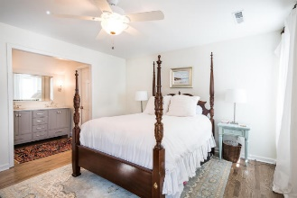
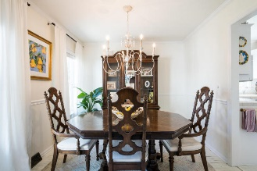
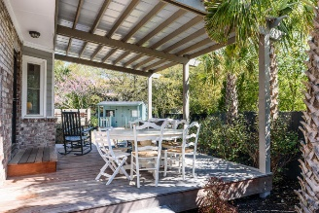
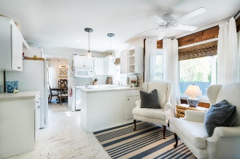
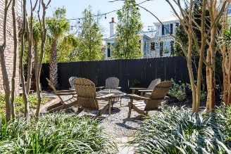
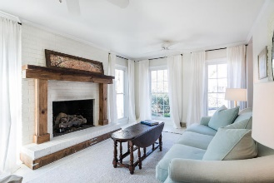
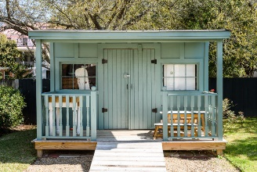


932 Richter Way Old Village ~ Mount Pleasant MLS# 18007205 ~ $875,000
Open House
Sunday 2-4 PM
Must See! Great location!
Open House
Sat 1-3 & Sun 2-4
This quaint and charming brick home has beautifully renovated bathrooms, new paint and new oak flooring upstairs!
A recent addition and masterfully built covered deck provides additional space for outdoor living that is perfect for grilling and dining outdoors, lots of natural light, interesting details and a great floor plan define this home.
It is located in one of the most desirable neighborhoods in Mt Pleasant with shopping, dining, schools, Alhambra Park, tennis and a dog park just steps away.
Enjoy a stroll to the Old Bridge or take a 5 minute drive to Sullivan's Island.
Mac Jenkinson
M (843) 224-0210
mac@carolinaone.com
Beth Moore
M (843) 532-4892
bmoore@carolinaone.com
www.jenkinsonandmoore.com
Jenkinson & Moore, LLC | Carolina One Real Estate | 1503 Palm Blvd | Isle of Palms, SC 29451-2280

