Slide 1
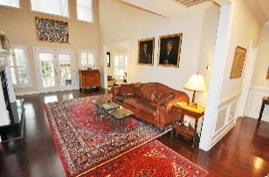
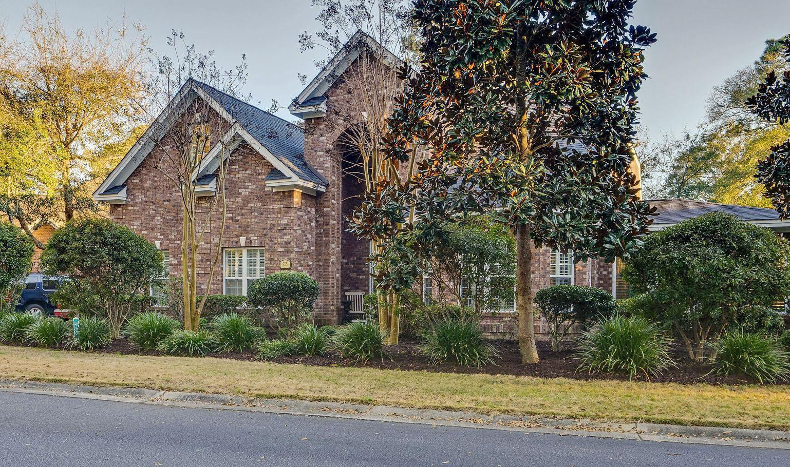
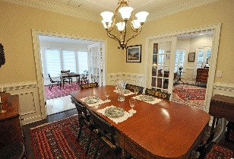
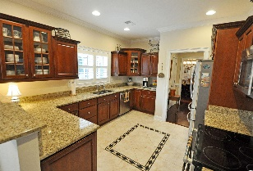
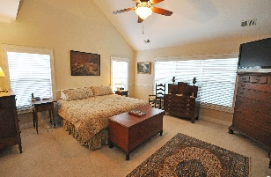
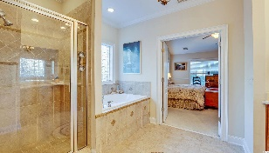
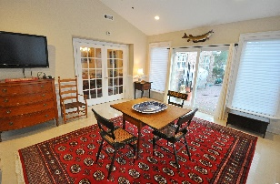
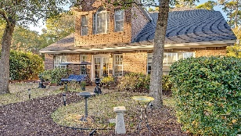
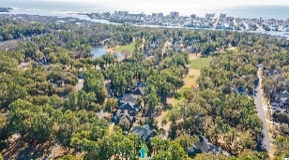
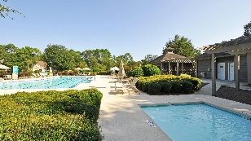
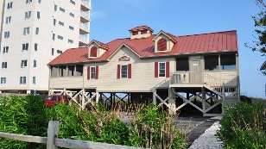


All-Brick Beauty In Private, Amenity-Rich Resort Community
935 Heshbon Dr
The Bluffs of Tidewater Plantation | North Myrtle Beach SC 29582
MLS# 2203646 | $720,000
Elegant, stately brick home located in the prestigious Bluffs section of Tidewater Plantation, rated one of the top 100 golf courses in the country! This custom home features extensive architectural detail throughout, and is a beautiful builder inspired unique design-the only one of its kind in the community! The facade features a "castle like" appearance with three imposing gables, an arched two story entry porch and a turreted bay to the right. This study/den features cherry floors, Plantation shutters and 2 sets of French doors leading into the marble entry way and into the dining room. The magnificent 21' long marble entry features a grand open staircase to the right with the hall/gallery leading the to large, two story open living room. This room features cherry floors, ceiling fan, a tall fireplace with decorative mantel/granite base and architectural detailing reaching to the ceiling. The massive bank of windows features Plantation shutters and motorized blinds to control light. French doors lead outdoors to an inviting brick patio with far reaching views from the tee straight down the fairway! The kitchen features Plantation shutters throughout, granite countertops, stainless steel appliances, a breakfast bar and an adjoining breakfast nook with windows overlooking the golf course. Adjacent to the kitchen is a lovely Butler's pantry with a granite countertop, cherry cupboards below and glassed, cherry cupboards above for barware, glasses etc. Across from this area is a convenient sizeable pantry. One leaves this area and enters into the formal dining room with cherry floors, ceiling fan, wainscoting, dentil molding and a large banquet table for entertaining. French doors lead from the dining room into both the front library/den study and into the large, 300 sq. foot Carolina room/sun room with, ceiling fan and large windows on all sides. These windows are fully screened on all sides allowing for a "sun room" use option. Glass doors lead to the secluded, large brick patio with mature hedges for privacy. The master suite is on the first floor level, and features a ceiling fan, vaulted ceiling with a long, bank of windows in the rear facing the backyard with mature landscaping and long, straight, golf course views down the fairway. The adjoining master bath features a jacuzzi tub, separate shower and a beautiful inlaid tile motif in the center of the room. Cherry cabinets and large walk in closet complete the suite. The upstairs level comprises a large, open loft overlooking the marble entry and living room. This area is used as a library/den. Two large bedrooms are on either side with closets, ceiling fans and private baths. The large bonus room can be a 4th bedroom, and incorporates a closet, adjoining bathroom and two side storage attics. Allowance for carpeted rooms to convey at closing. See Agent to Agent Remarks. The "jewel in the crown" is the Tidewater beach cabana for owners' use boasting open/screen porches, bathrooms, showers and a kitchen! The white, sandy beach has recently been voted the 11th best in the nation! Tidewater features 24 hr. manned, gated security as well as a 24 hr. video monitored, complimentary, gated storage area for boats, jet skis, motorcycles, campers etc. NEW DRIVEWAY. NOT IN A FLOOD ZONE. Old Republic Platinum Home Warranty with HVAC coverage to convey at closing. Other amenities include a restaurant/clubhouse/grill, golf shop, driving range, pools/hot tubs, hard and clay surface tennis courts, fitness center pickle ball, bocce, lending library, amenity center for public/private events, yoga classes, book/dinner clubs, mahjong, bridge, outdoor concerts and seasonal events. Seacoast Medical Center and great shopping close by. Long term rentals are allowed in The Bluffs. Low HOA fees, taxes and incomparable amenities make Tidewater a popular choice for discriminating buyers. Biking/walking the carts paths is permitted early AM and late PM when course is closed.
3D Virtual Tour: https://my.matterport.com/show/?m=SVT9QAn3ABn
Deborah Collins
843-424-9013
dctidewater@yahoo.com
NEW WAY PROPERTIES MYRTLE BEACH

