Slide 1
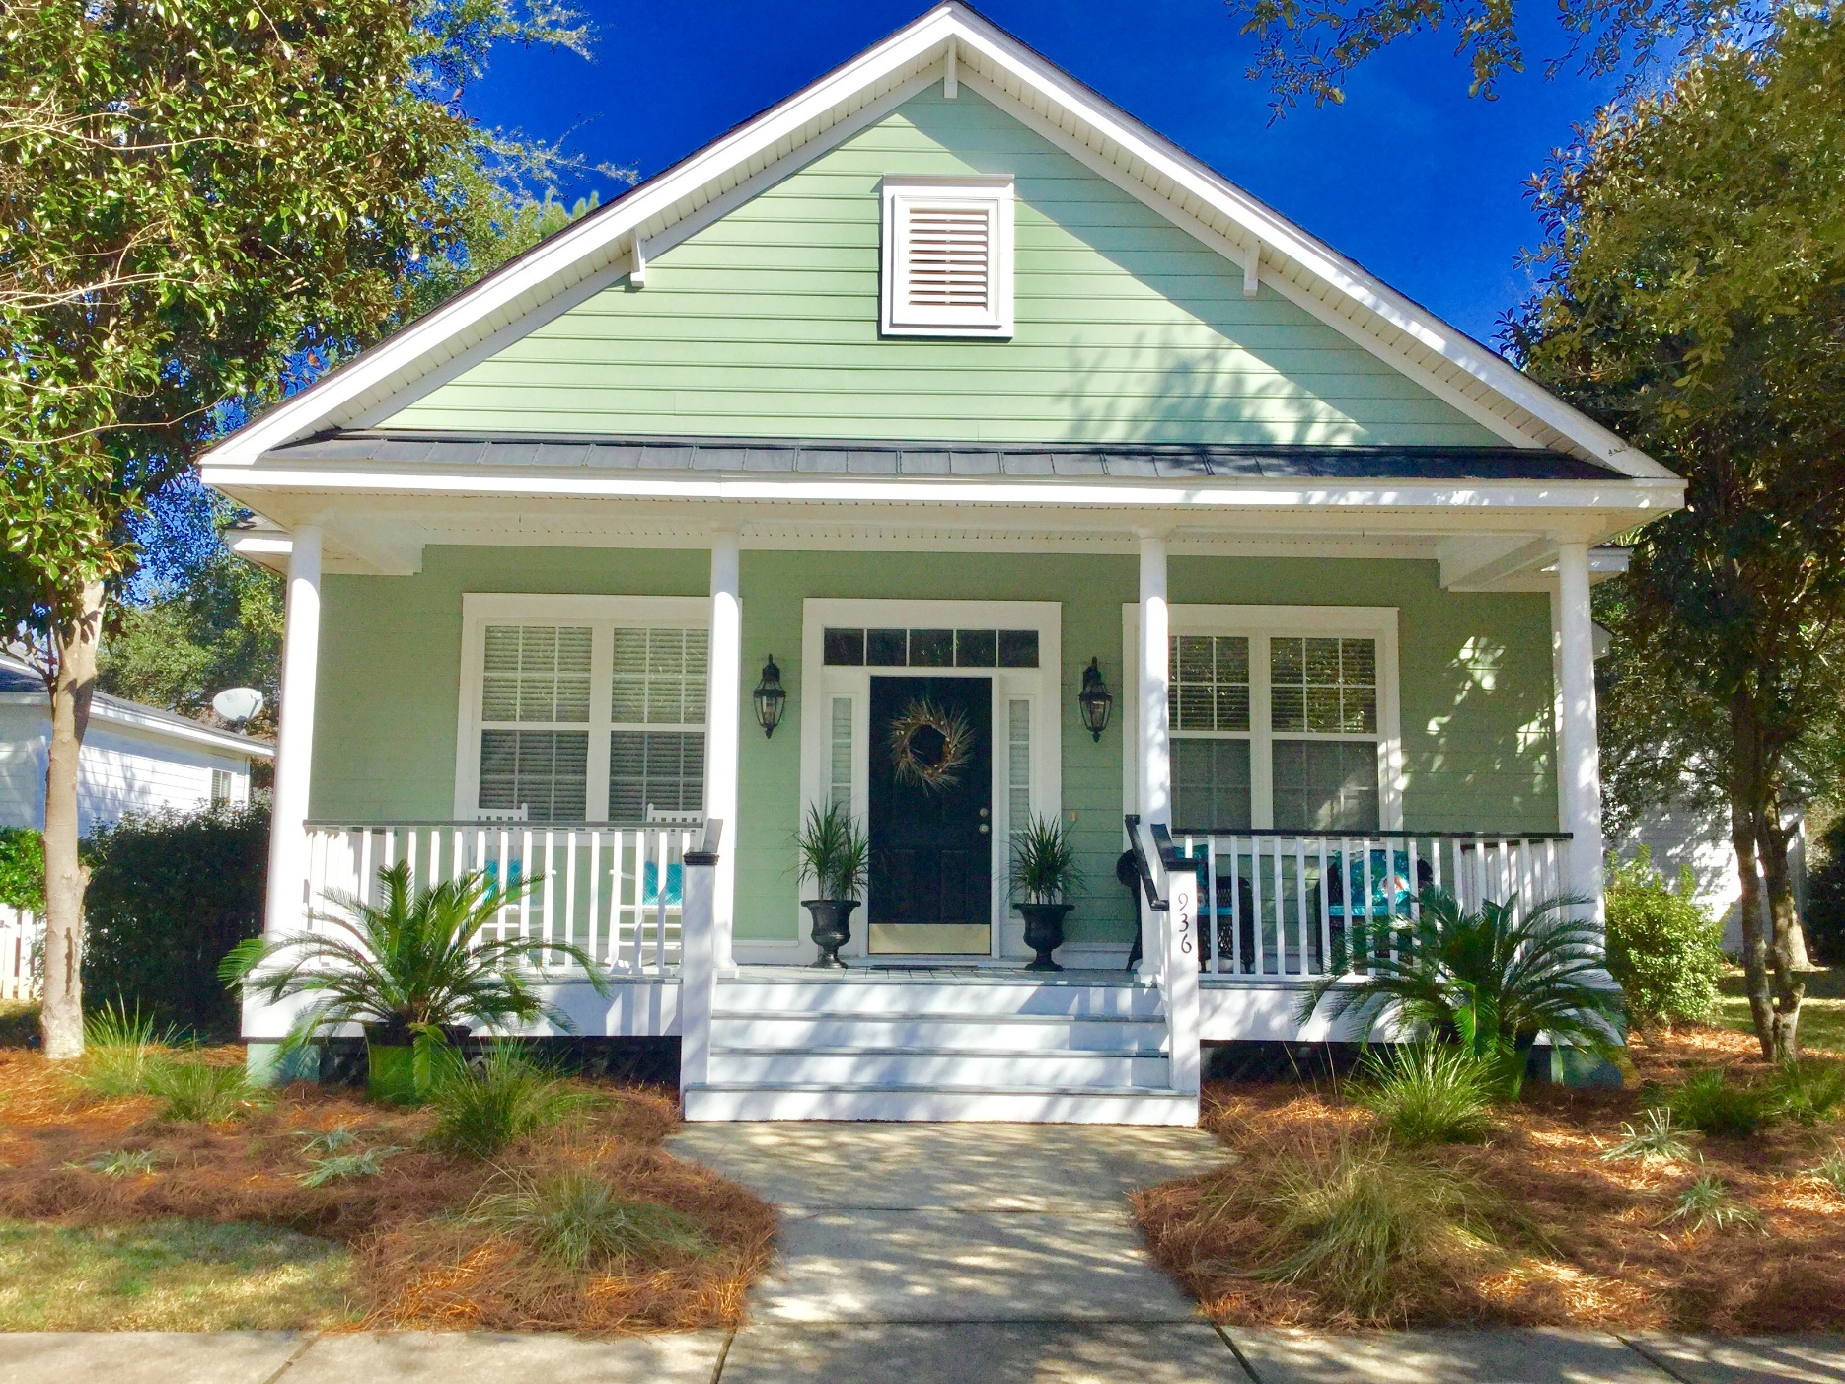

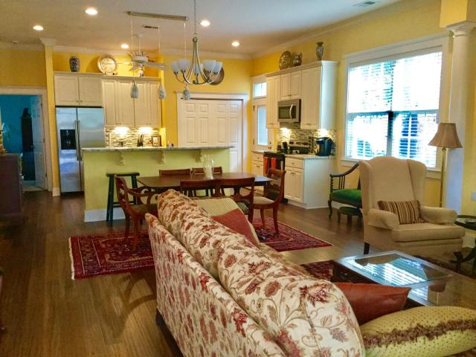
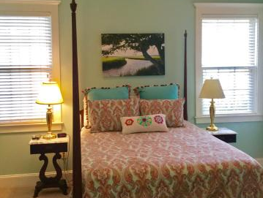
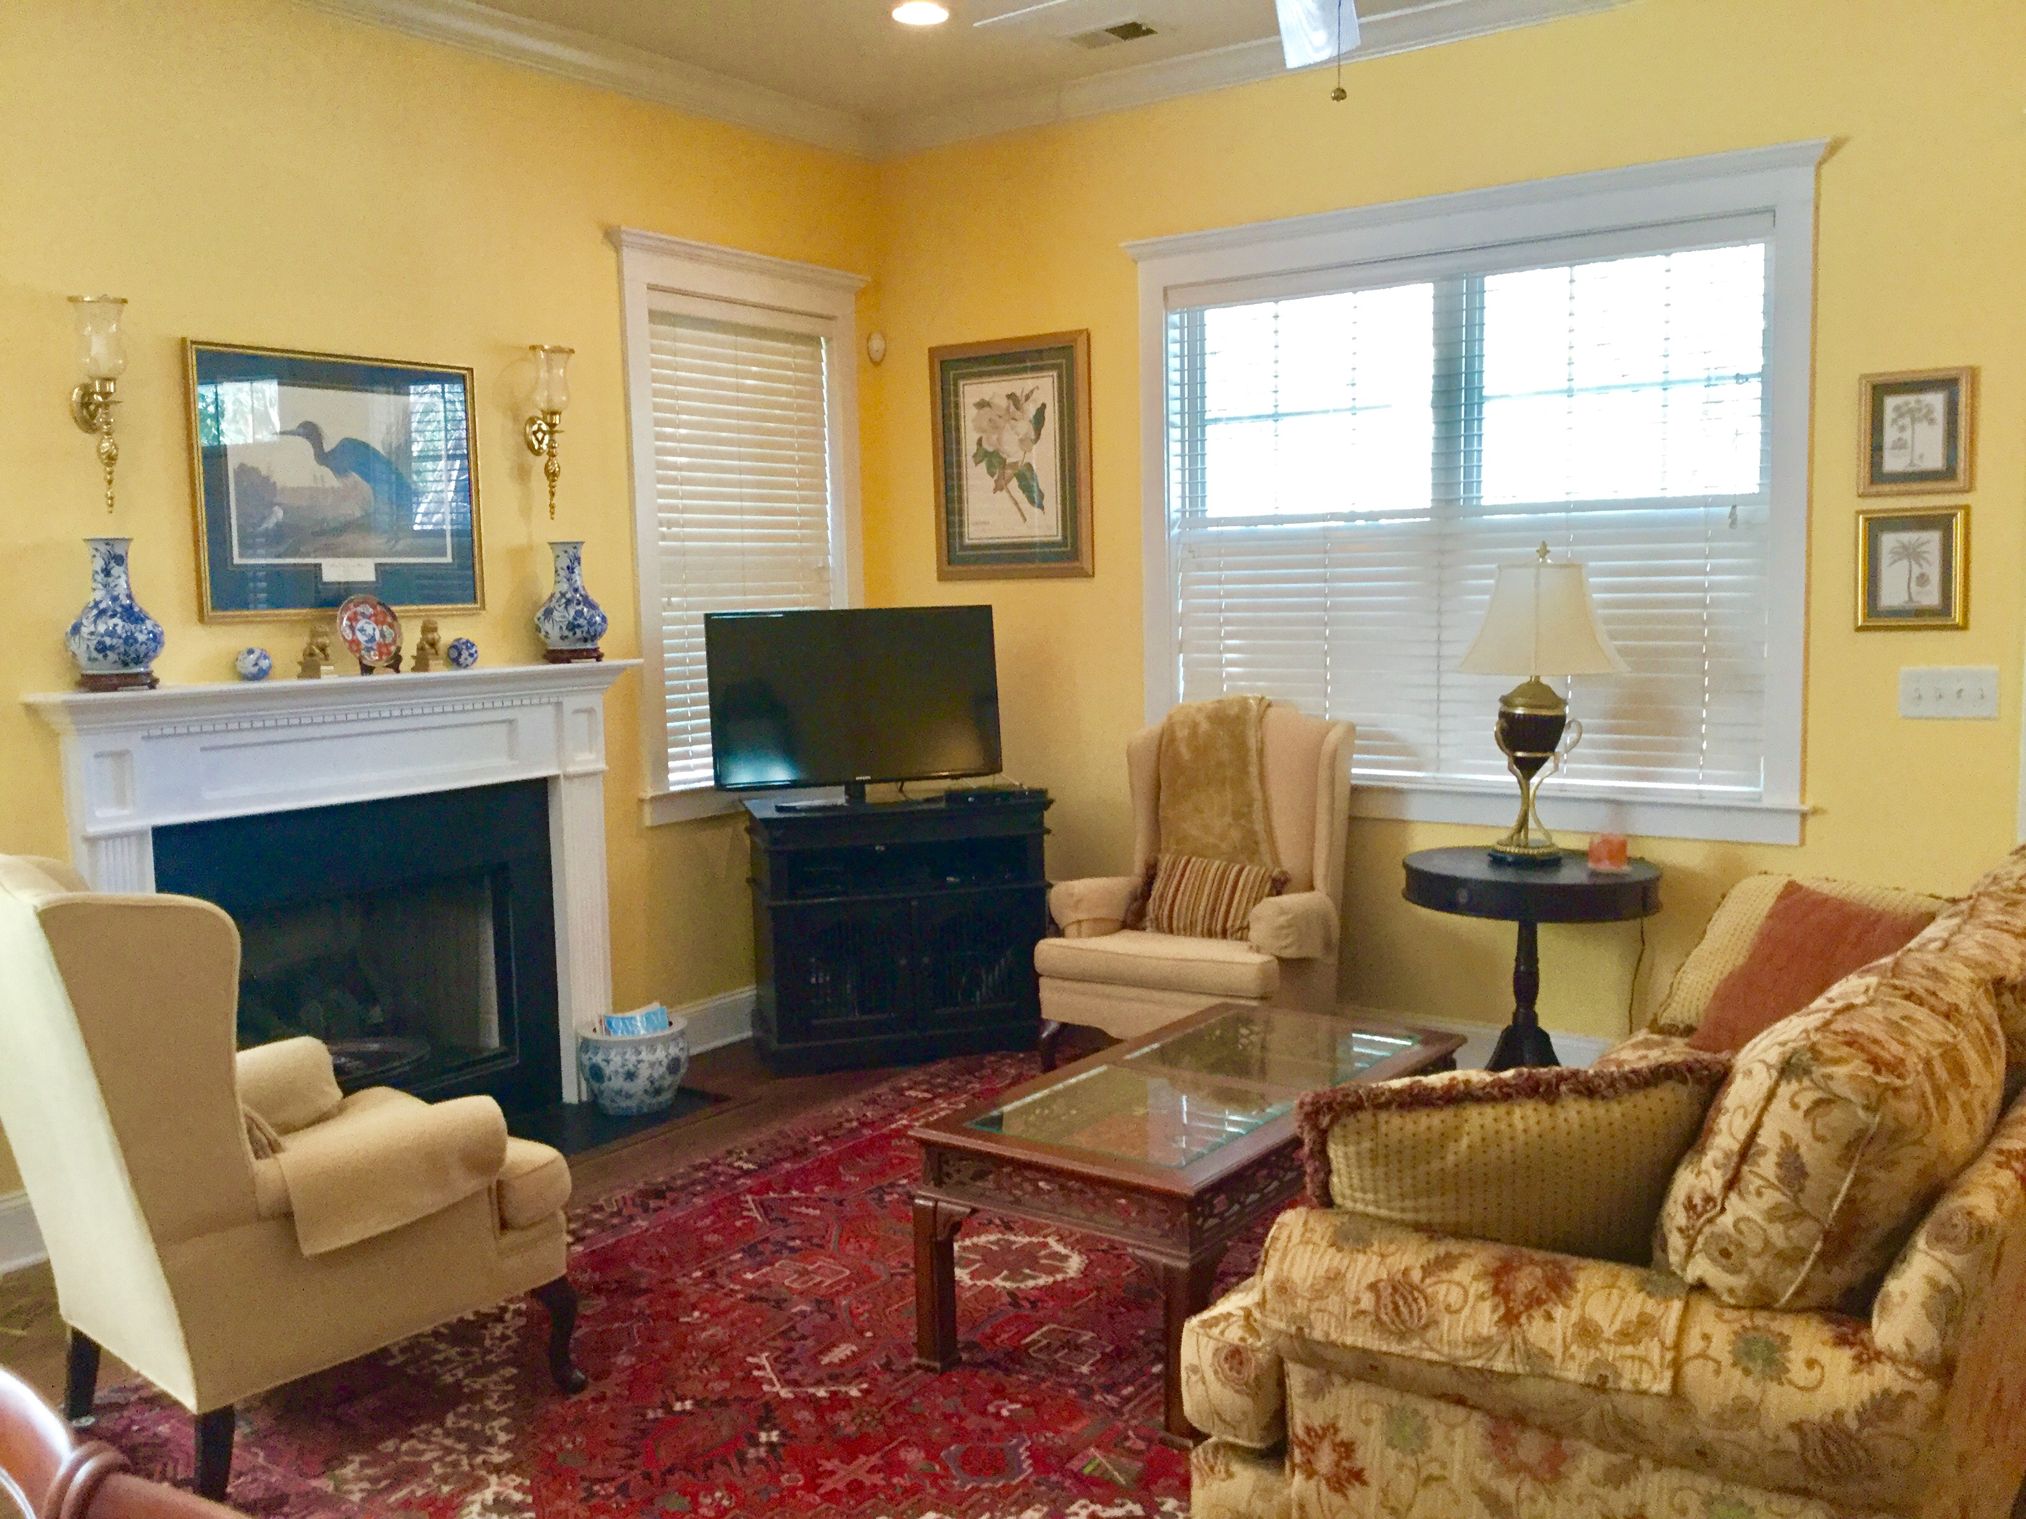
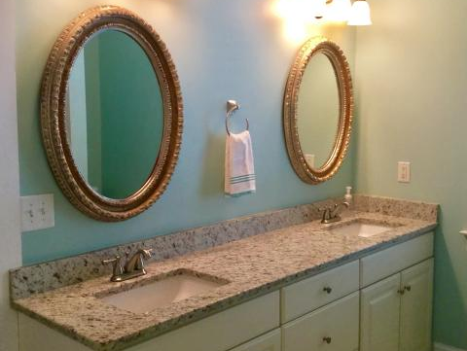
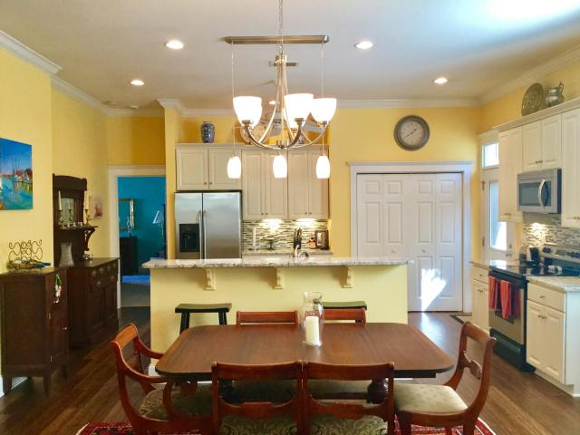
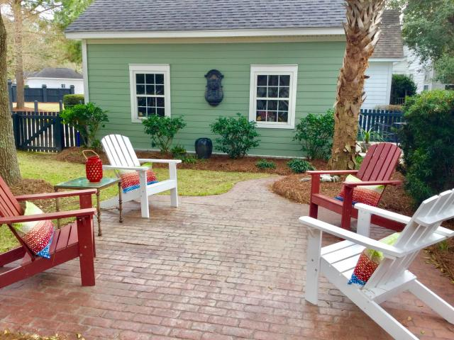
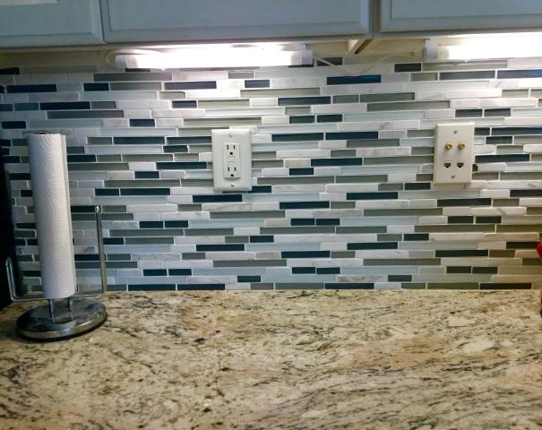
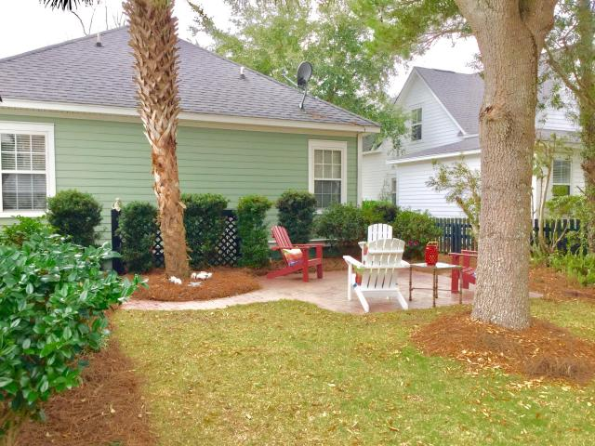

Parkshore Marshfront
Craftsman Cottage on
Daniel Island
936 Etiwan Park Street
Daniel Island ~ MLS# 17003890 ~ $480,000
Charming Craftsman style cottage with 3 bedrooms and 2 baths with open floor plan.
All new hardwood floors, granite counter tops in kitchen and master bath, backsplash, new lighting and painted throughout and all new front yard landscaping.
Enjoy relaxing on you front porch or entertaining in your fenced backyard that has two patios.
You can either dine on your oyster shell patio or relax on your brick patio and enjoy your serene back yard.
Great location close to schools, parks and restaurants.
Coastalina Realty of Charleston 916 Palm Blvd
Ste 101 Isle Of Palms, SC 29451
Dar Venable, Realtor Mobile - (843) 330-2424 dvislander@bellsouth.net coastalinarealtyofcharleston.com

