Slide 1
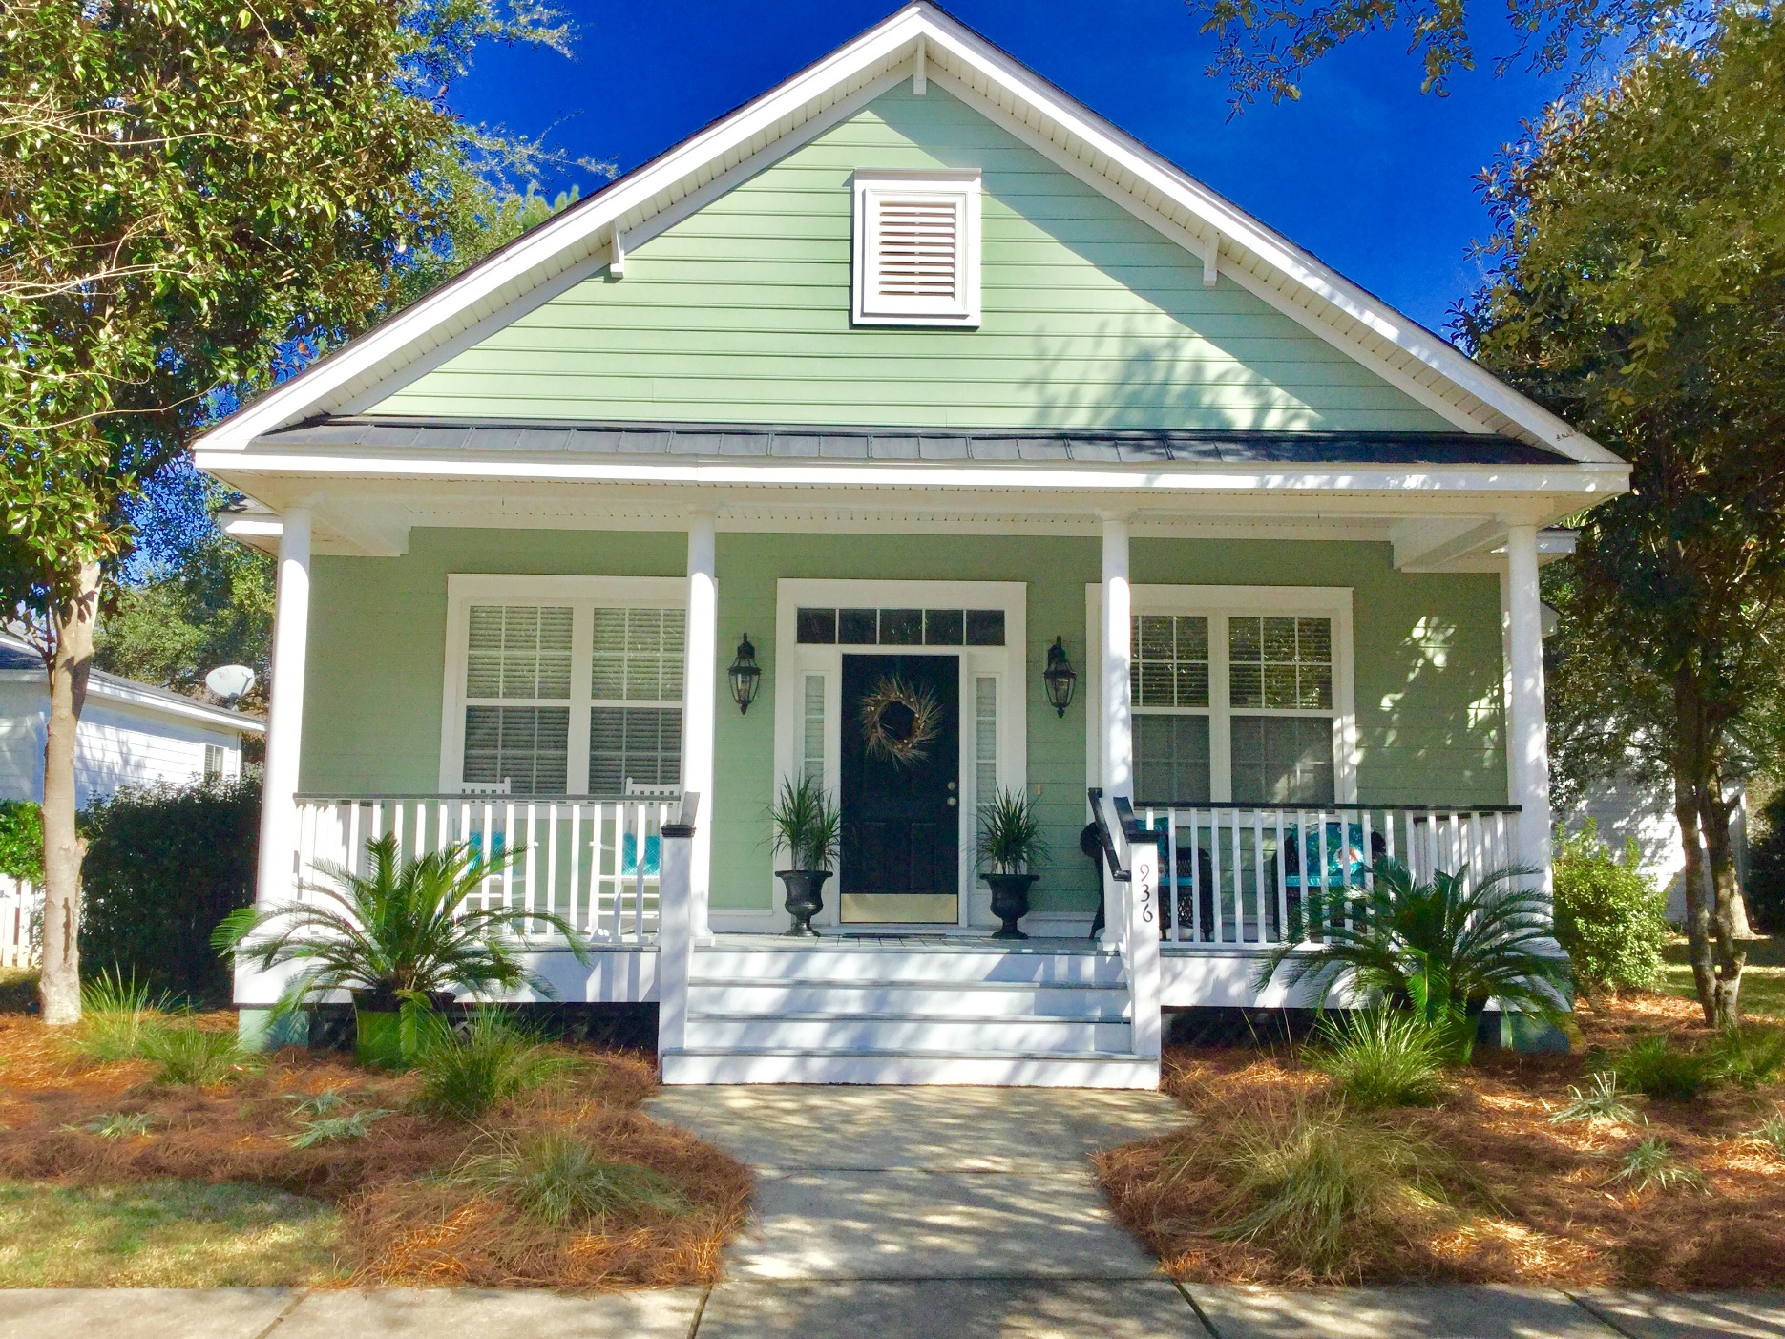

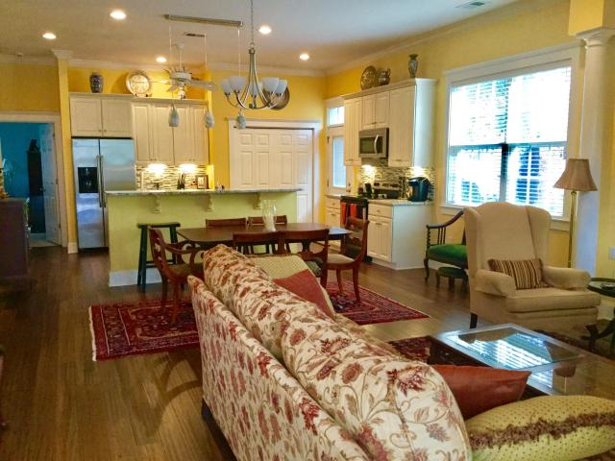
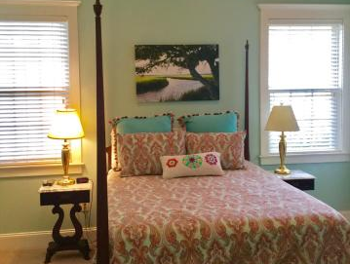
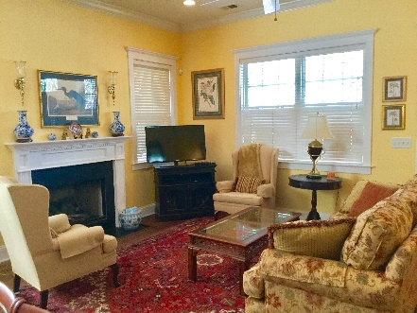
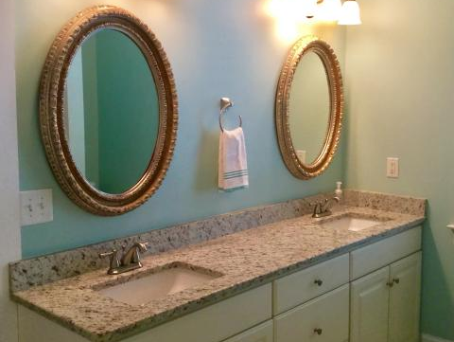
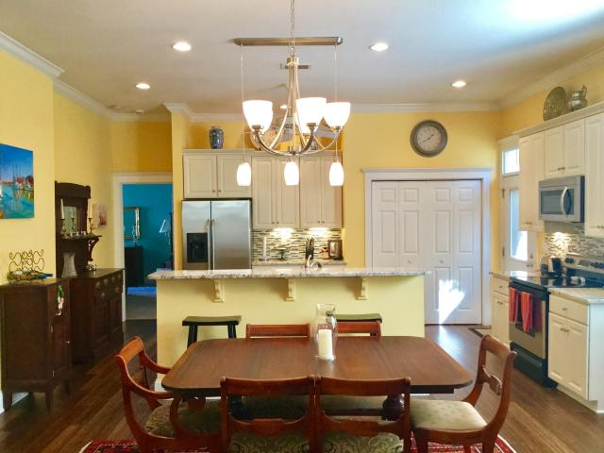
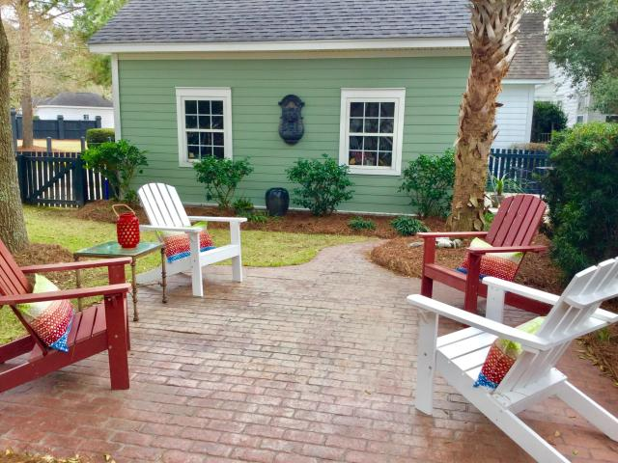
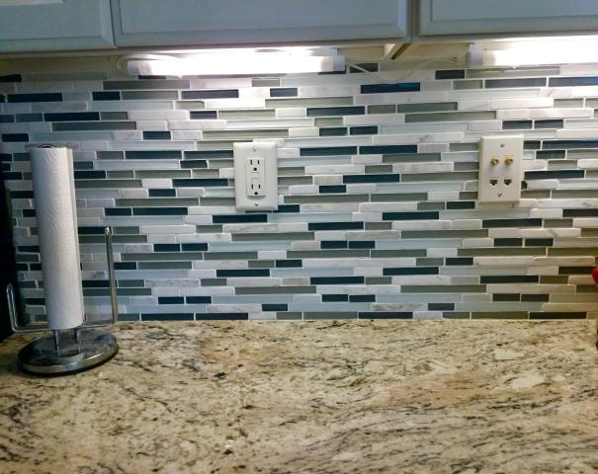
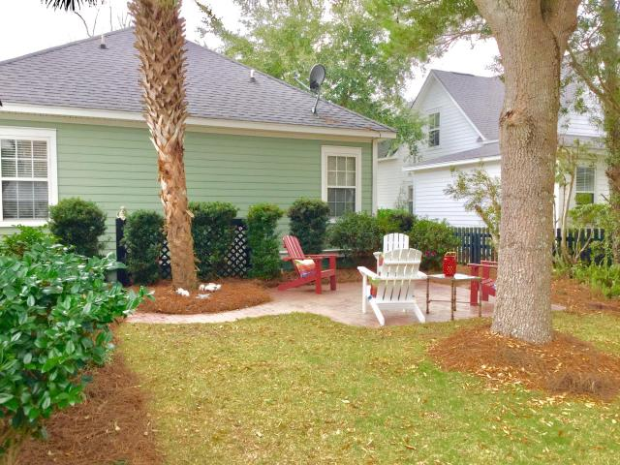

Lowest priced home on
Daniel Island
Price Reduced!
936 Etiwan Park Street
Daniel Island ~ MLS# 17003890 ~ $474,900
Charming Craftsman style cottage with 3 bedrooms and 2 baths with open floor plan.
All new hardwood floors, granite counter tops in kitchen and master bath, backsplash, new lighting and painted throughout and all new front yard landscaping.
Enjoy relaxing on you front porch or entertaining in your fenced backyard that has two patios.
You can either dine on your oyster shell patio or relax on your brick patio and enjoy your serene back yard.
$3,000 TOWARDS BUYER'S CLOSING COST WITH PREFERRED LENDER
Coastalina Realty of Charleston
916 Palm Blvd
Ste 101
Isle Of Palms, SC 29451
Dar Venable, Realtor
Mobile - (843) 330-2424
dvislander@bellsouth.net
coastalinarealtyofcharleston.com

