Slide 1
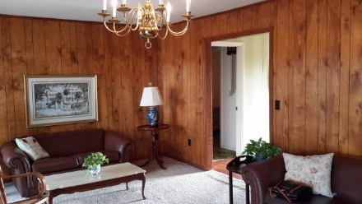
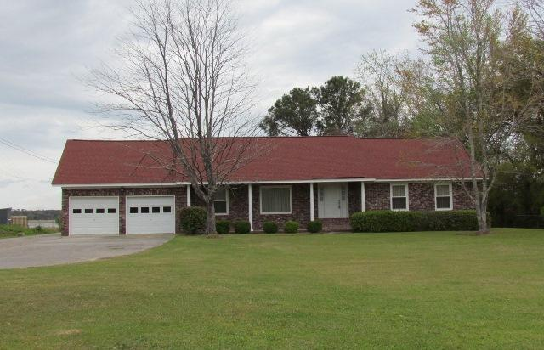
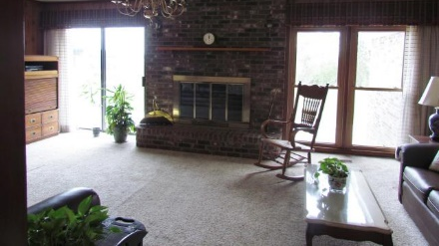
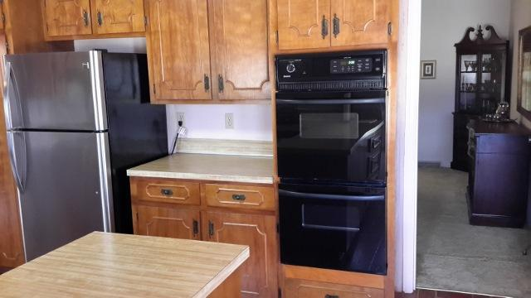
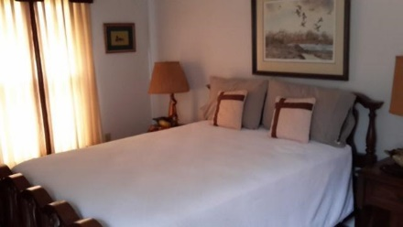
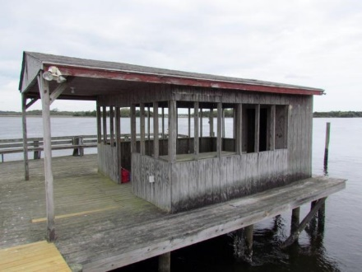
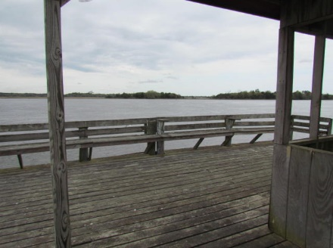
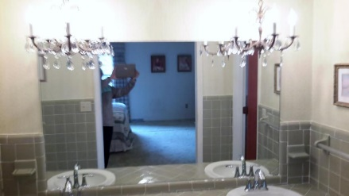
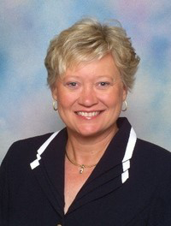
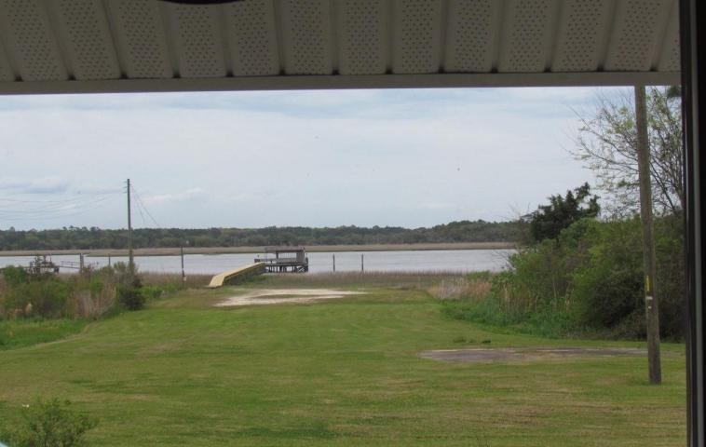

937 River Road
Bay Fruit - Johns Island, SC 29455
MLS# 16007863 - $1,200,000
Open House
Sunday 1-3PM
Highly sought after true deepwater home with 2.5 acres of high ground overlooking the Stono River and 1 acre of marsh. Dock in place with brand new walkway just completed. This unique property has a enclosed room on the pierhead that can be grandfathered in. No one can get these enclosures anymore!! Well maintained one story ranch home with a completed FROG upstairs. Bathrooms have a separate shower and another bathtub/shower in Master and Guest bath. Home in good shape but in need of updates. Or, you can live in this home while you build your dream home on this large waterfront lot. Flood insurance currently only $550/year.
Irene Thomas
Sales Associate
Cell: (843) 509-8058
Fax: (843) 725-7048
Irene.Thomas@agentowned.com
AgentOwned Realty | 902 Savannah Hwy | Charleston, SC 29407

