Slide 1

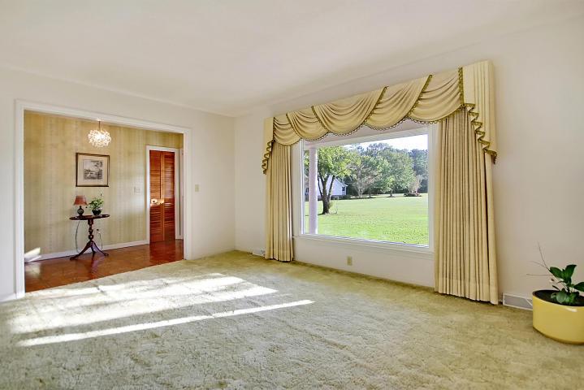
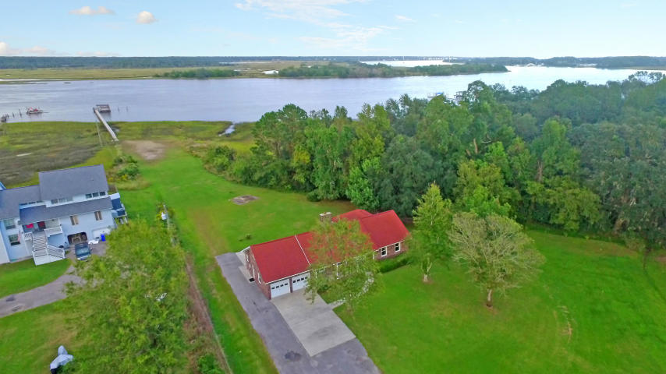
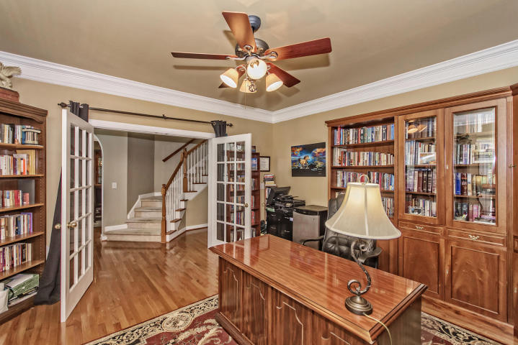
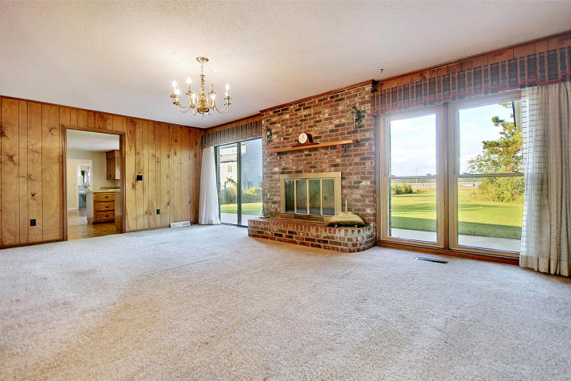
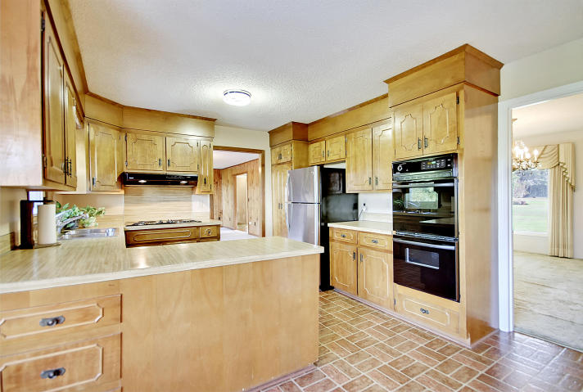
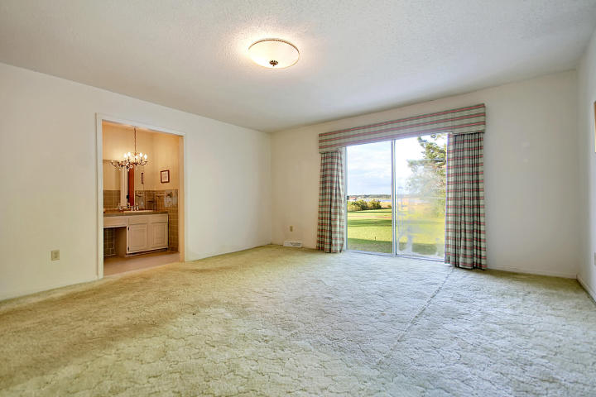
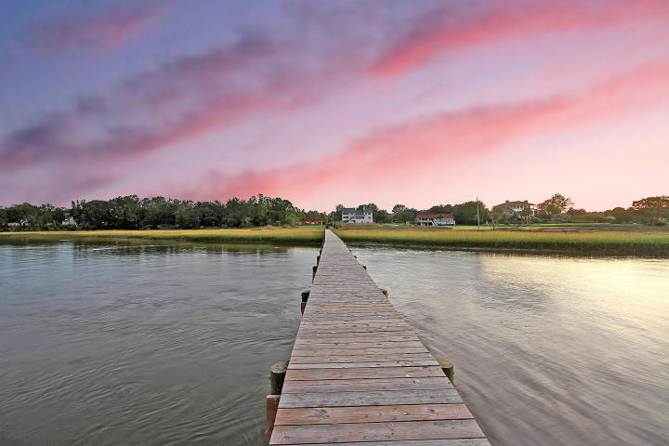
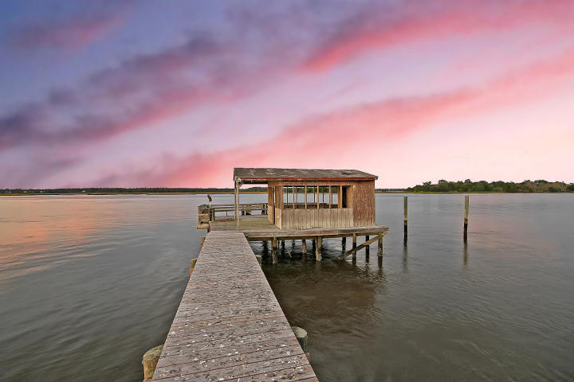

BEST VALUE FOR A
DEEPWATER PARADISE!
937 River Road
Bay Fruit | Johns Island, SC 29455
MLS# 17028242 | $899,900
Brick ranch in great condition on over 3½ acre expansive lot on DEEP WATER complete with an oversized DOCK. Young roof, young HVAC, inexpensive, transferrable flood insurance (will likely be approximately $500 for new owners), new walkway to dock, new Gorell armored, hurricane-resistant windows throughout the home with 50-year warranty, transferrable termite bond with Orkin, new water heater. You can see the glorious STONO RIVER water from most of the rooms in the house. Extra large windows throughout the home make you feel at one with the water. Water is ALWAYS DEEP so you can walk out to your private dock and take your boat out at all times. You can have this DEEP WATER PARADISE for the BEST VALUE PRICE in all of greater Charleston.
Chip Walsh
843-822-4663
chipwalsh@gmail.com
The Boulevard Company, LLC
35 Broad Street
Charleston, SC 29401
www.TeamWalshRealEstate.com

