Slide 1
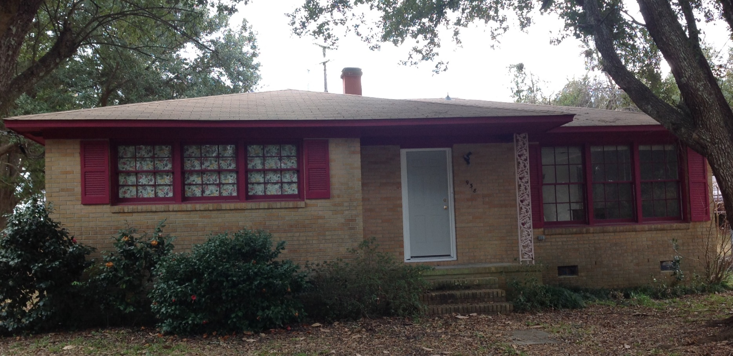
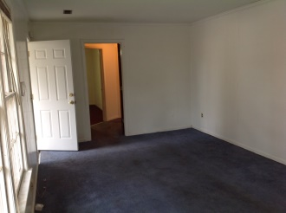
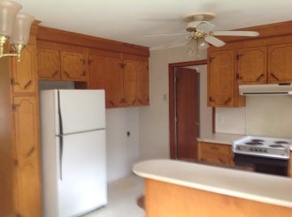
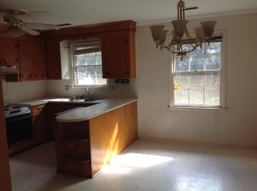
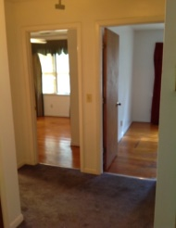
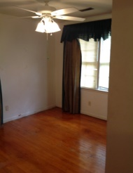
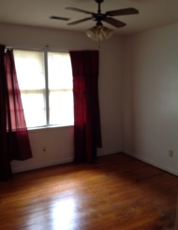
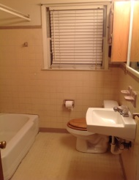

Calling All Investors
938 Valley Street
Hanahan ~ Gold Cup Springs ~ $99,500
Great house to fix or flip
1175 Sq Ft brick ranch
3 bedroom,1bath
End of cul-de-sac
Hardwood floors throughout
Large yard with mature trees
Coastalina Realty of Charleston
916 Palm Blvd
Ste 101
Isle Of Palms, SC 29451
Dar Venable, Realtor
Mobile - (843) 330-2424
dvislander@bellsouth.net
coastalinarealtyofcharleston.com

