Slide 1
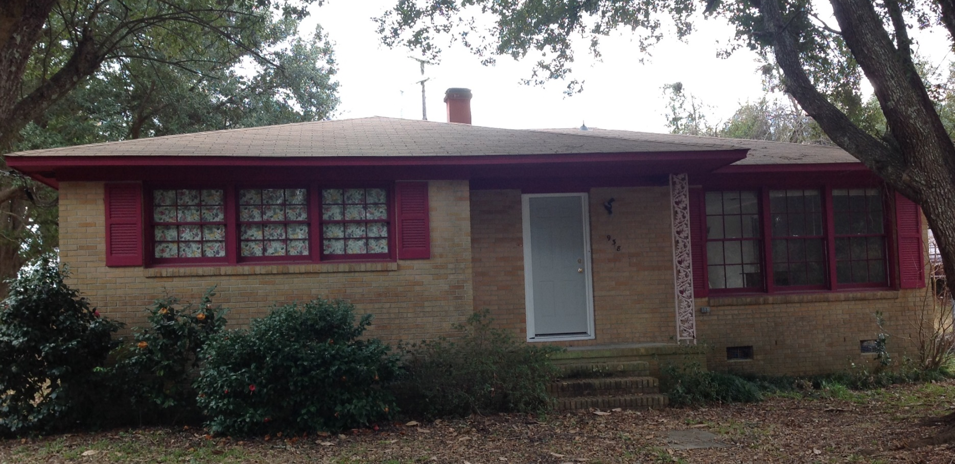
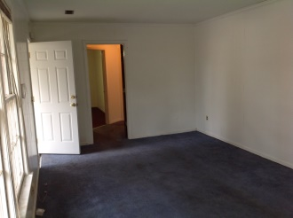
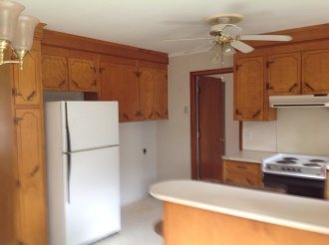
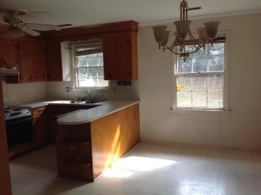
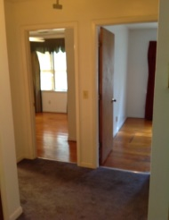
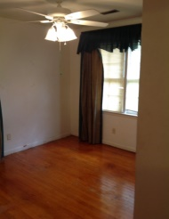
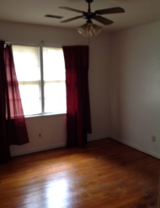
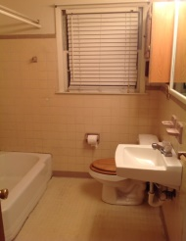

Hanahan Under $100,000
938 Valley Street
Hanahan ~ Gold Cup Springs MLS#15003263 ~ $99,500
Great house to fix or flip
1175 Sq Ft brick ranch
3 bedroom,1bath
End of cul-de-sac
Hardwood floors throughout
Large yard with mature trees
Coastalina Realty of Charleston 916 Palm Blvd
Ste 101 Isle Of Palms, SC 29451
Dar Venable, Realtor Mobile - (843) 330-2424 dvislander@bellsouth.net coastalinarealtyofcharleston.com

