Slide 1



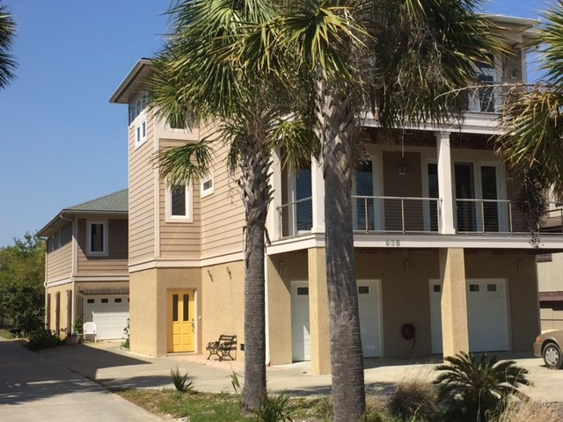
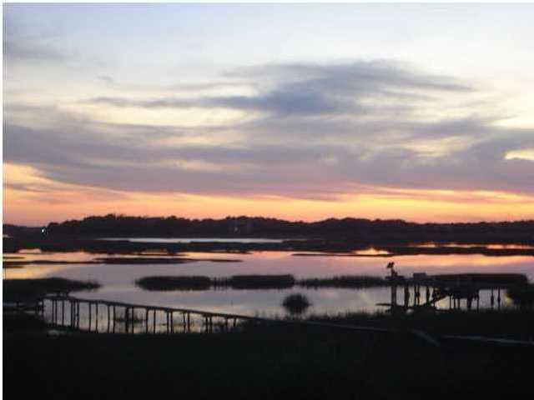
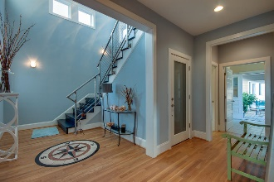
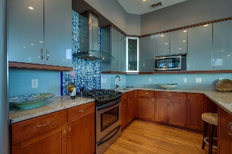
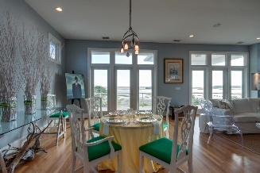
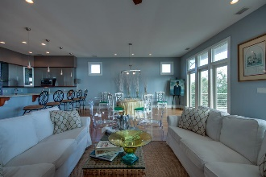
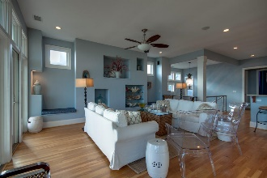
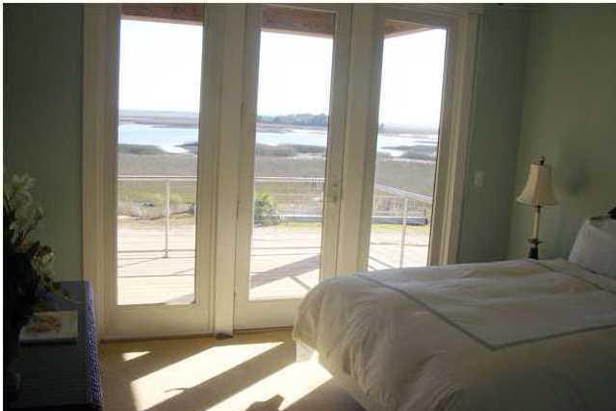
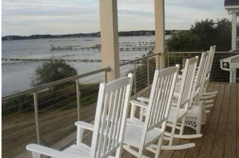
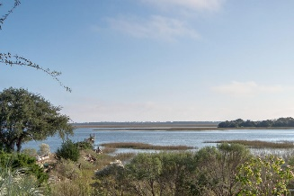


Agent Preview Friday April 8th from 10:00 -12:00
938 W Oceanview Road
Oceanview - Charleston
MLS# 15028639 - $988,000
SAVE this property from the RENTAL market!
Come see if you have a client that may be interested!
Register for prizes!
Unique, Private, Beautiful!
This is a Custom Built Lowcountry waterfront Gem!
4 bedrooms and 4 baths in the Main house and the Guest House with 2 bedrooms and one bath is connected by a breezeway in back. Elevator access in garage.
The Guest house has creek view. Main house has Beautiful expansive views of Clark Sound. Beautiful interiors, very well done in every aspect, don't miss the pictures and virtual tour.
Very unique property tucked away in a corner of James Island, yet close to access for a quick trip to Downtown and interstate connections. Short trip to the Edge of America, Folly Beach. The Main House is fabulous for entertaining. Dock permit in hand. The owner built with no intention of selling and it shows. Easy to see!
Jan M. Miller, Broker Associate
jan.miller@goldenbearrealty.com
www.GoldenBearRealty.com
Golden Bear Realty | 654 Coleman Blvd, Suite 100 | Mt Pleasant , SC 29464
Cell (843) 345-9719 | Office (855) 352-9088 | Fax (561) 721-3311

